Slide 1
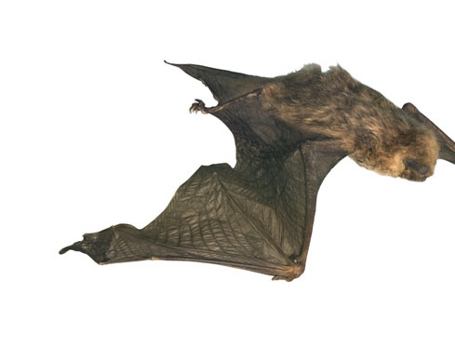

Glasgow Museums Natural History Quiz

Slide 2
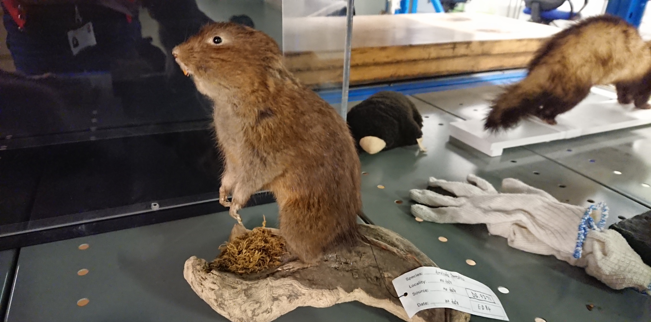
What declining small mammal species has been found thriving in Easterhouse?
Water vole: You can watch a film about them here:
https://www.bbc.co.uk/programmes/p06b066z

Slide 3
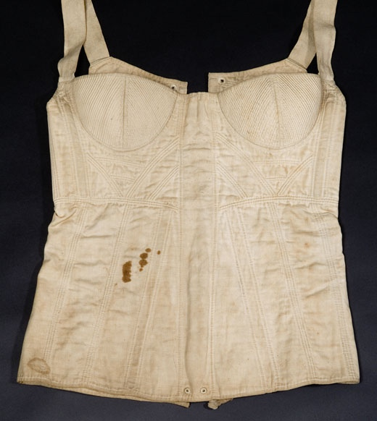
What type of bone was used in this corset (from 1820-30) to give structure?
Whale bone

Slide 4
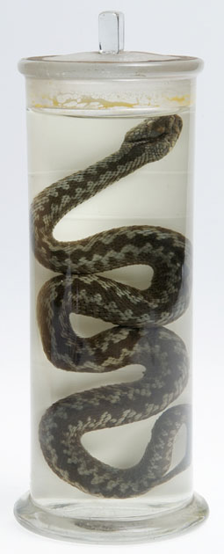
What is the only native venomous snake in Britain?
Adder

Slide 5
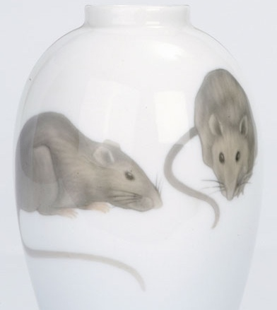
This rat vase was presented to Dr John Brownlee, Physician-Superintendent, Belvidere Fever Hospital who, in 1900, quickly identified and contained an outbreak of…… in Glasgow.
Bubonic plague (in this case, not caused by rats)

Slide 6
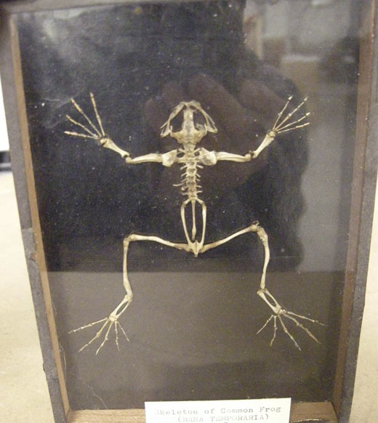
Guess the animal from the skeleton
Frog

Slide 7
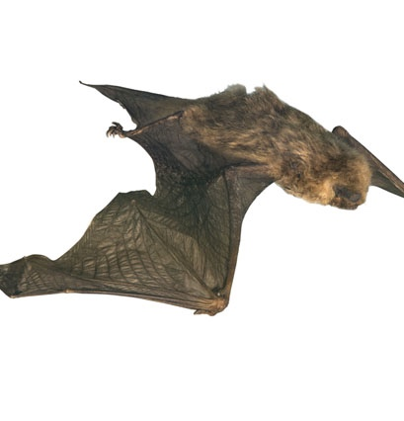
How many gnats do you think a pipistrelle bat could eat in a night (according to the RSPB)
100
3,000
20,000

Slide 8
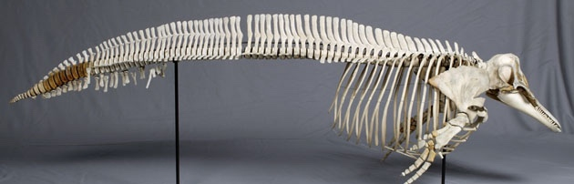
Guess the animal from the skeleton
Dolphin

Slide 9
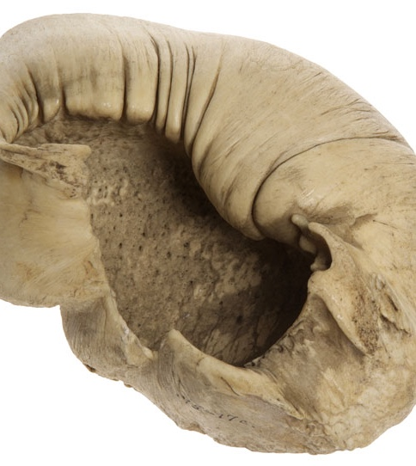
What is this mystery object?
Clue: it would help a large sea creature to hear
This is the ear bone of a bowhead or Greenland right whale.

Slide 10
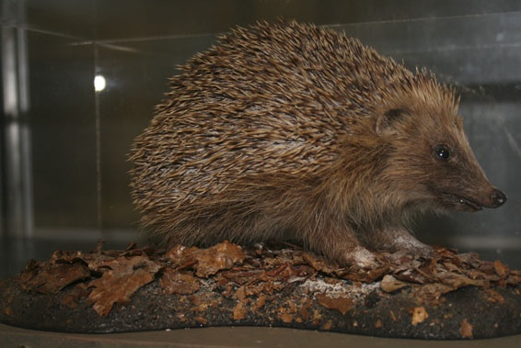
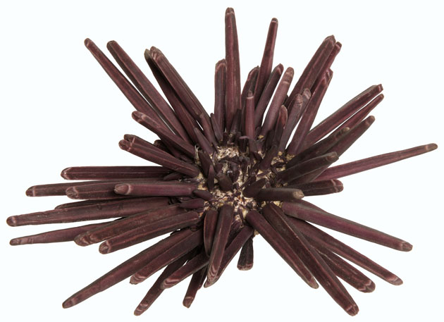
In the past hedgehogs were given the same name as a spiky sea creature. Can you guess what they were called? (There is a clue in the bottom picture)
Urchin

Slide 11
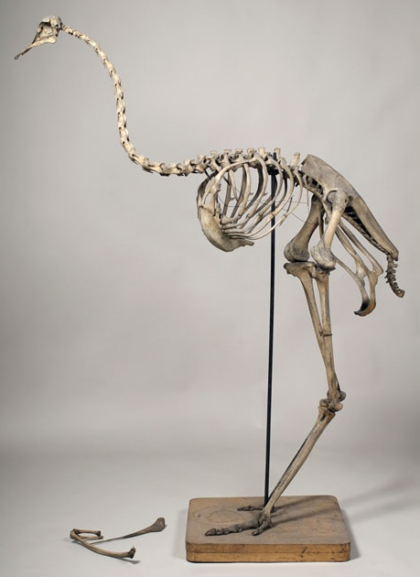
Guess the animal from the skeleton
Ostrich

