Slide 1
Santa Claus is Coming to Town!
Let’s Explore the Real Santa Claus

Slide 2
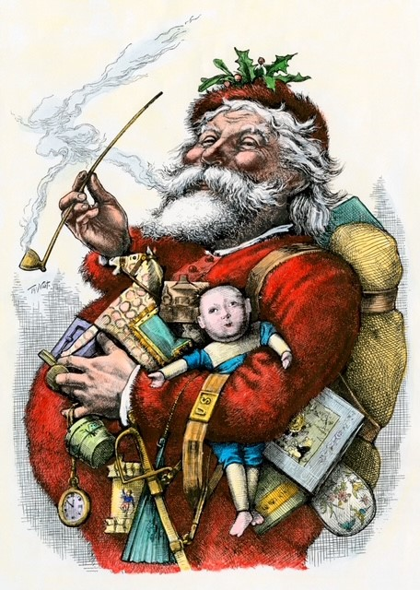
Do you remember Santa Claus?
What other names is he know by?

Slide 3
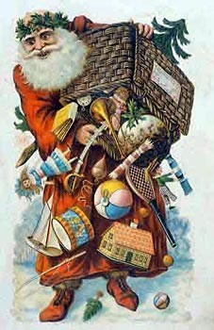
We wrote letters to him….
We left out glasses of milk on Christmas Eve.
What did you used to leave out for him?

Slide 4
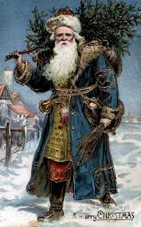
What is different about Santa Claus in this picture?
Did Santa Claus always look like this?

Slide 5
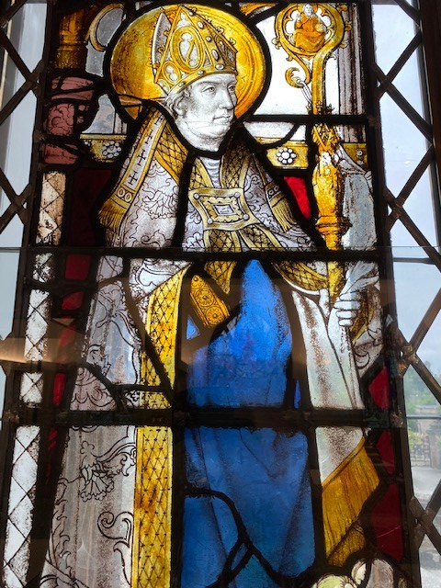
Santa Claus is really St Nicholas
St Nicholas lived in the 4th century. He was the Christian Bishop of Myra in Asia Minor - now southern Turkey.

Slide 6
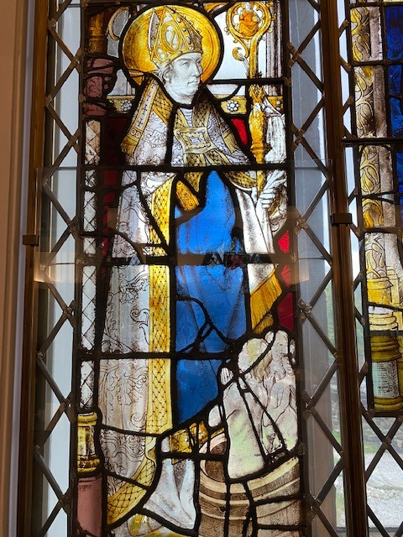
This stained glass window in our museum shows the real Saint Nicholas
It was made in the Netherlands in the 16th century, probably for a church. It is part of the Burrell Collection

Slide 7
Now let’s see how much we know about
St Nicholas

Slide 8
Question 1
What is the special name for the hat St Nicholas is wearing?
A. Bonnet
B. Mitre
C. Fedora

Slide 9
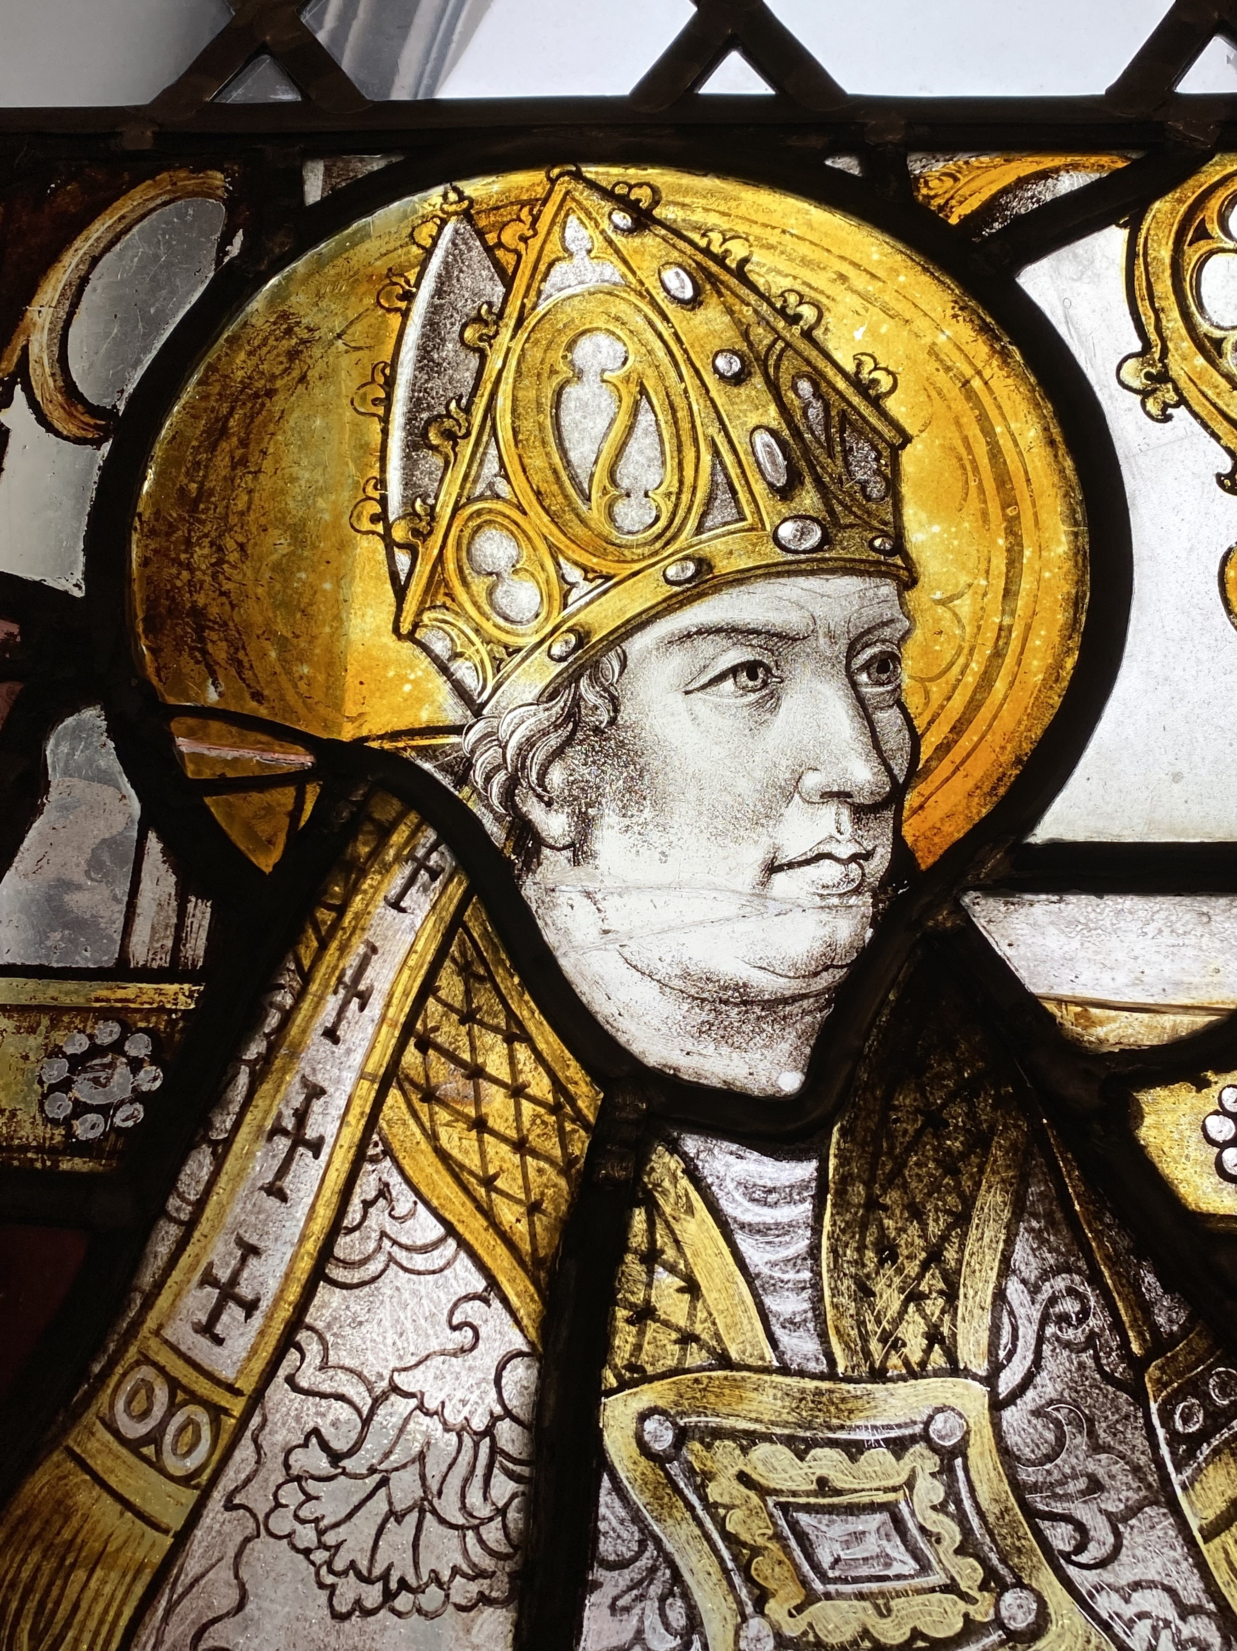
Answer
A. Mitre
A mitre is shaped like a pointed tongue of fire to show that a bishop is blessed by the Holy Spirit.

Slide 10
Question 2
What is the name of special staff St Nicholas is holding in his left hand?
A. Paddle
B. Stake
C. Crozier

Slide 11
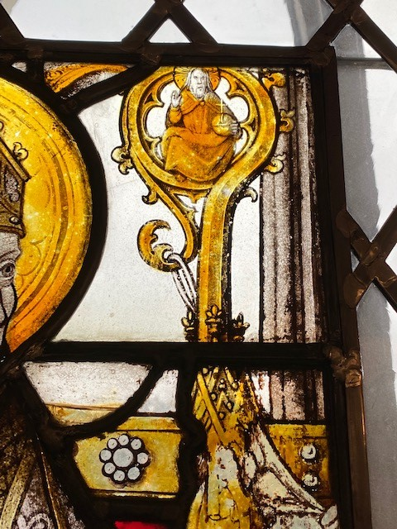
Answer
C. Crozier
The crozier also know as a pastoral staff is carried by a bishop to show their leadership as a shepherd who leads their sheep.

Slide 12
Question 3
What is the name of the special shoes St Nicholas is wearing?
A. Episcopal loafers
B. Episcopal Sandals
C. Episcopal trainers

Slide 13
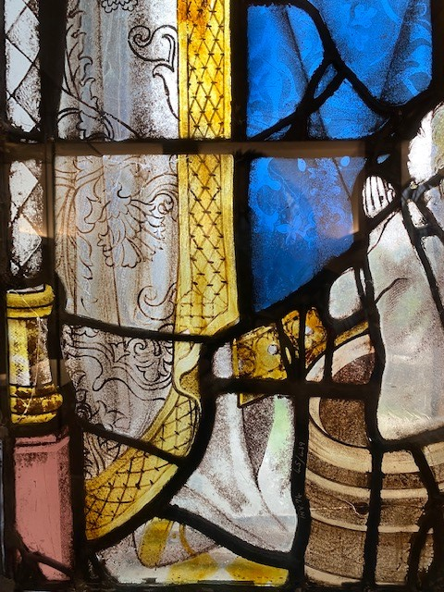
Answer
B. Episcopal Sandals
Bishops used to wear these special sandals or slippers during religious ceremonies.

Slide 14
Question 4
What are the children next to St Nicholas doing?
A. Having a bath
B. Waiting for their Christmas presents
C. Being brought back to life

Slide 15
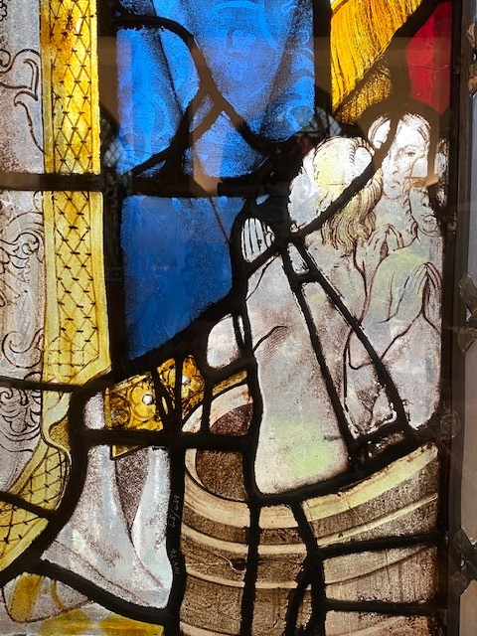
Answer
C. Being brought back to life
St Nicholas brought three young children back to life after they were murdered and hidden inside a storage barrel.

Slide 16
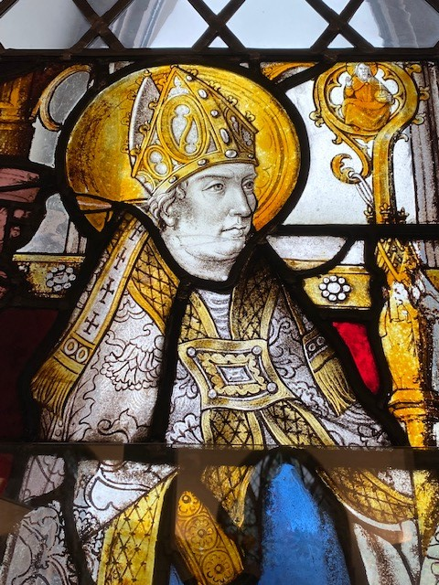
Question 5
St Nicholas is the Patron Saint of
A. Aberdeen
B. Russia
C. Sailors

Slide 17
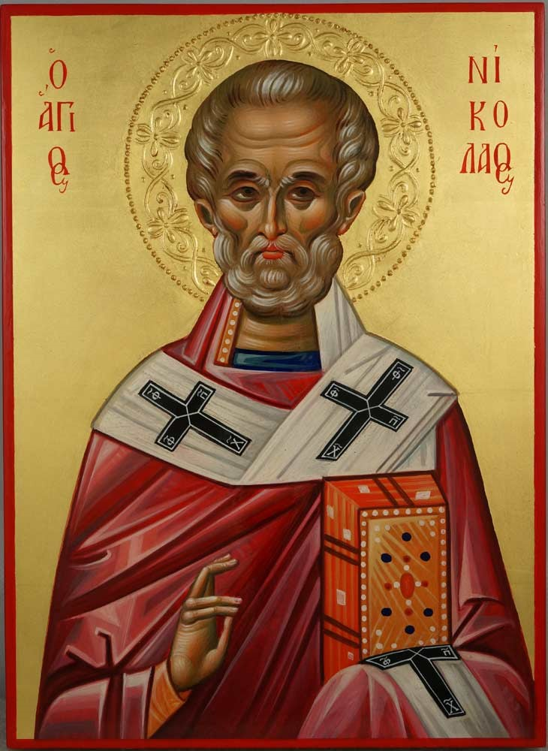
Answer
C. All Three!!
St Nicholas is also the patron saint of children, pawnbrokers, fishermen, Greece, Liverpool, barrel makers, grocers and even pirates!

Slide 18
What songs can you sing about Santa Claus?
Time for a Sing Song!

