Slide 1
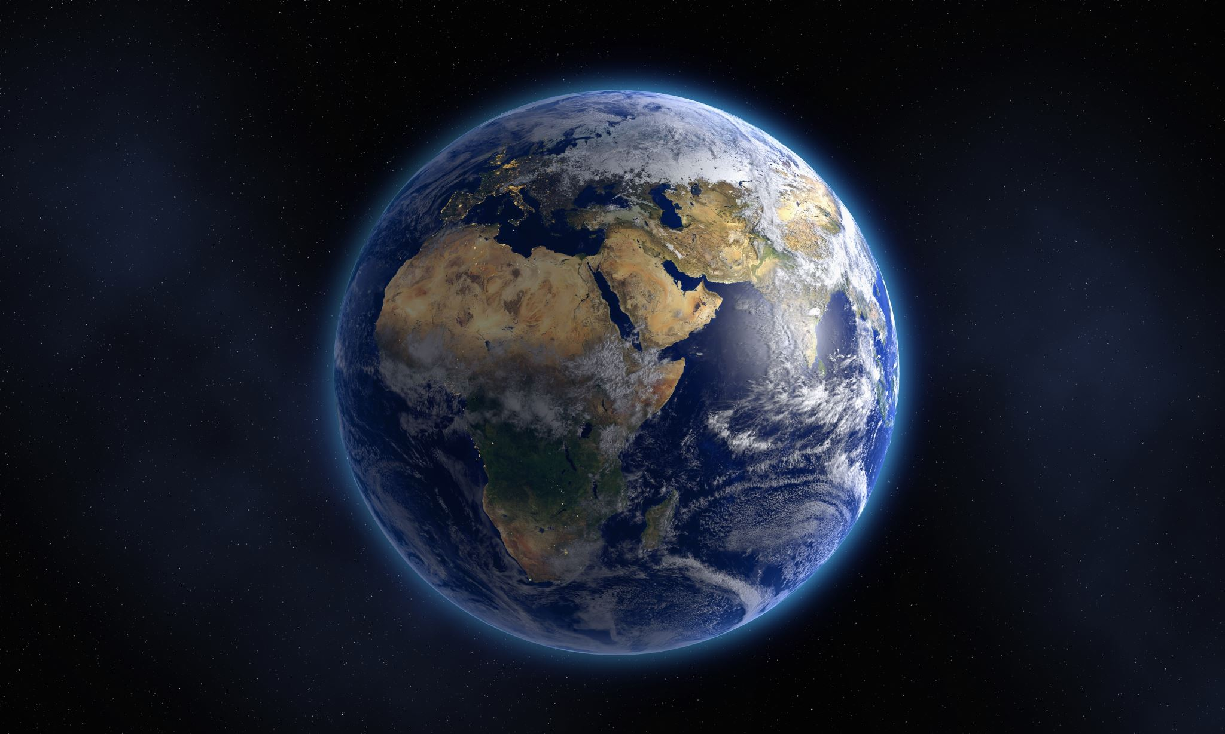
Our climate stories
Glasgow Museum's Collections

Slide 2
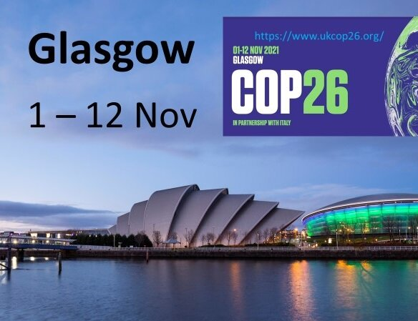
In November 2021 Glasgow will host the 26th UN Climate Change summit– bringing together world leaders to try to accelerate action toward climate change goals.
This quiz and discussion will explore objects from our museum collections that are all linked to climate change in some way.
Recycling, upcycling,
sustainable transport and endangered animals aren’t new issues.

Slide 3
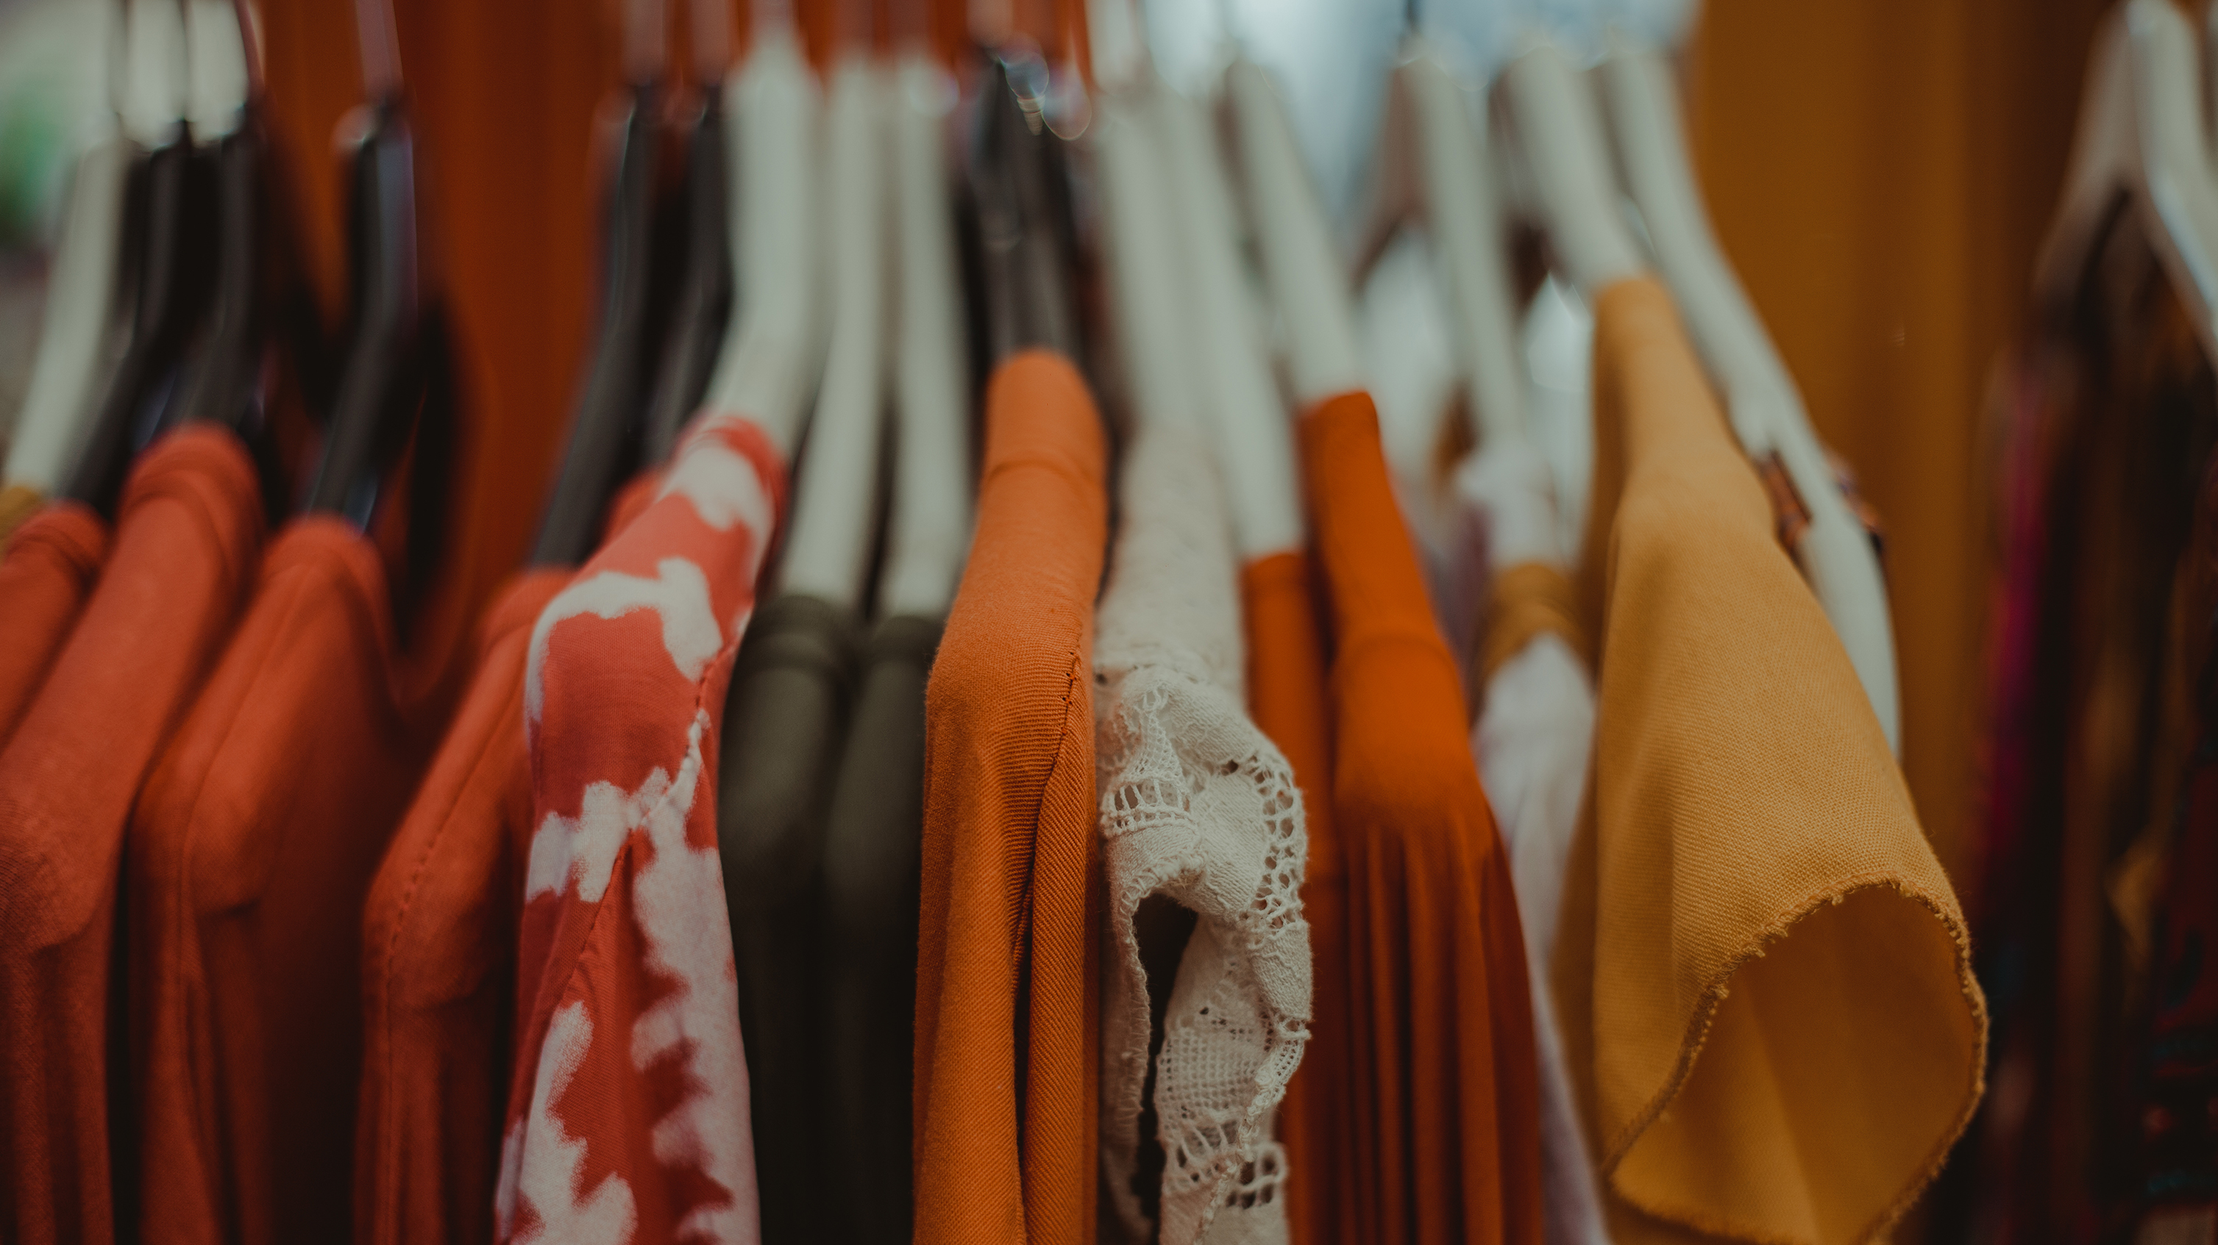
Clothes and mending

Slide 4
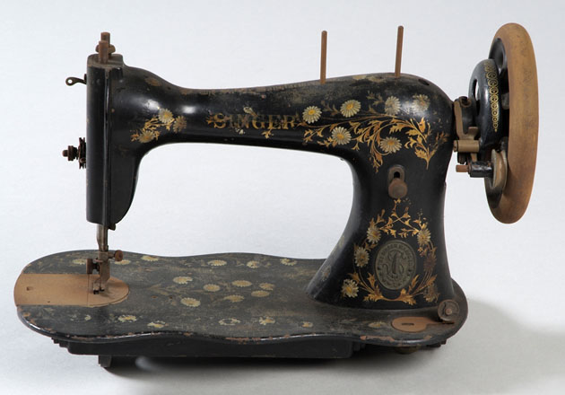
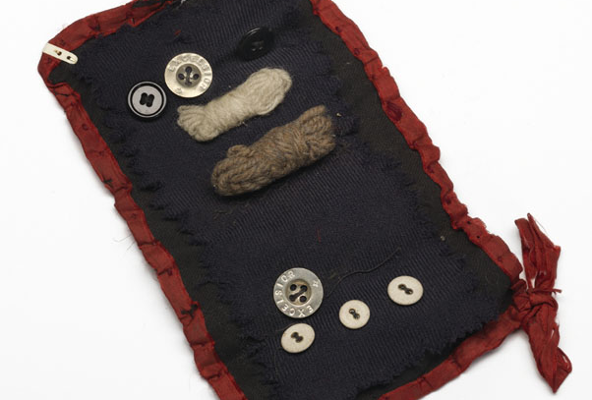
A) 1980
When did the Singer Sewing machine factory finally close?
B) 1965
C) 2001

Slide 5
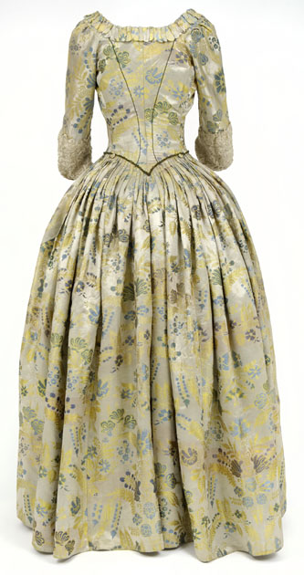
Which of the following is UNTRUE?
This gown is around 300 years old
It was worn (by different women) for 150 years!
It belonged to Jean Armour (Robert Burns’ wife)
Do you mend or alter your own clothes?
How did you learn to do this?

Slide 6
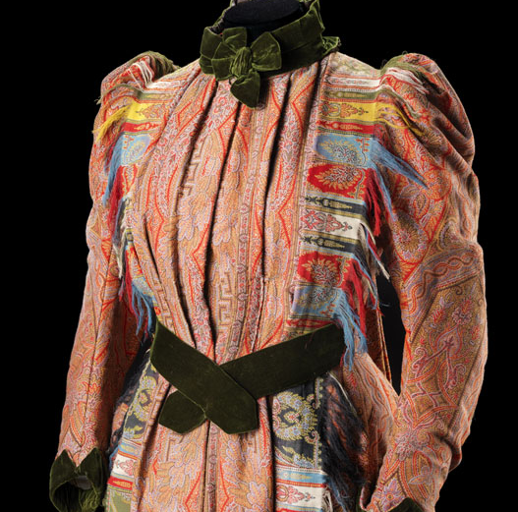
Upcycling is not just a recent trend. This house dress is made from 2 imitation Kashmiri wool shawls and silk velvet…. it was made in Uddingston in 1890-92!

Slide 7
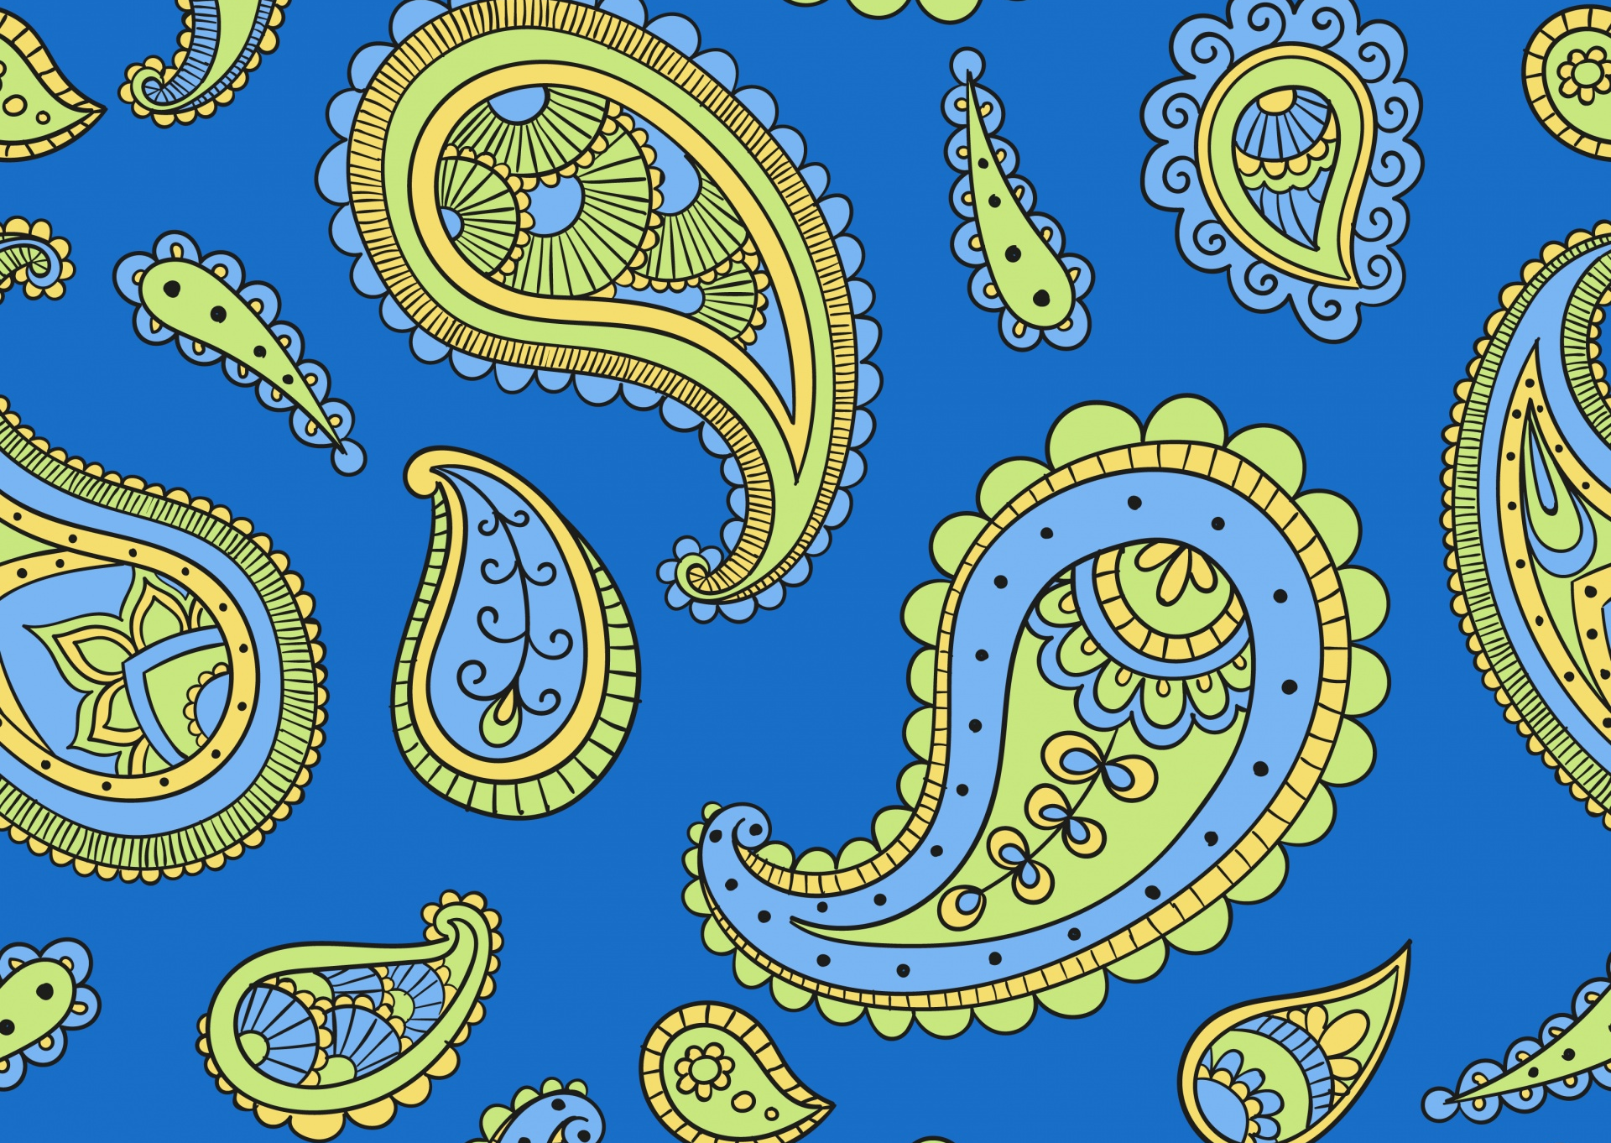
Where does Paisley pattern come from?
Paisley
India/ Kashmir
Ancient Celtic art (from Britain)
d) All of the above

Slide 8
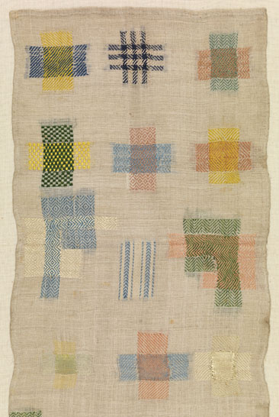
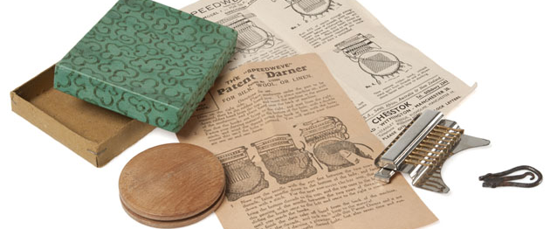
Have you ever darned or mended your own clothes?
Darner and Sampler from our collection

Slide 9
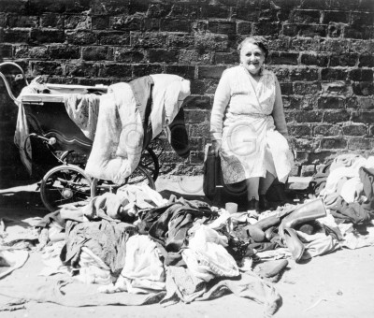
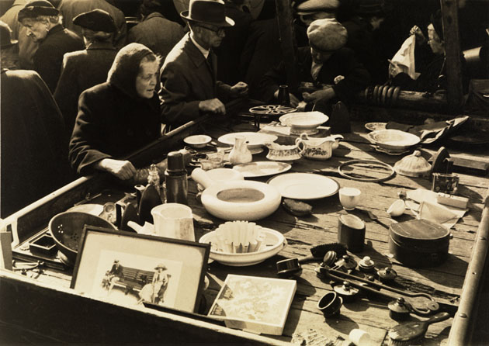
Did you ever shop in the Barras or Paddy’s Market? Do you visit charity shops?
Eric Watt- At the Barrows and Paddy’s Market 1955 Andrew MacDonald

Slide 10
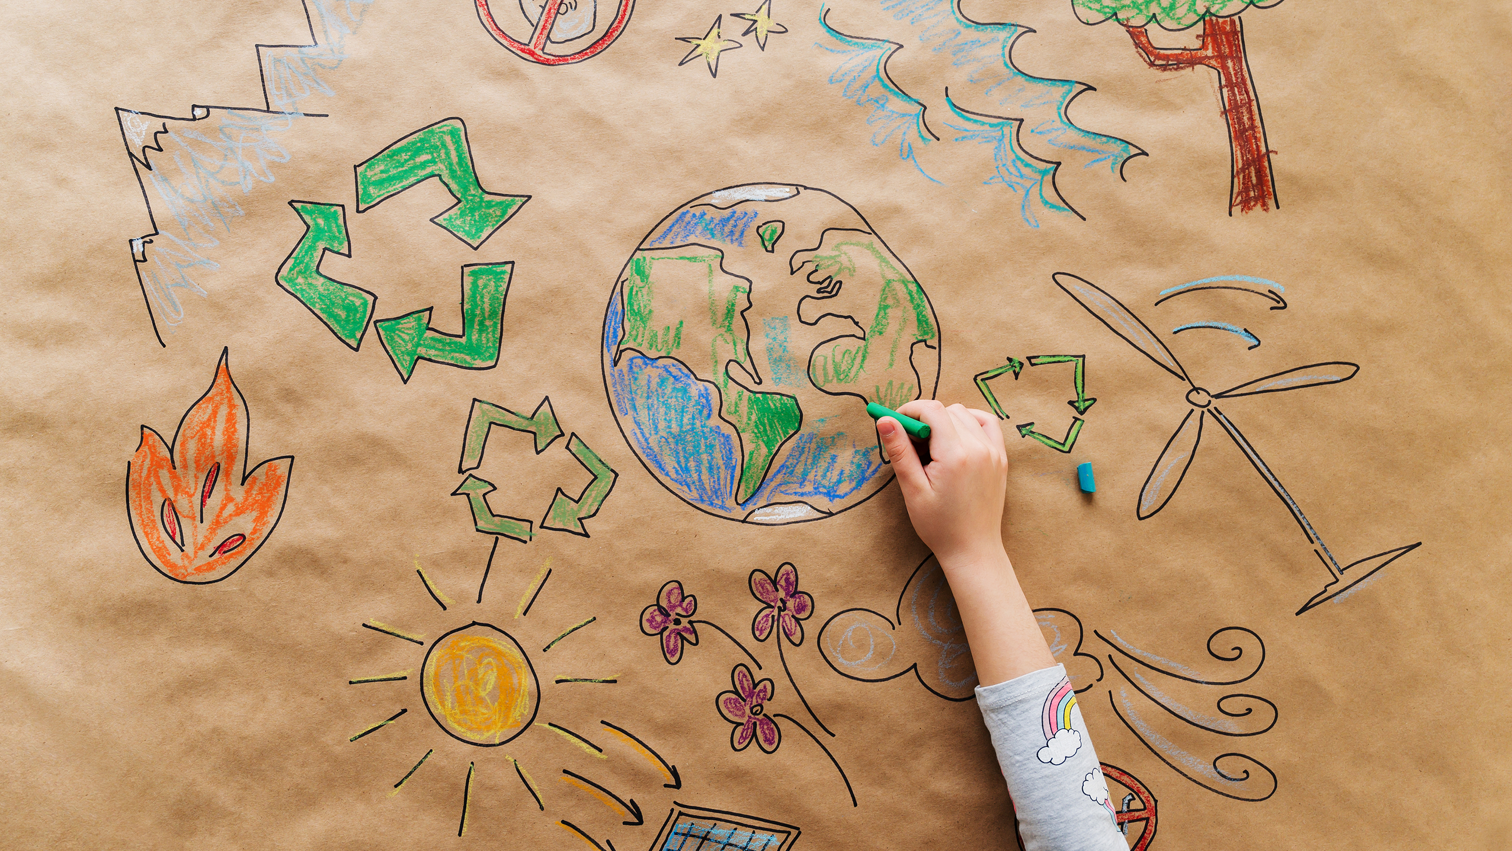
Recycling and upcycling

Slide 11

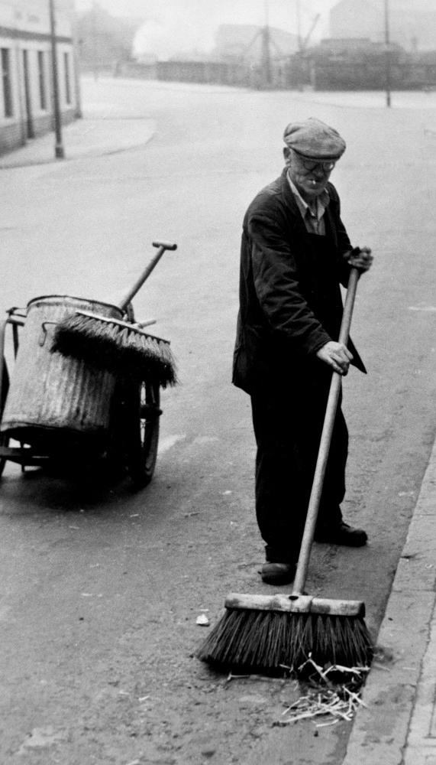
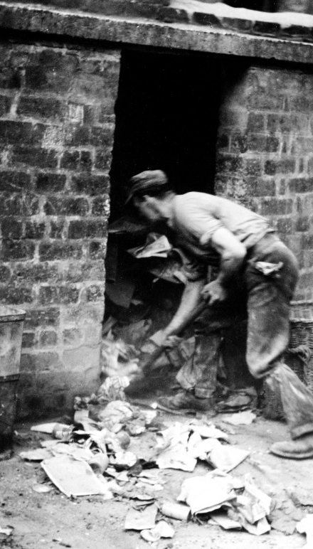
How much rubbish did residents of Glasgow throw away in 2019 (according to the council’s Resources and Recycling Strategy 2020-30)
255,000 tonnes
200,000 tonnes
100,000 tonnes
What % of household waste was recycled?
10%
25%
50%

Slide 12
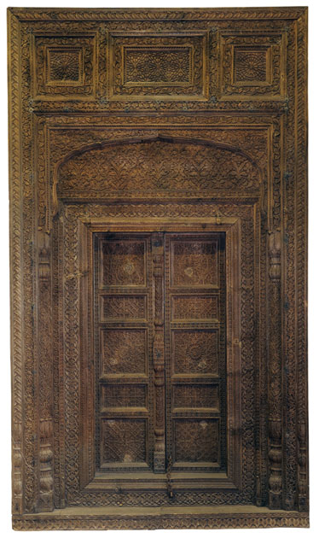
This door was made from Himalayan Cedar. But where did the wood come from?
Railway sleepers
Wooden packing cases
c. Scrap wood
d. Bed frames
The frame is made from recycled railway sleepers. The two doors are panels from packing crates.
The door was purchased at the 1888 Glasgow International Exhibition. Two carvers from Bhera (now in Punjab in Pakistan) were sent to the Glasgow for the Exhibition but it is not known whether they carved this in Glasgow or if it was brought from Punjab.

Slide 13
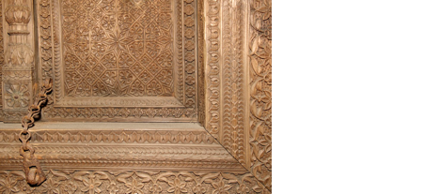
Have you ever upcycled a piece of furniture or made anything yourself?

Slide 14
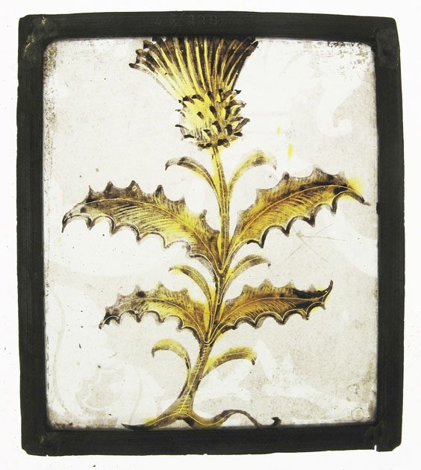
This is a small piece of painted glass in the Burrell Collection, 15x14 cm
Which of the following are TRUE
A) Thistles allegedly were a cure for plague
B) This type of cotton thistle was sometimes used to fill pillows etc.
B) The glass has been re-used (as glass was expensive)
All of the above

Slide 15
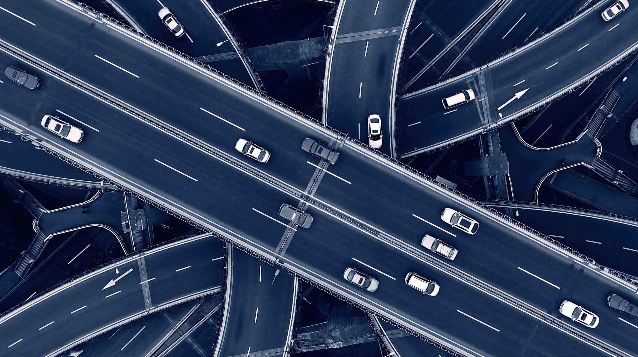
Transport
and Technology

Slide 16
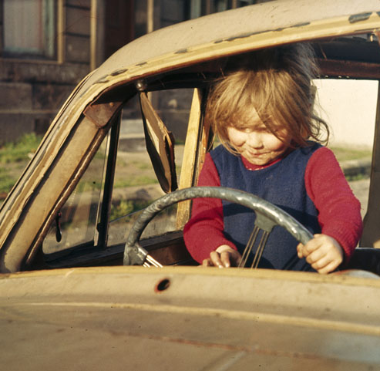
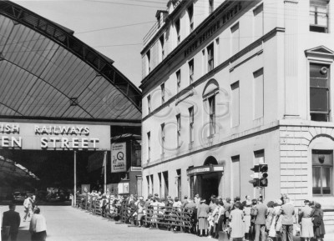
How did you travel to school or on holiday when you were a child?
A little girl plays in a wrecked car in Pollokshields. -Eric Watt, circa 1960s. And Queen Street station, Glasgow Fair 1955 Thomas Robertson

Slide 17
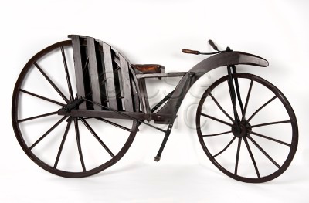
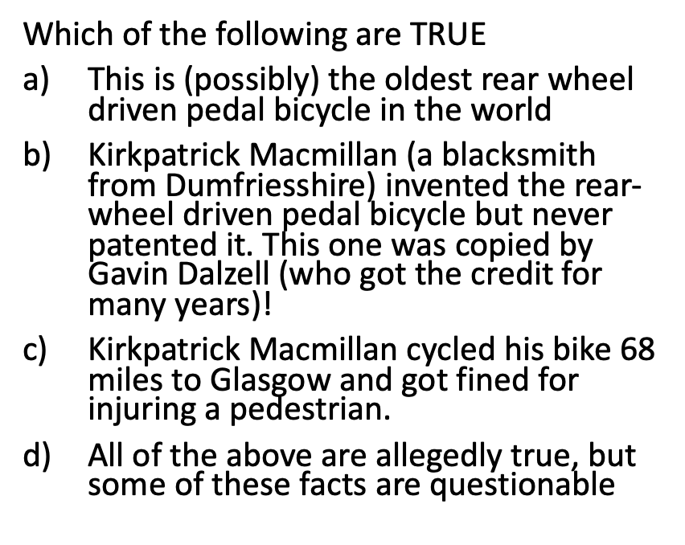


Slide 18
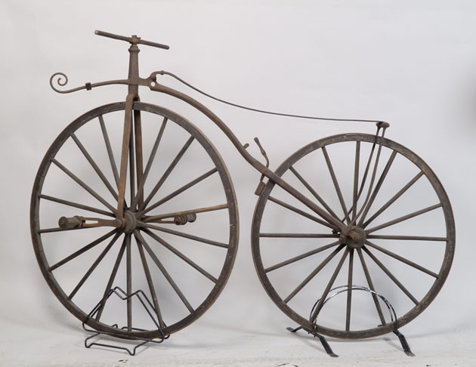
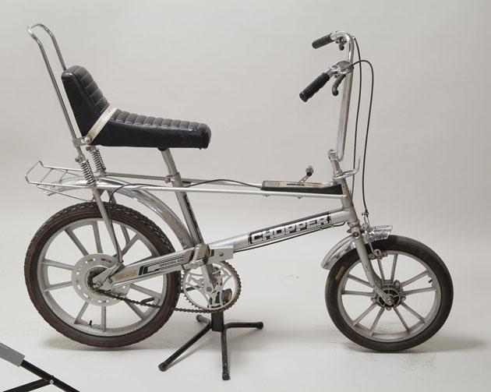
What was your first bike like? Do you ever cycle?

Slide 19
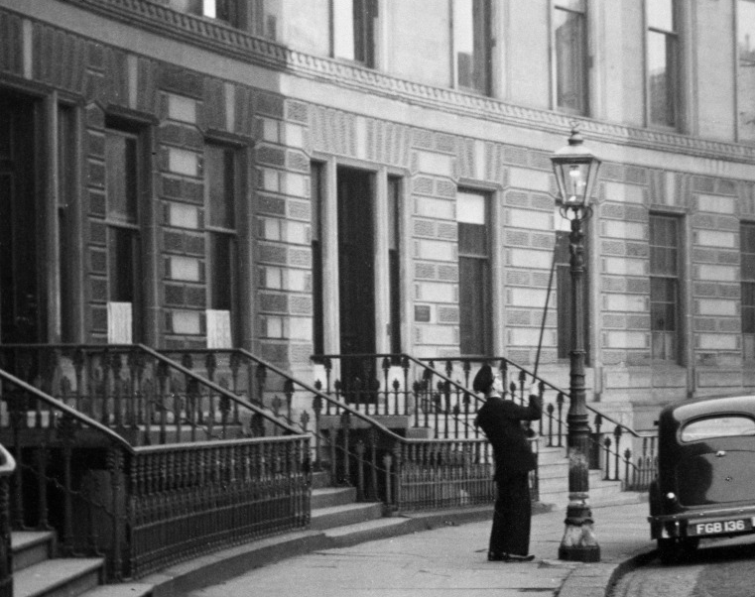
When was the last gas streetlight in Glasgow lit for the final time
1971
1914
1945

Slide 20
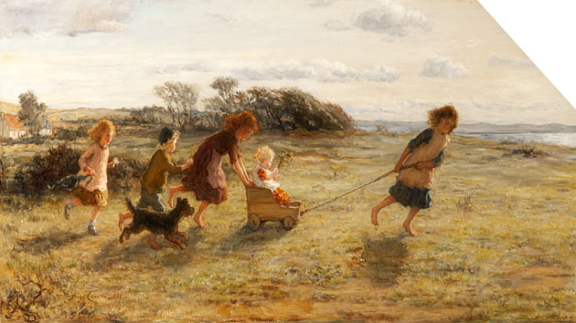
Did you ever make or have a go cart, bogey or guider?
Did you ever make toys and games from rubbish or things around you?
The Go Cart-
Hugh Cameron (1885)

Slide 21
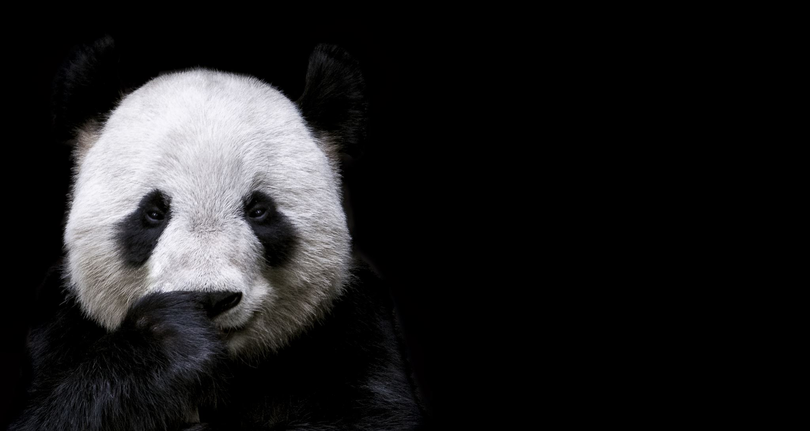
Natural History, biodiversity and extinction

Slide 22
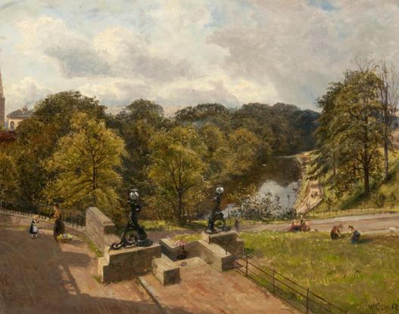
What did the word Glasgow originally mean?
A. Glow of the Moon
B. Green Hollow/ Dear Green Place​
C. Big City
The River Kelvin from the North at Botanic Gardens, 1884- William Glover

Slide 23
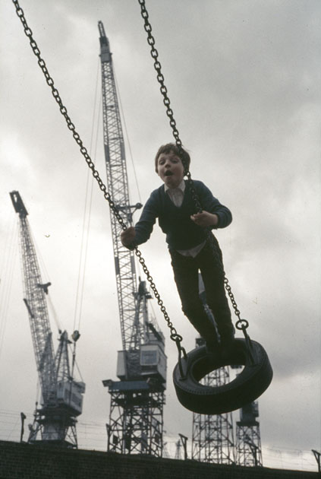
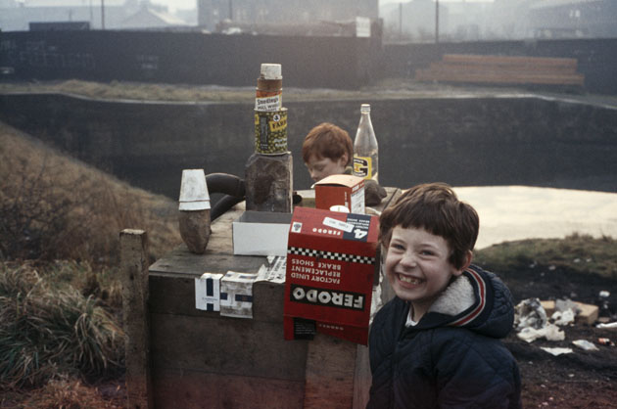
How have the river and canal changed since the 1960s and 70s?
Eric Watt- Boy swinging on a tyre with shipyard cranes- 1970s and Boys playing by the Forth and Clyde Canal at Temple.-1960s

Slide 24
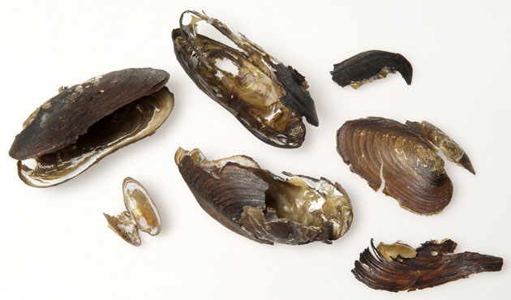
Why were fresh-water mussels like these lost from many Scottish rivers in the late 1900s?
A) Pollution and poor water quality
B) Being over collected by people looking for pearls
C) Declining numbers of salmon and trout, upon which the mussels rely for part of their life cycle.
All of the above

Slide 25
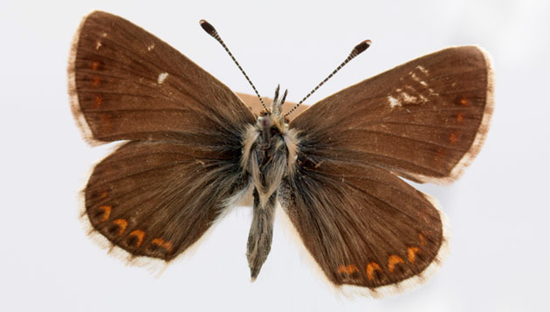
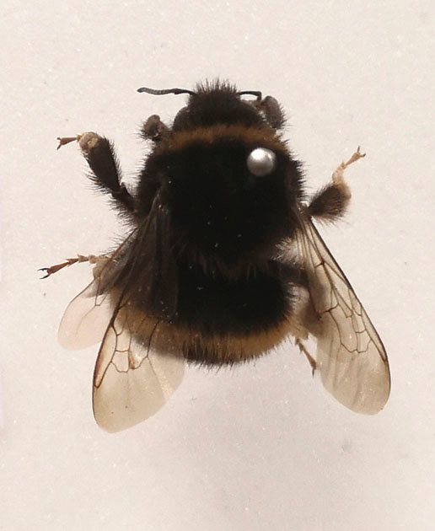
How many different types of bees can be found in Scotland?
Bumblebees and other insects transfer pollen between plants, this allows the plants to reproduce by growing seeds and fruit, which is important for wildlife and farming.
a. 8
b. 10
c. 19

Slide 26
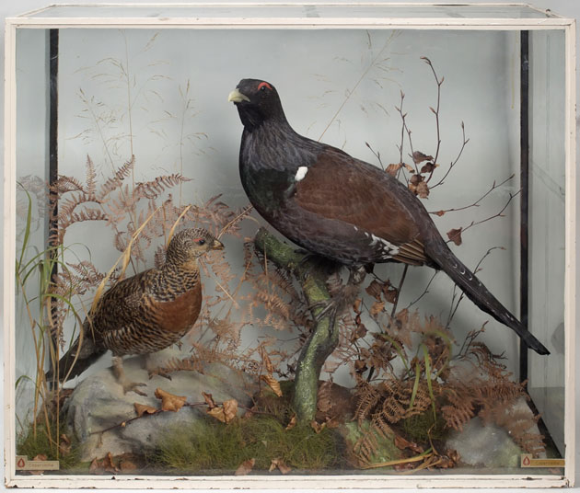
What are these?
A) Capercaillies
B) Pheasants
C) Doves
Capercaillies are native to Britain, but became extinct in the mid-1700s. They were re-introduced in 1837 and by the 1970s numbers of capercaillies had grown to about 20,000. Since then, they have suffered a major decline. In 2017 scientists estimated that there were only 1,114 Capercaillies in Scotland, making it one of our rarest birds.

Slide 27
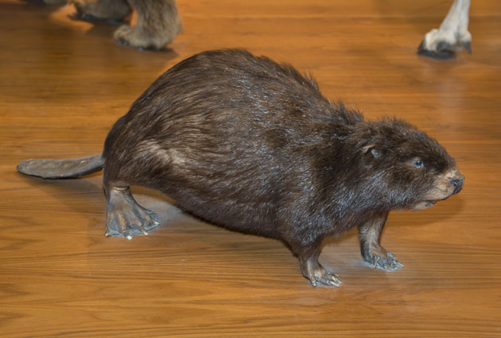
This animal was extinct for over 400 years in Scotland, following a reintroduction project it is now recognised as a native species in Scotland.
Have you ever seen one of these?
Do you know what its young are called?

Slide 28
It is a European Beaver.
Its young are called kits.
It is

Slide 29
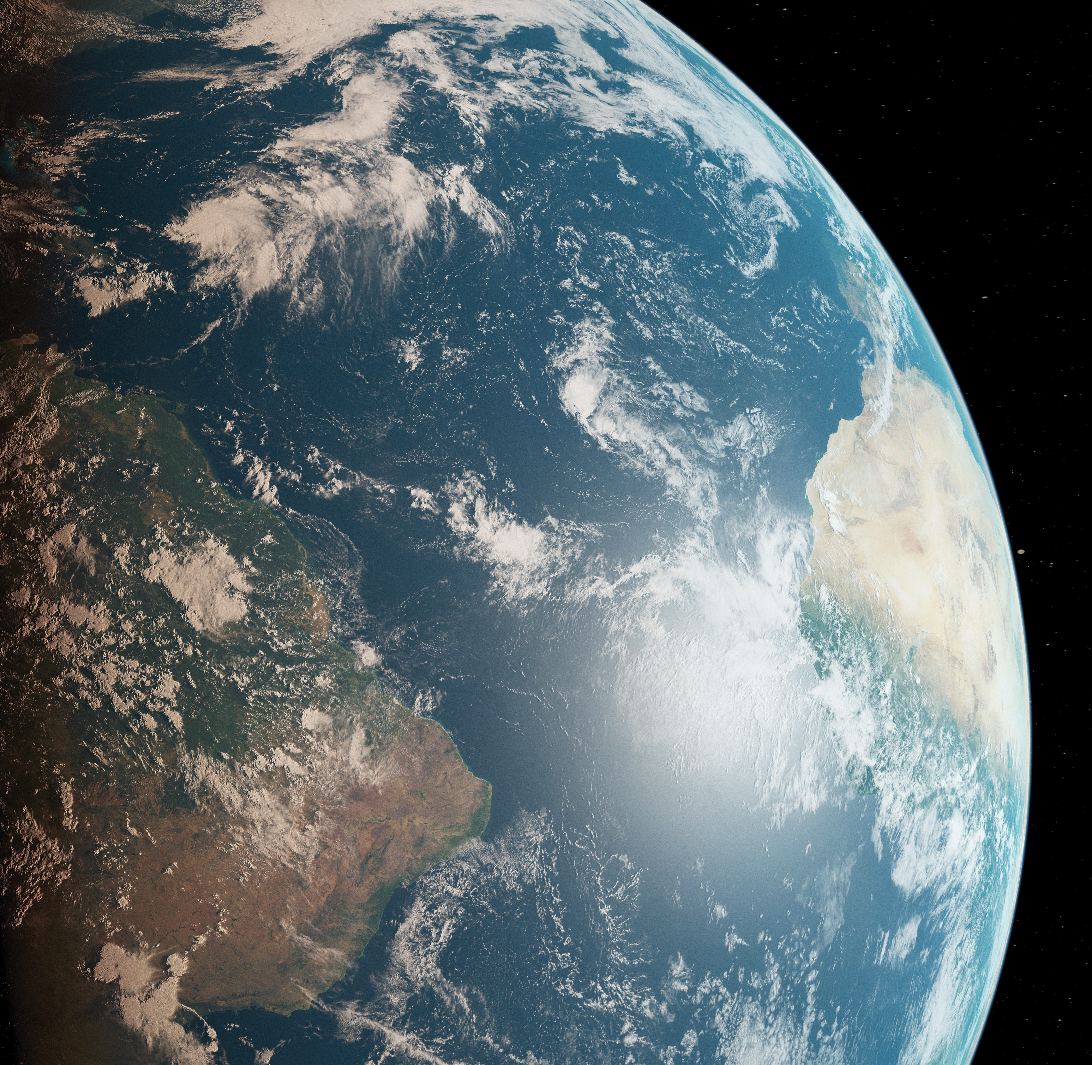
What do you think are the most important things we can do for the environment?

Slide 30
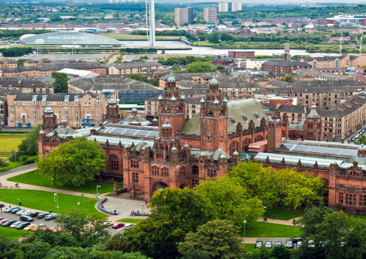
We hope you enjoyed Glasgow Museum's Climate Stories.

