Slide 1
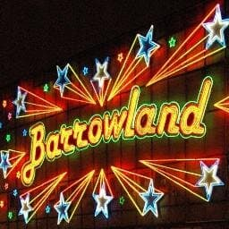

Slide 2
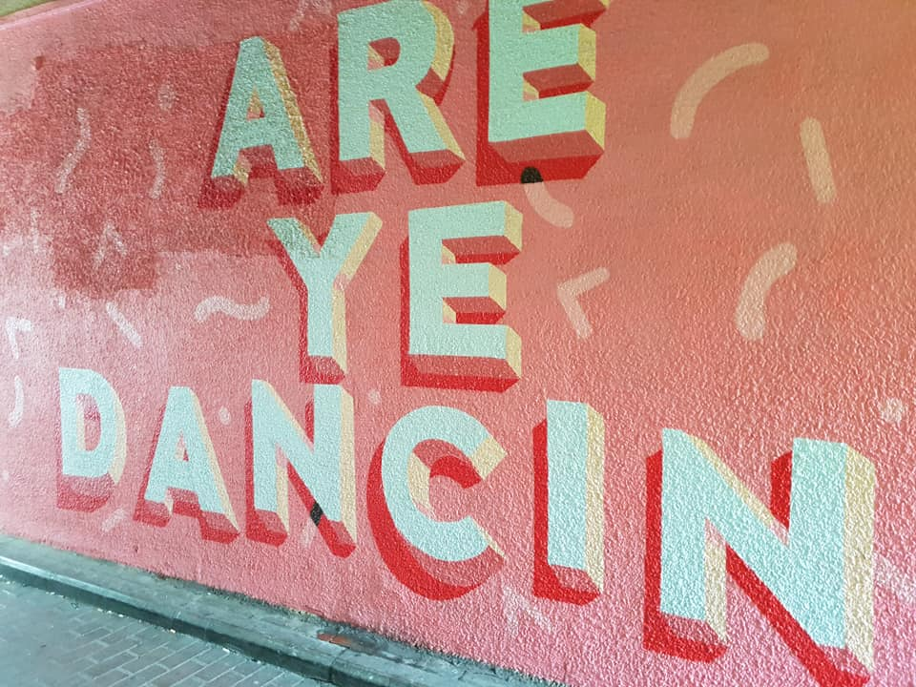

Slide 3
Are ye Dancin’? Are ye askin’?
Back in the early days of the Barrowlands: https://movingimage.nls.uk/film/3181?search_term=Barrowlands&search_join_type=AND&search_fuzzy=yes
Leeeeeeet’s twist again: https://www.youtube.com/watch?v=oRlT8ZoExGU
You’ve done the Twist, but can you remember how to do the monkey? https://www.youtube.com/watch?v=5l9jV1oNRyY
Now do the Hucklebuck: https://www.youtube.com/watch?v=jv4Tc0N1KKk

Slide 4
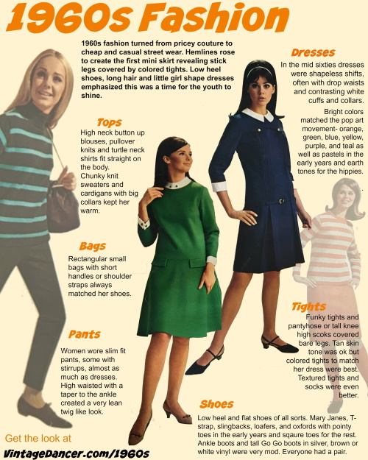
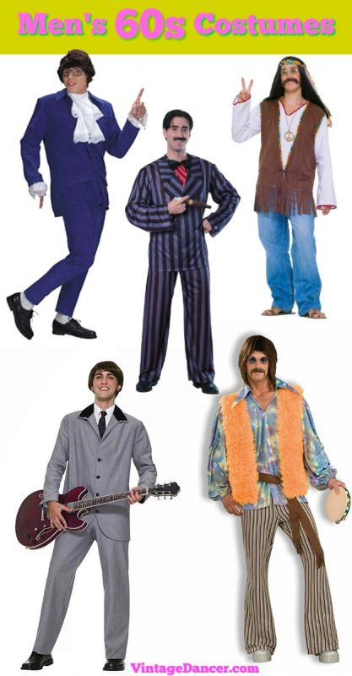
Are ye goin’ oot dressed like that?

Slide 5


