Slide 1
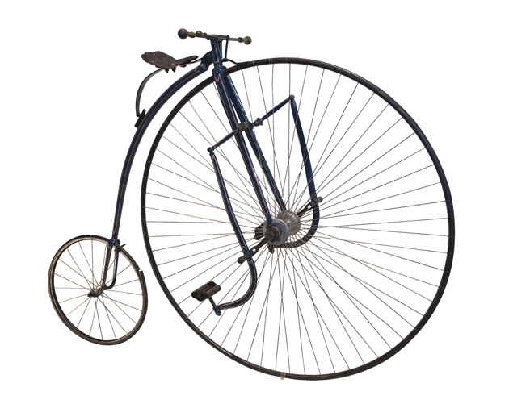

Glasgow Museums
Unusual Objects Quiz

Slide 2
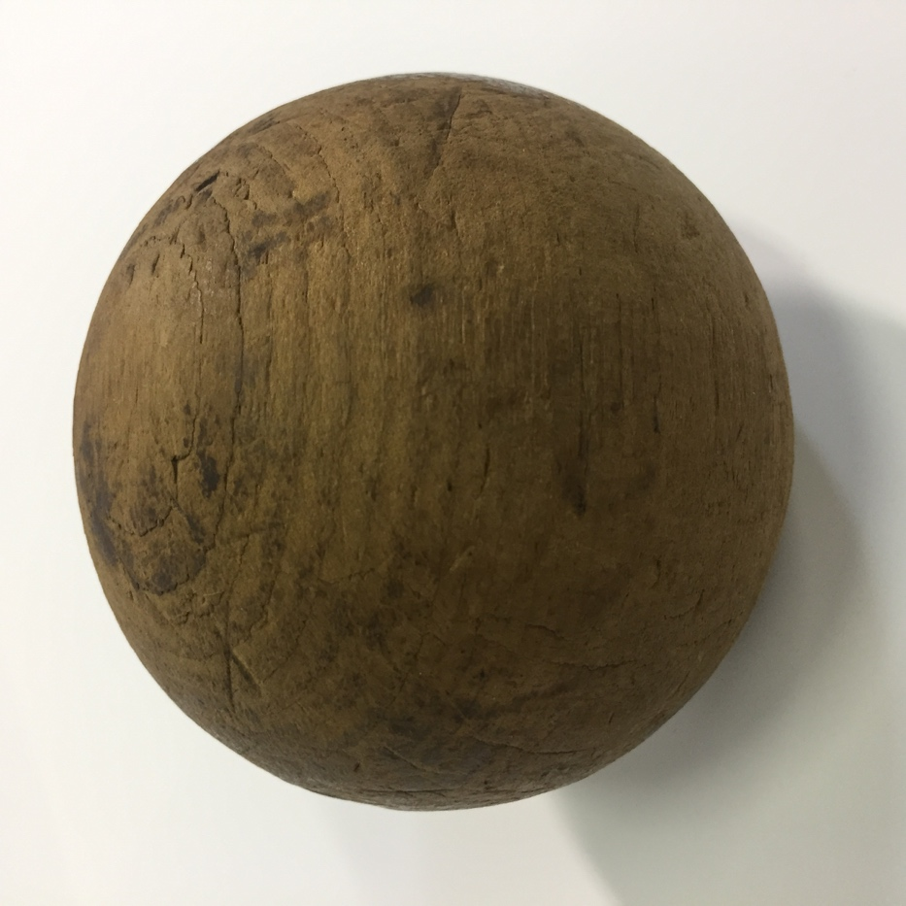
MYSTERY OBJECT
It is NOT a cannonball
It was used in the early 1900 in the theatre.
Clue: You might associate the name with a James Bond film or one of the balls in the lottery!
It is a thunder ball for making the sound of thunder at the theatre!

Slide 3
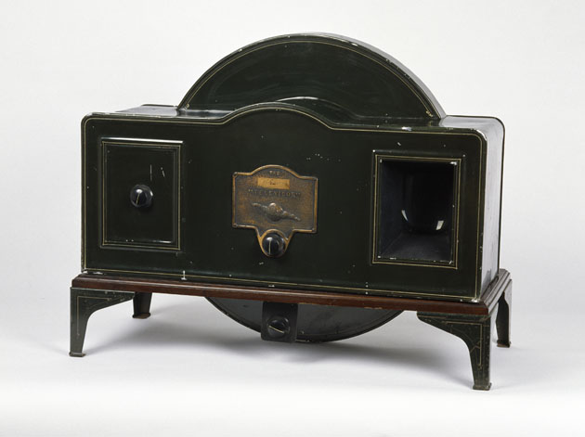
What is it?
A TV
An oven
A hamster house
This Baird Televisor from around 1930–2 is an example of the first commercially available television.

Slide 4
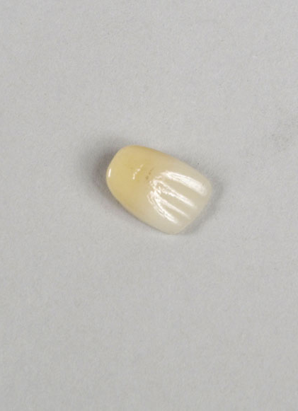
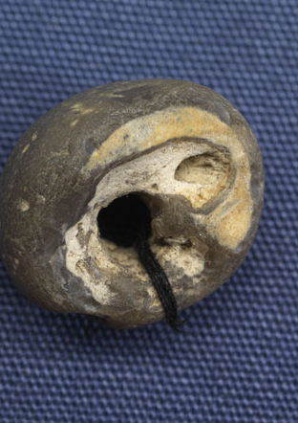
What do you think these may have been used for?
Clue: You might have a rabbit’s foot or heather?
They are lucky charms.
On the right is a hag stone charm and on the left is a human tooth used as good luck charm.

Slide 5
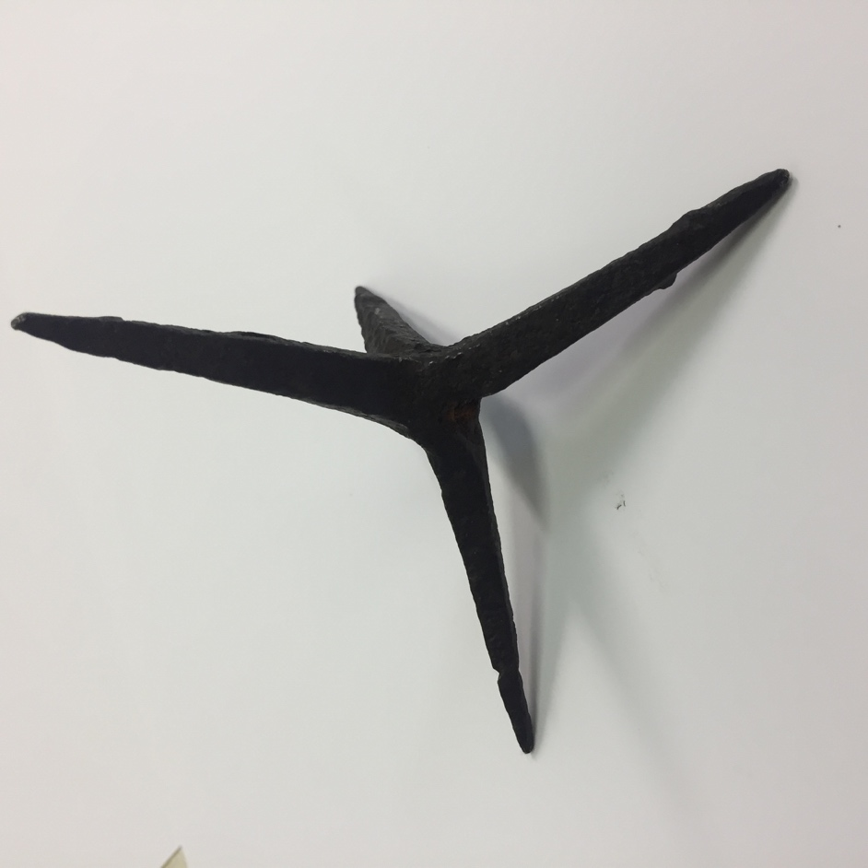
MYSTERY OBJECT
This was used at the time of Mary Queen of Scots reign.
Clue: You might see a similar thing used on vehicles on documentaries about the police!
It is a calthrop- these were used to disable horses in battle

Slide 6
The Singer Xtraordinary
This bike was designed to make cycling safer.
What was dangerous about riding a penny-farthing?
Going over the handlebars

Slide 7
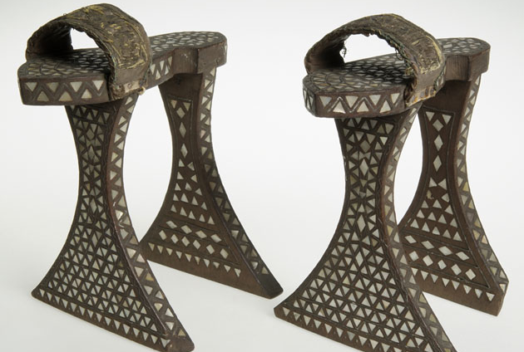
What are these for?
To be worn in a public bath to protect your feet from the hot floor
They are stilts for religious performances
For keeping your dress out of the dirt (and other nasty things) on the street
They are Ottoman bath house clogs

Slide 8
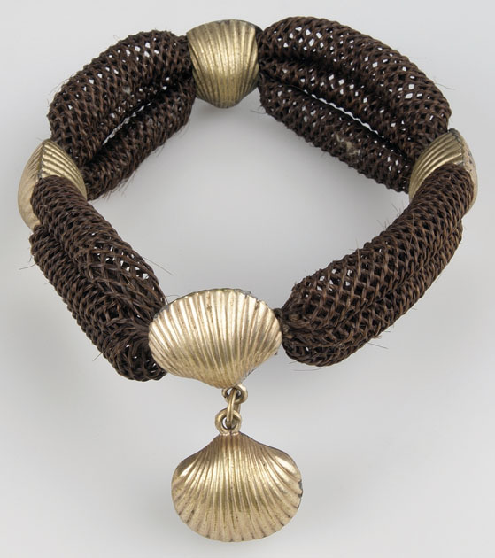
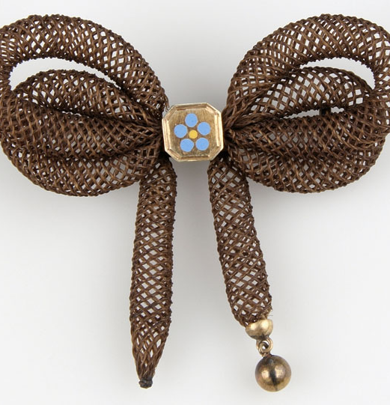
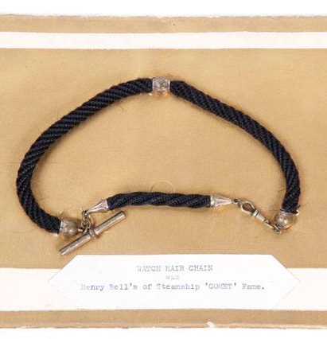
These pieces of jewellery are made from something very unusual. Can you guess what it is?
Human hair

Slide 9
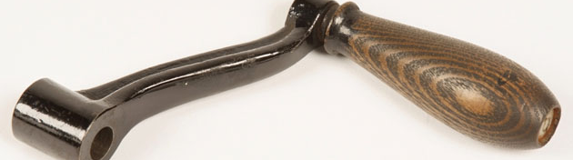

What is it?
The Crank handle from a portable cinema projector
Part of a cheese grater
A police officer’s truncheon
It dates from 1900-1910. The projection lamp would run from a car battery and the film would be cranked with this handle.

Slide 10
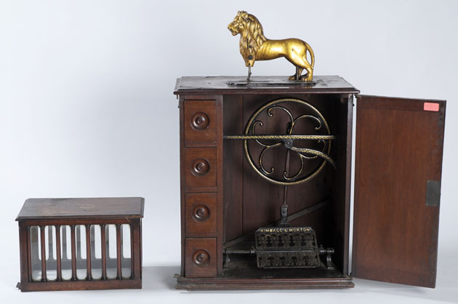
What do you think this is used for?
An ornament
A sewing machine
A clock
This is an example of a ‘Lion’ model sewing machine.

Slide 11
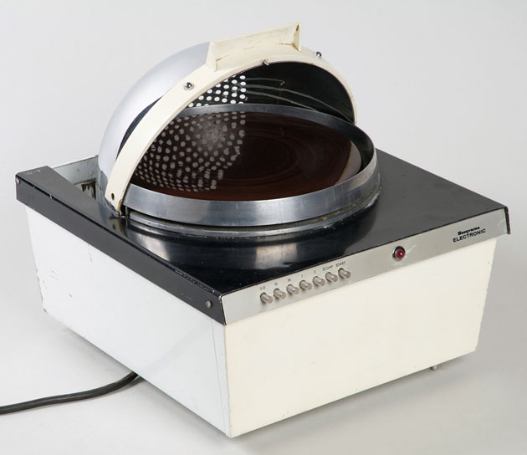
What is it?
A radio for picking up signals from space
A helmet to stop radiation
A microwave
This is a microwave oven made by Husqvarna of Sweden in 1960's

