Slide 1
Riverside MuSEUM
Highlights and Quiz
Notes:
Presenter notes
A slideshow of some of Learning Assistant Sarah favourite objects from the Riverside Museum.

Slide 2
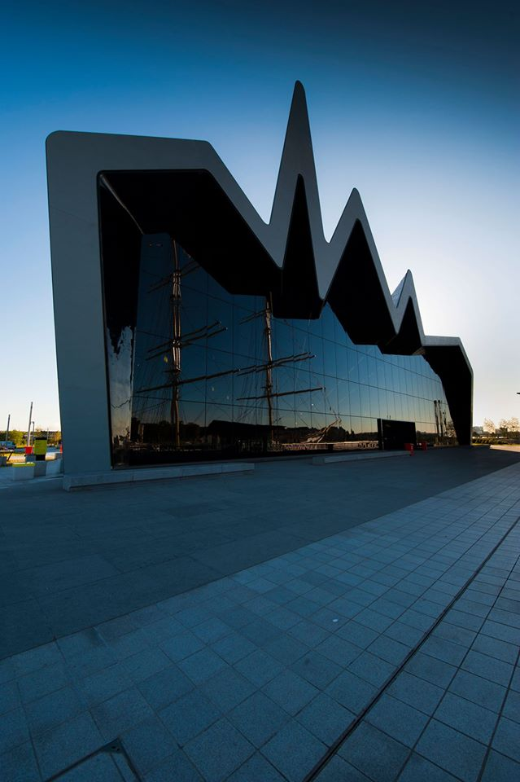
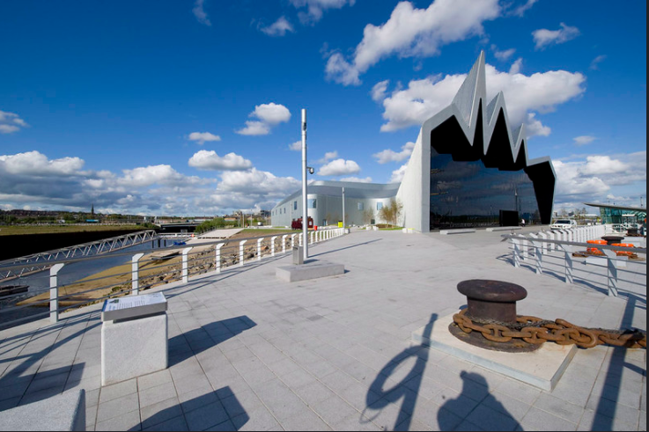
Notes:
Presenter notes
A slideshow of some of Learning Assistant Sarah favourite objects from the Riverside Museum.
Riverside museum opened in 2011. It was the first purpose built museum created by Glasgow Life in the 21st century. It was previously located at Kelvinhall. It now sits next to the River Clyde near Partick. It houses the city’s collection of transport and technology. Reflecting Glasgow’s contributions to industries such as shipbuilding, train manufacturing and engineering.
It was designed by intentionally renowned architect Zaha Hadid.
Over 3000 objects inside.

Slide 3

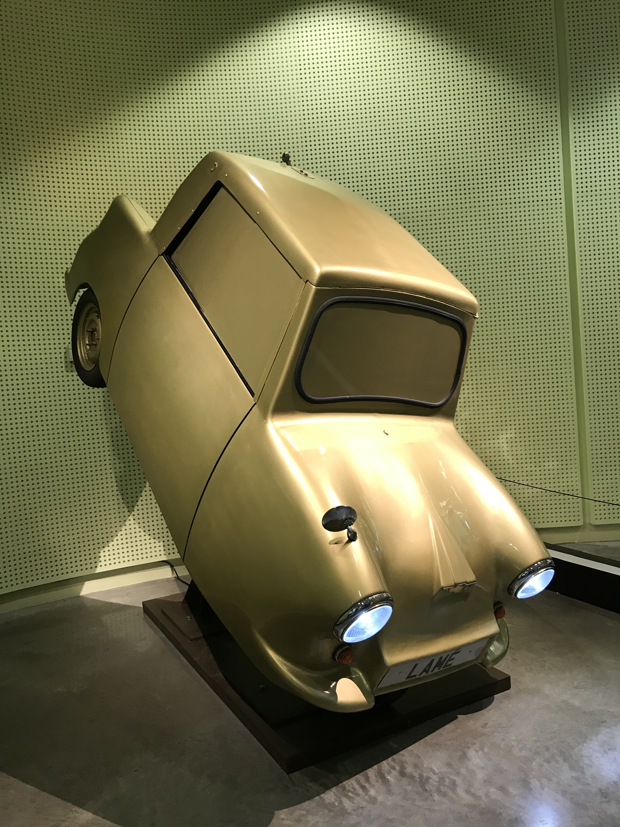
Gold Lame
This is a fairly new display
at the Riverside Museum
so you may not have seen
it yet.
It is by artist Tony Heaton.
What do you think of it?
Notes:
Notes for the presenter
The artwork is inspired by the “Wee Bluey” car (which also can be seen at Riverside) The little 3 wheeler car.
Artist Tony Heaton said about the work, “ … this one escaped, suspended , transformed from prosthetic to sculpture, transmuted from blue to gold, lame to lamé”
The 3 wheeler car was invented to provide mobility to disabled people. However was later declared by the UK government and was subsequently banned.

Slide 4
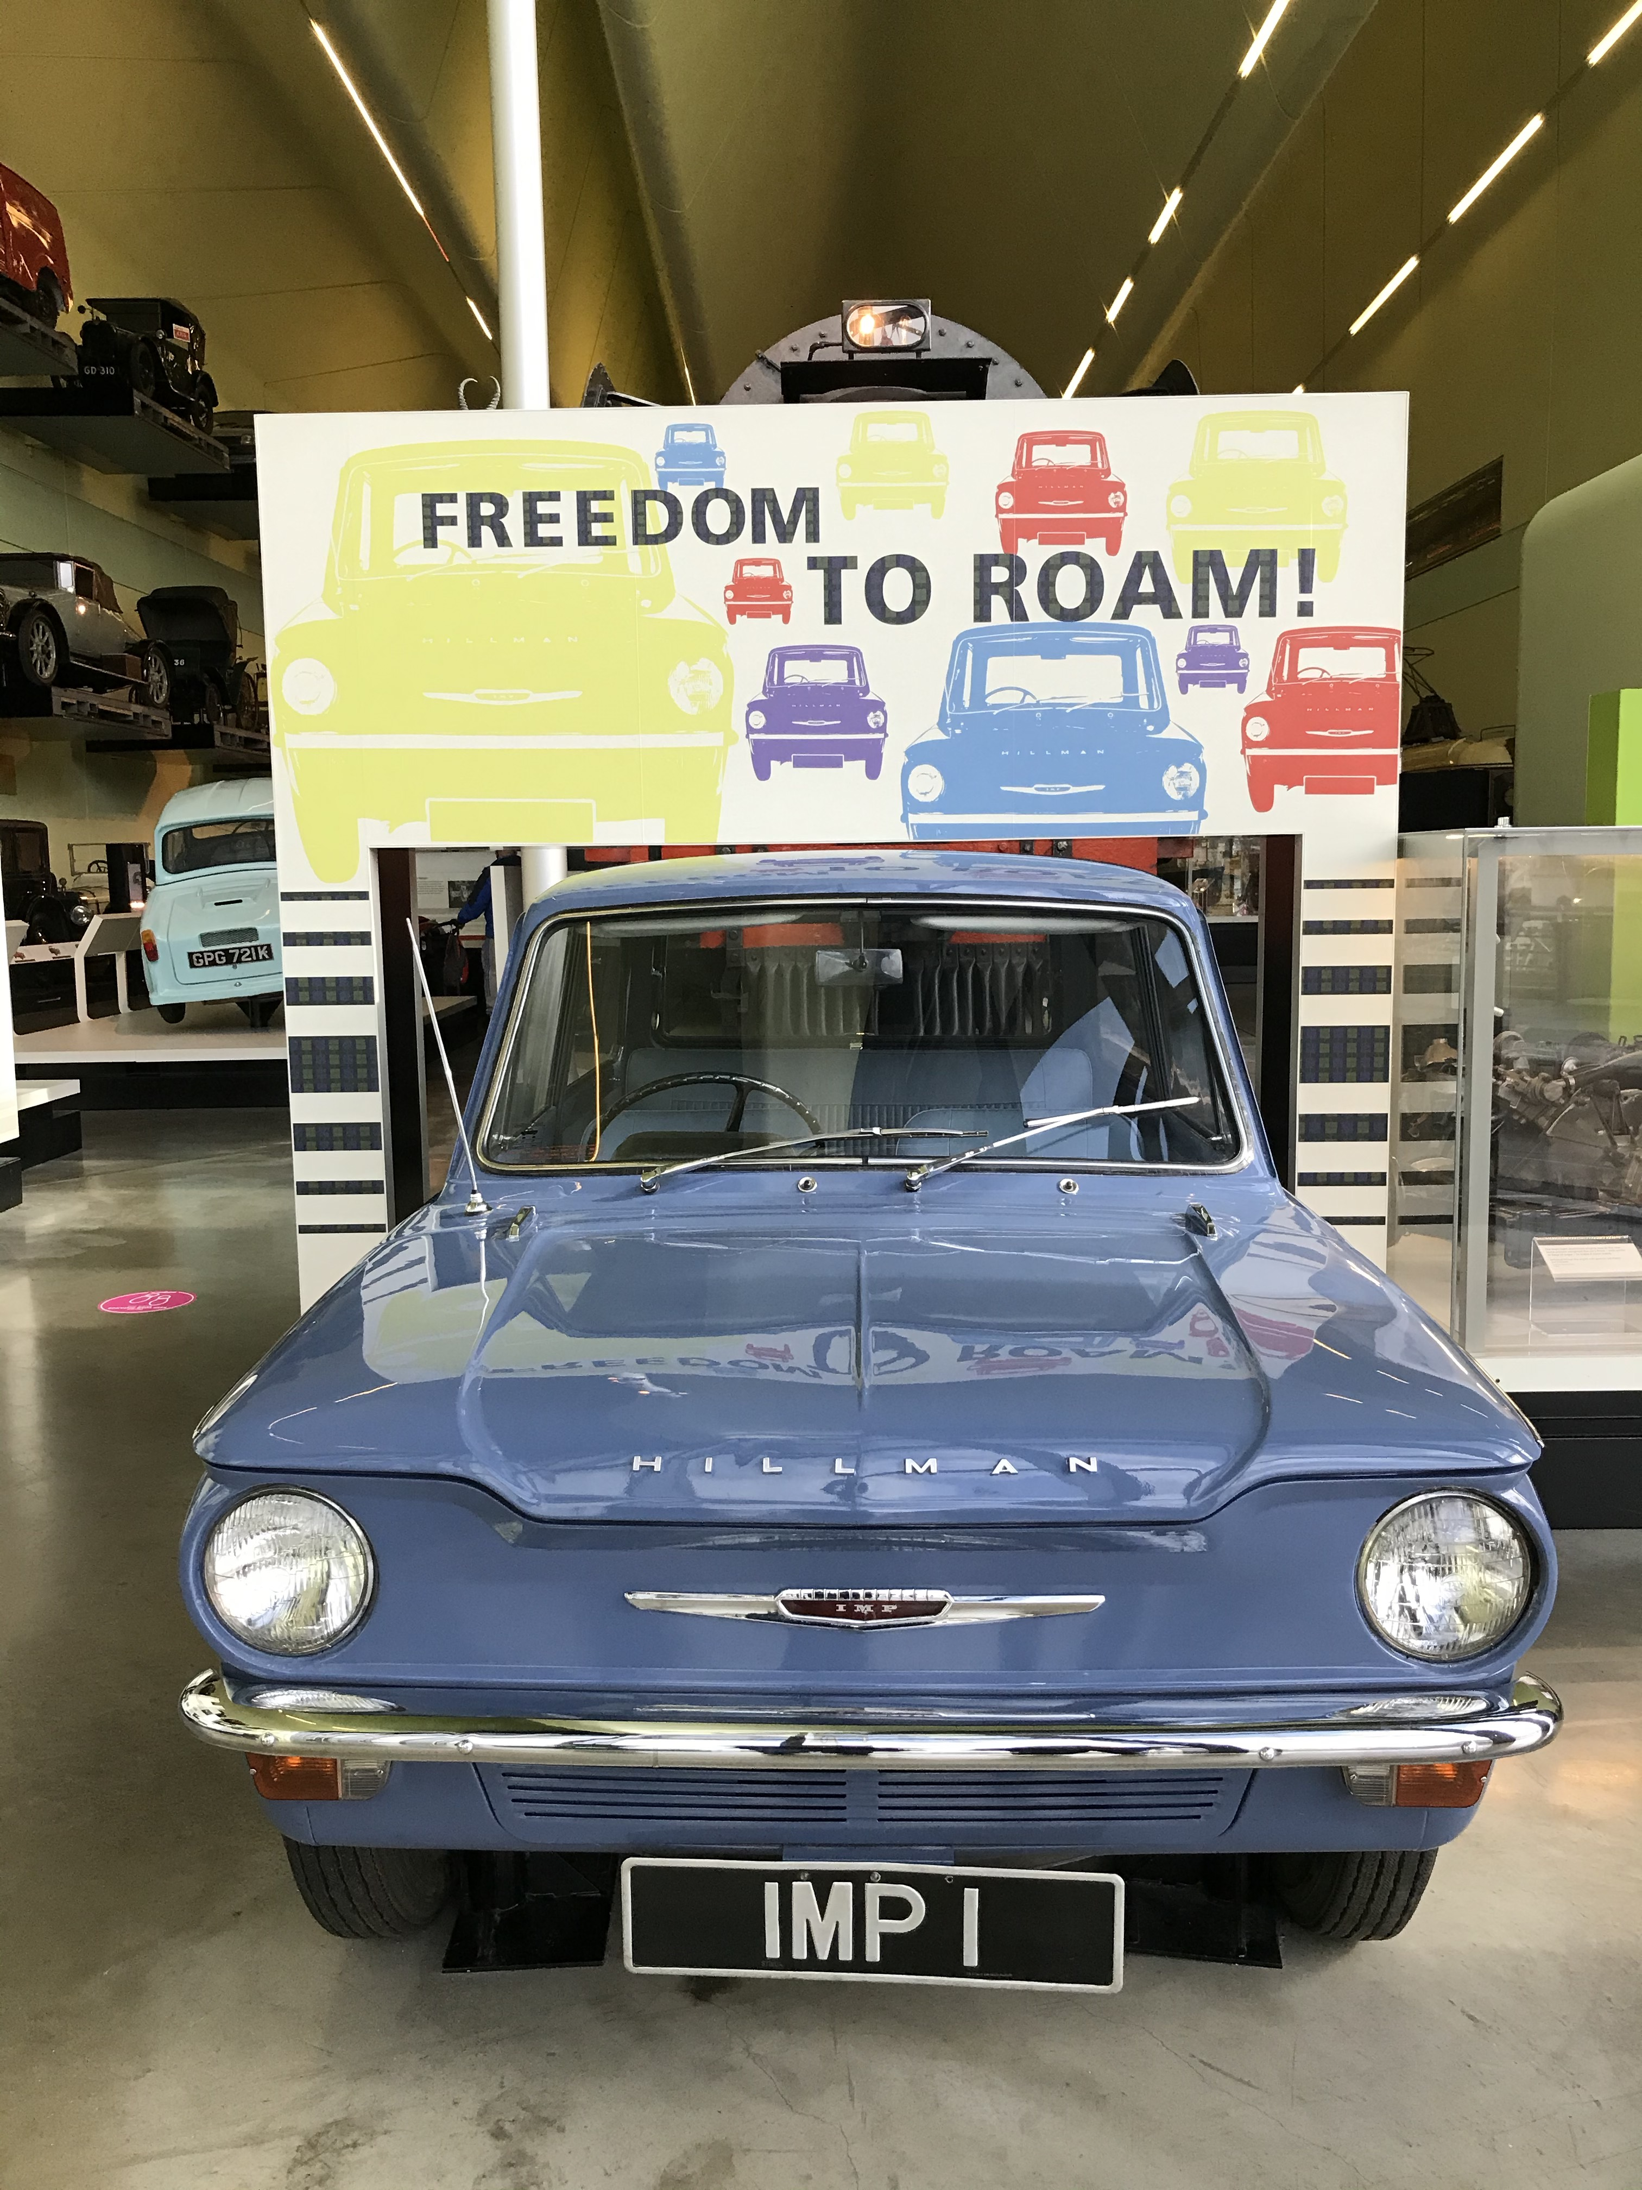
The Hillman Imp
1963
This is the very first
production model of this
revolutionary car.
This is the car I hear visitors
get excited about
in the museum,
usually they’ve known
someone who has had one
and have fond memories of it.
Notes:
Presenters notes
The Hillman Imp was manufactured locally in Linwood, a car plant was especially built to make these Hillman Imps in the sixties.
This car was seen as a new hope for Scottish industry and was expected to “transform the Scottish economy”. However in the excitement the rush to launch the car contributed to the Imp’s reputation for being unreliable.

Slide 5
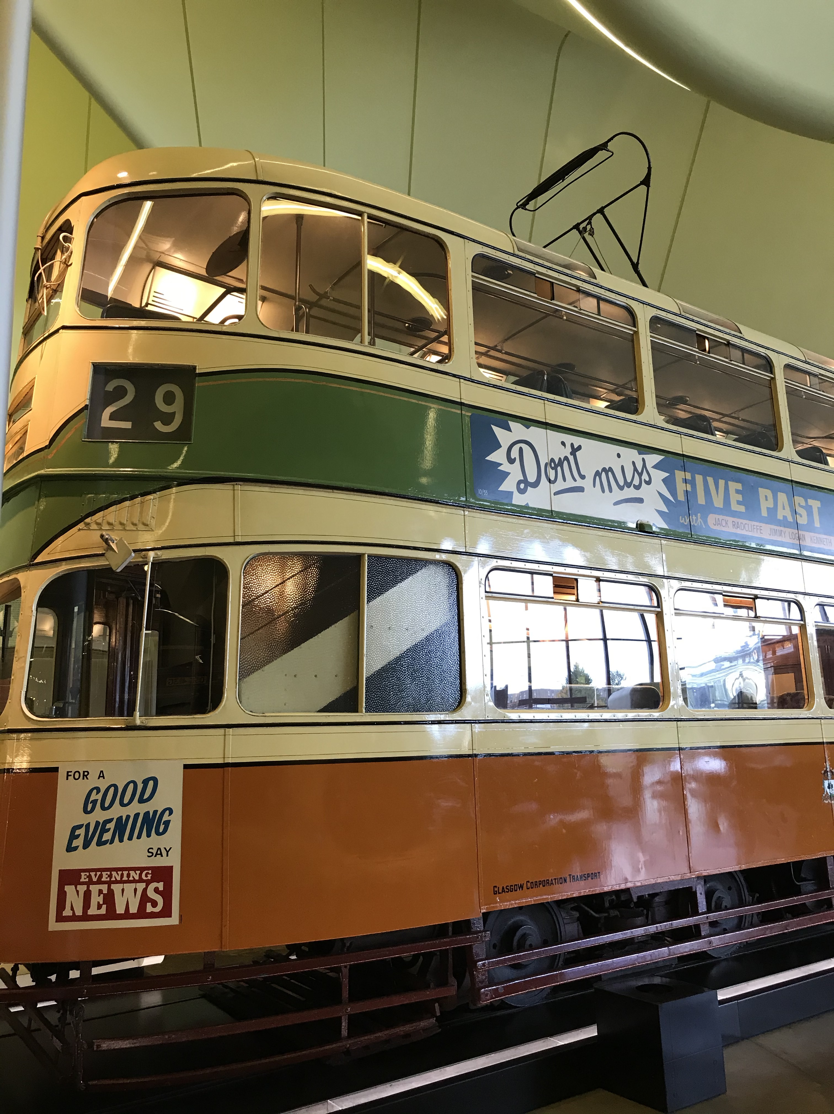
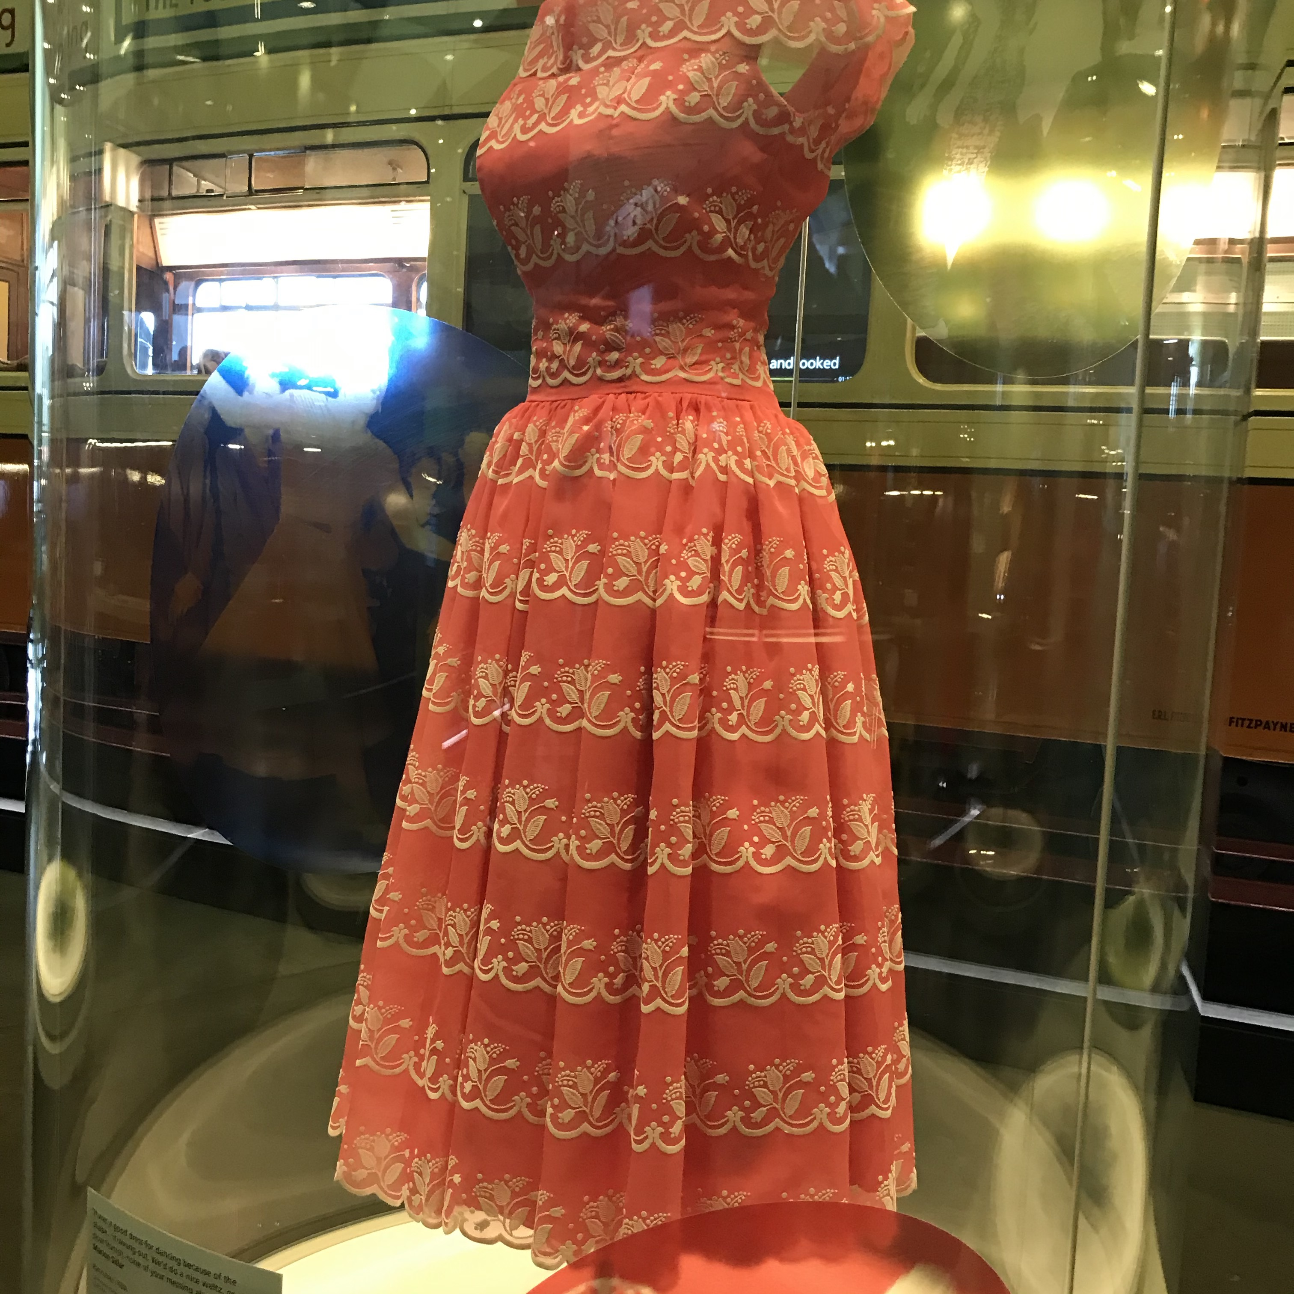
Tram Dancing Display
This is Cunarder tram
1392.
The story around this display
focuses on young people
in the fifties getting the tram
to the dance halls in Glasgow.
It has an ad on the side
advertising the Locarno dance
hall on Sauchiehall Street.
Notes:
This display features the Tram, videos of Glaswegians talking about their experiences taking the tram to the dance halls situated around Glasgow. This tram was in service between 1948 - 62.
3 dresses are featured as part of the display that would have been typically worn to the dance halls. The trams were convenient and comfortable to ride. The seats were comfy and upholstered so they didn’t catch the delicate fabrics of the dresses the women were wearing to the dancing. It was said the gaps between the flooring on the trams were a bit of hazard though as the ladies would often get their high heels stuck in them.

Slide 6
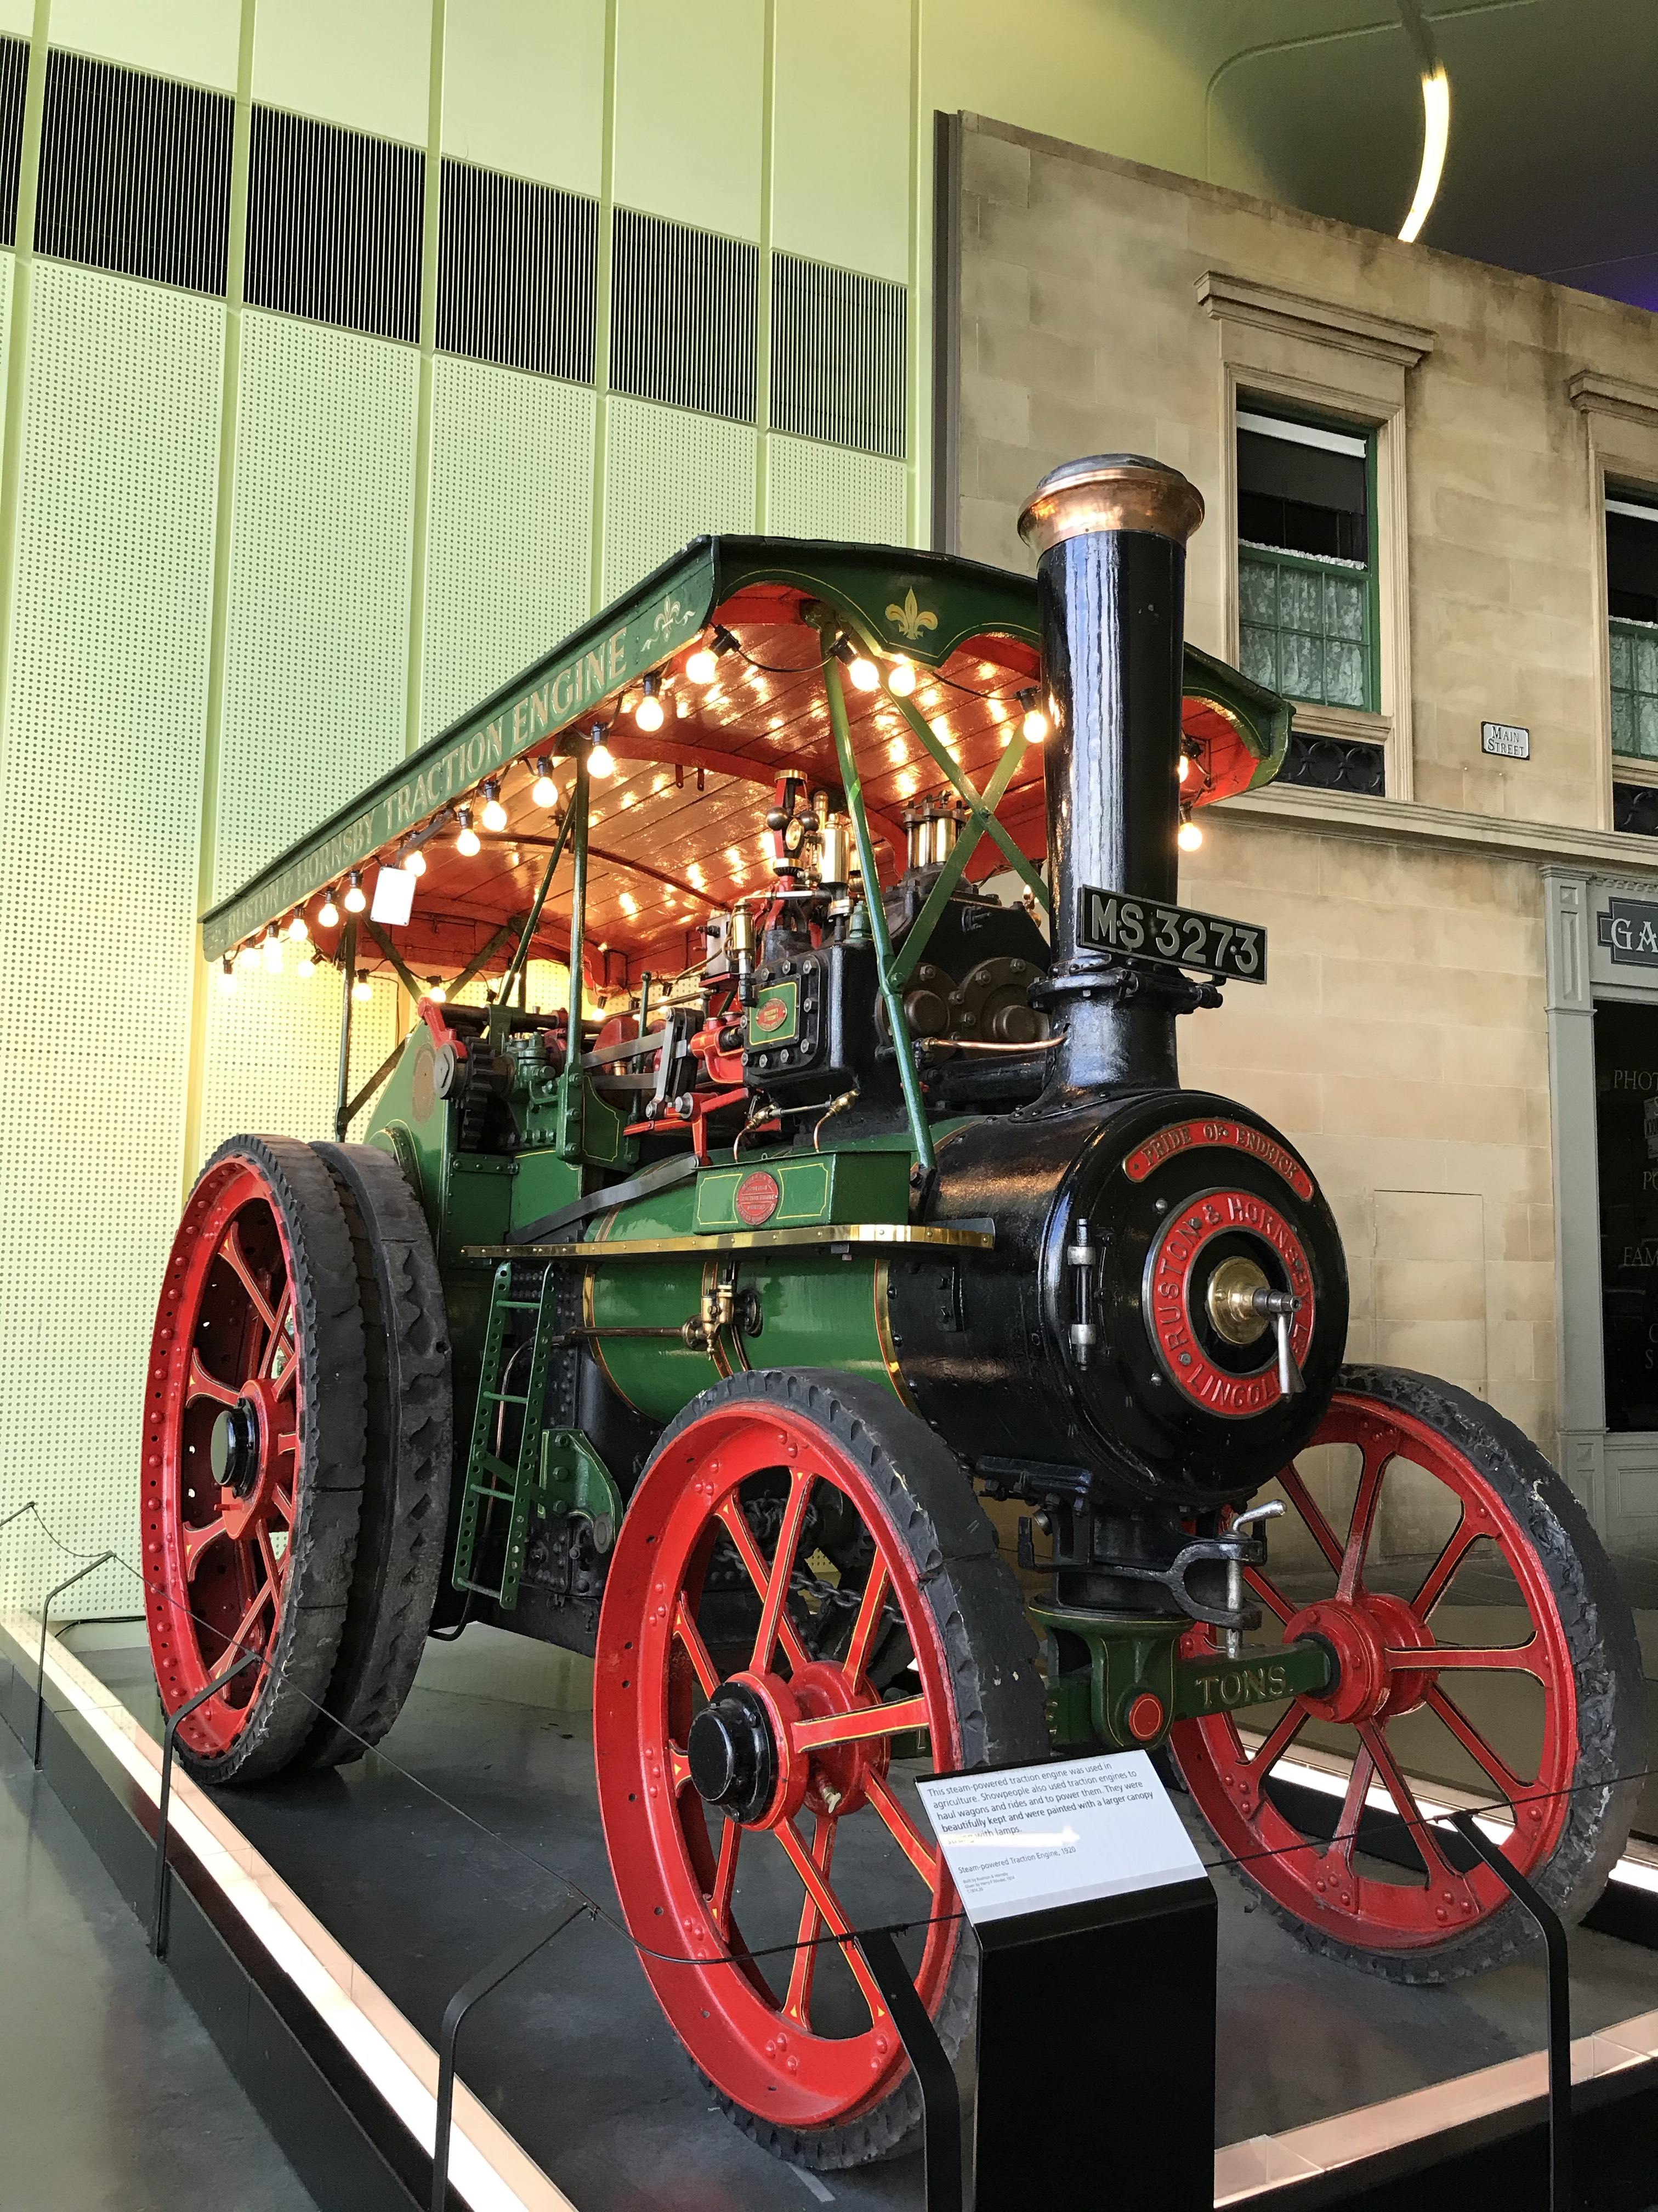
The Magnificent
Traction Engine
From 1920
This traction engine is featured
in our Travelling Show People
Display.
Notes:
This traction engine also features in the Travelling Show people display too. A steam powered traction engine used in agriculture. Show people also used the traction engines to haul wagons and rides and to power them. They were beautifully kept and were painted with a larger canopy strung with lamps. This one is from 1920.
Have you seen this in the flesh at Riverside? What do you think of it? I think it’s hard not to be impressed it’s beautiful!
Are you familiar with Traction Engines? I wasn’t sure at first what its purpose was.

Slide 7
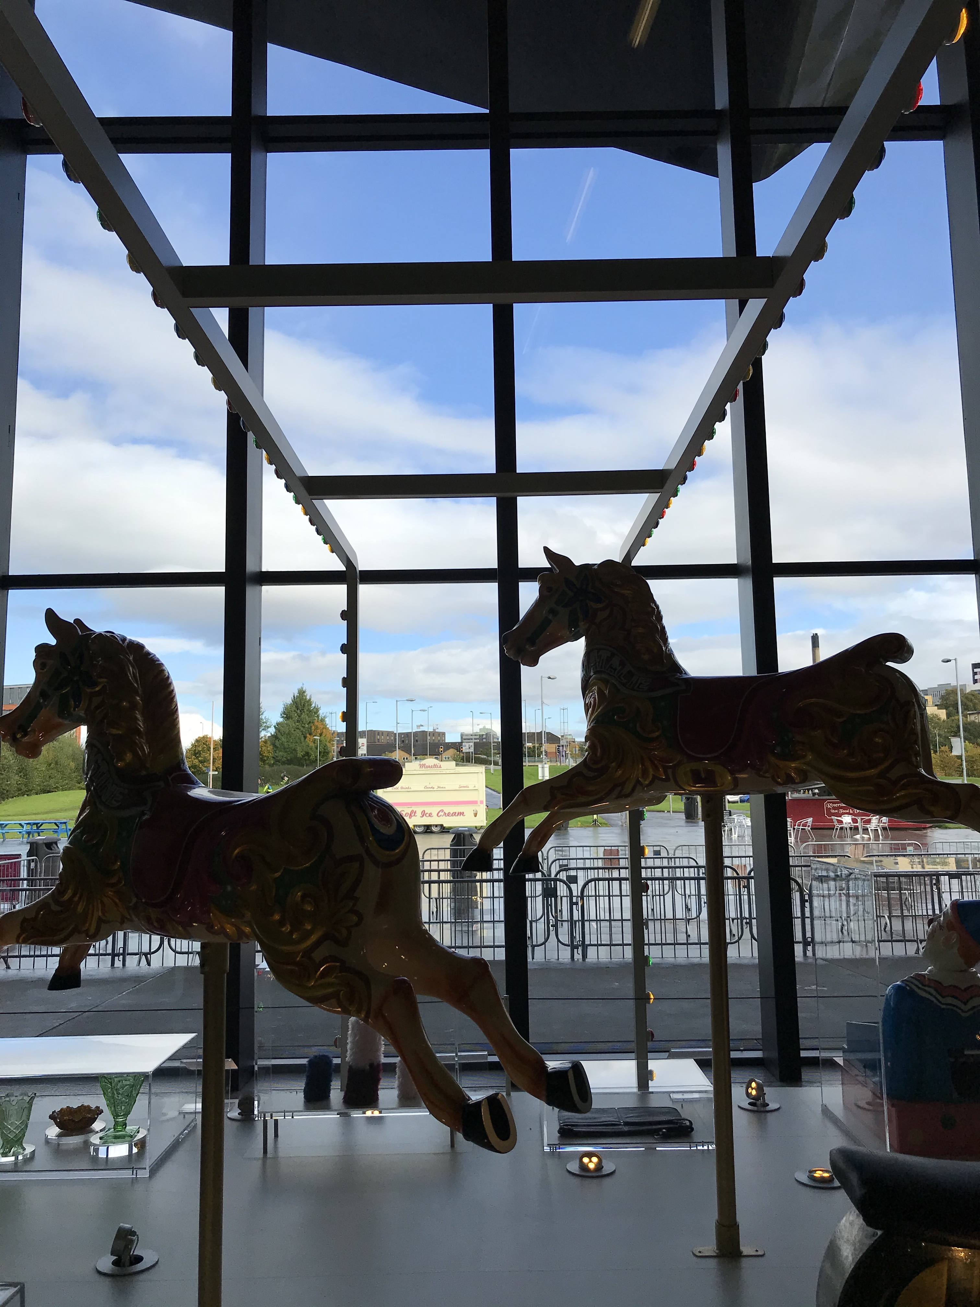
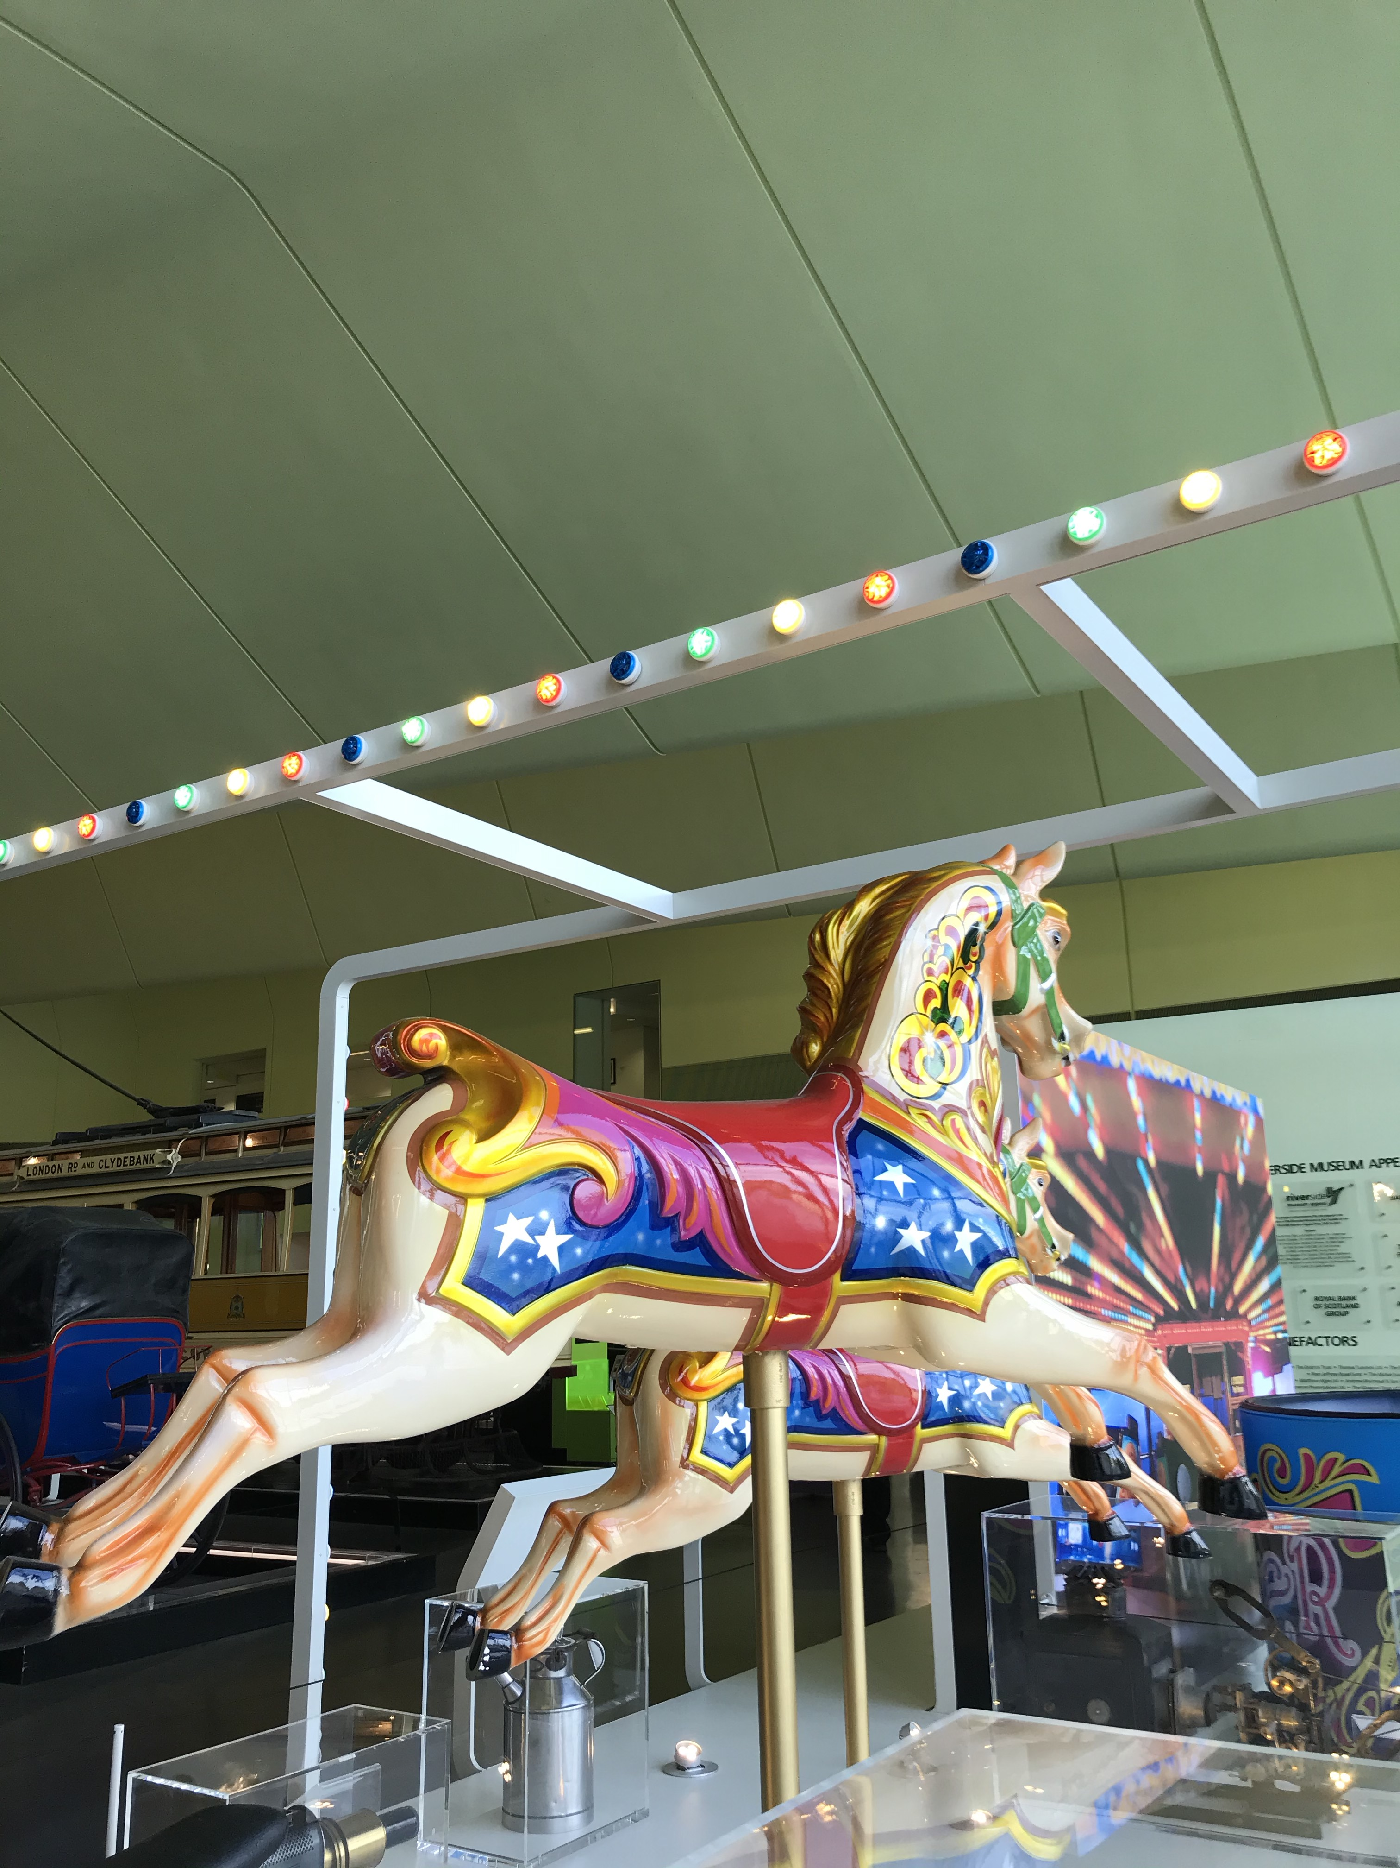
Travelling Show people
Carousel horses
Notes:
This is an image showing some of the lovely carousel horses featured in the Travelling Show people display in the museum.

Slide 8
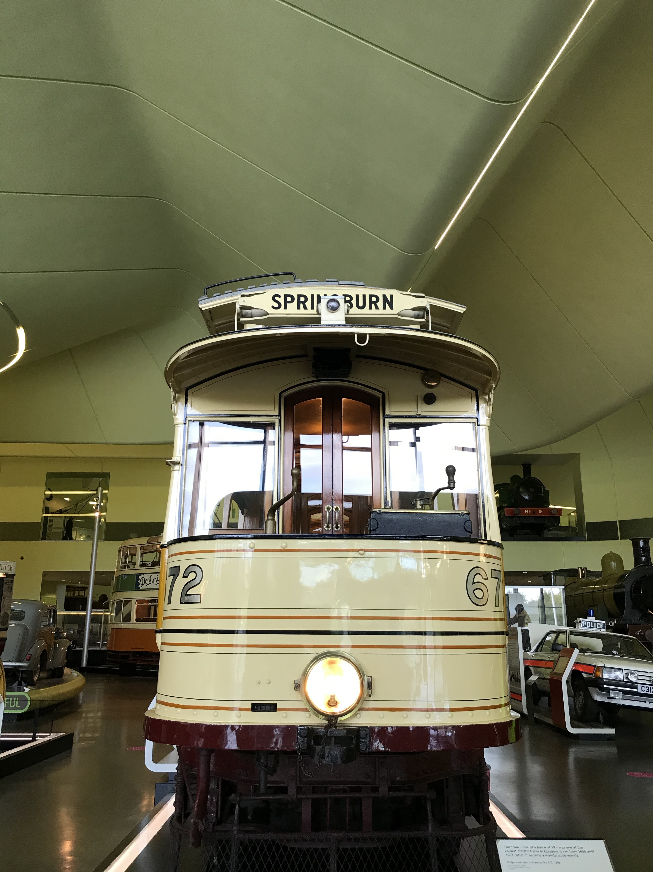
Room and Kitchen Tram
This electric tram sits right at the
entrance of the museum.
It was one of the first electric trams
In Glasgow previously it
was horse drawn trams.
Notes:
This tram car was known as a 'Room and Kitchen'. It was given the name as its layout was similar to that of a typical Glasgow tenement flat of two rooms. It is a single deck tram which dates from around 1900 and was used on the line between Mitchell Street and Springburn.

Slide 9
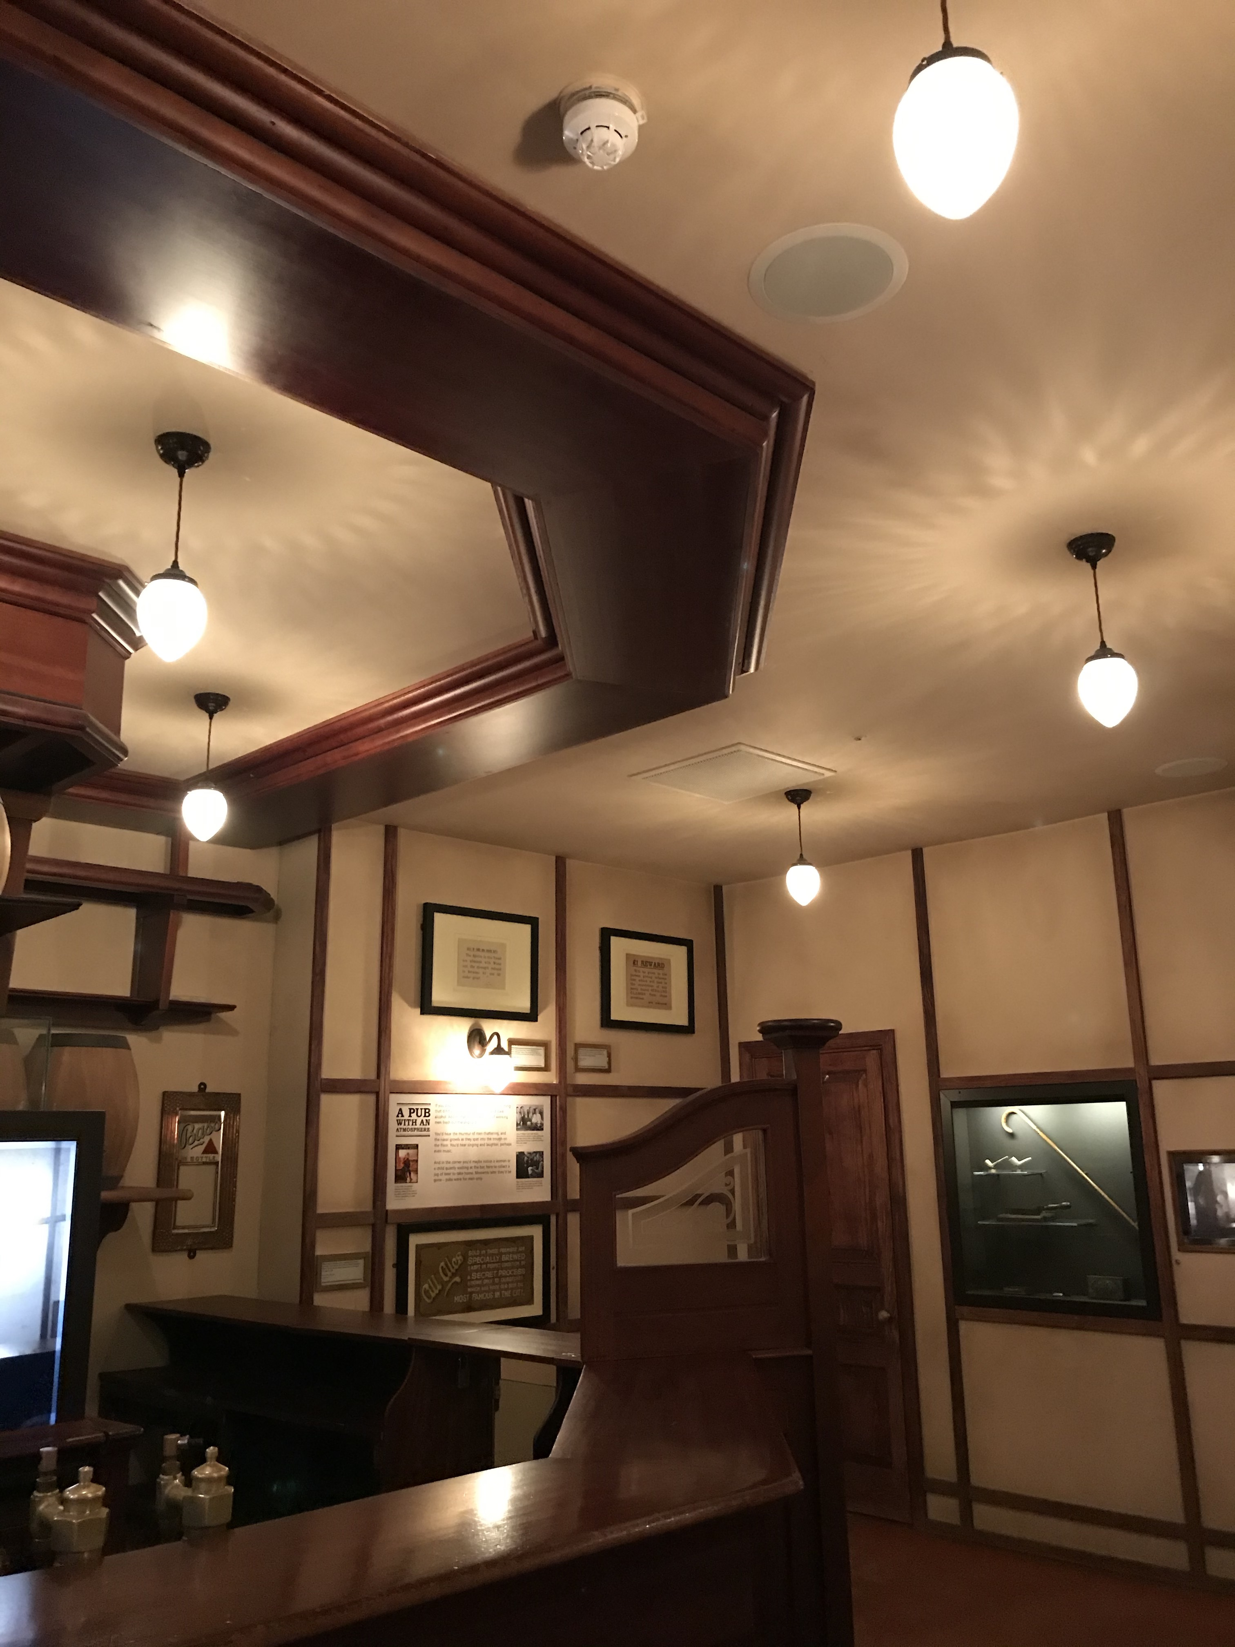
The Mitre Pub
The Riverside Museums pub
Located on Main Street
or someone refer to it as the
“Old Street”
Notes:
Here is an image of the inside of The Mitre Pub which is located in the “Main Street” at the Riverside Museum.

Slide 10
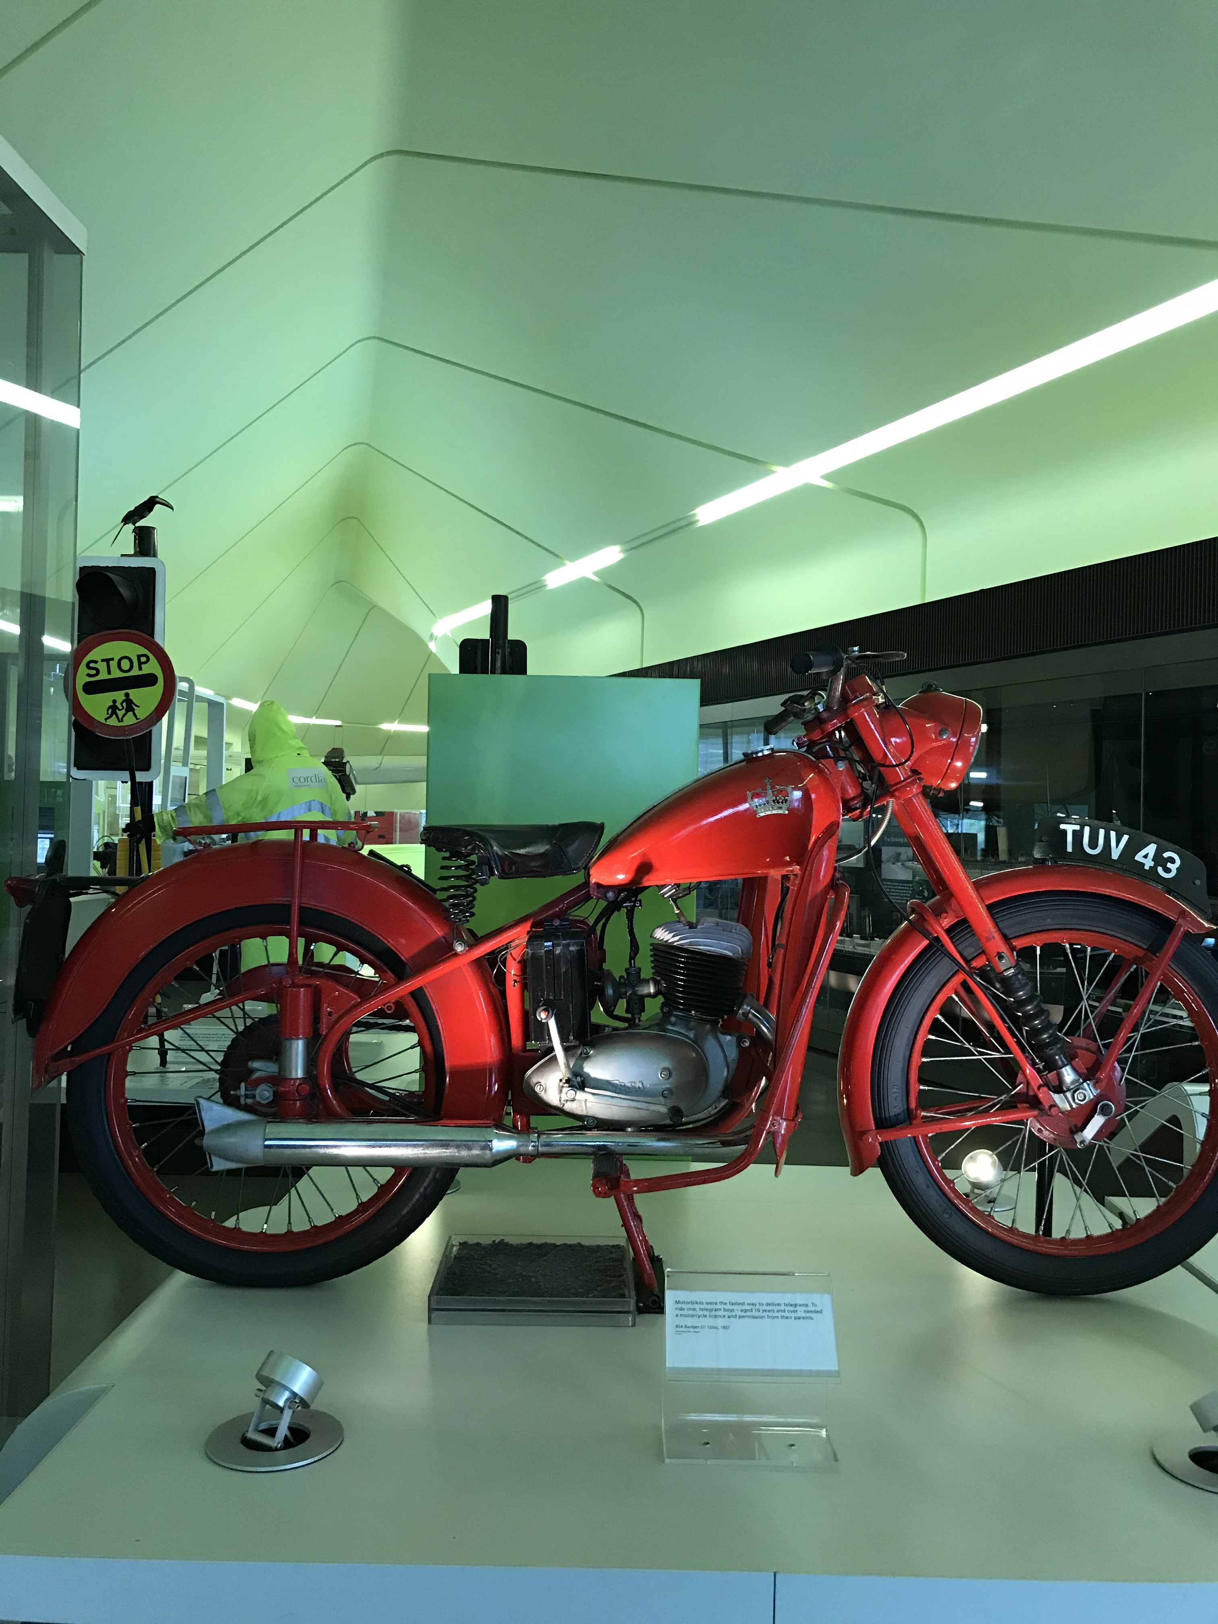
The Telegram Boys
Display
This red motorcycle was
used for telegram delivery.
Notes:
This display shows the Telegram boys red Motorcycle built by Birmingham’s Small Arms Company.
It also features the Telegram Messenger’s Accident Book (1940s-60s, which lists minor scrapes and slips to actual fatal accidents in Glasgow), messenger belt and pouch and some portraits of real Glasgow Telegram Boys.

Slide 11
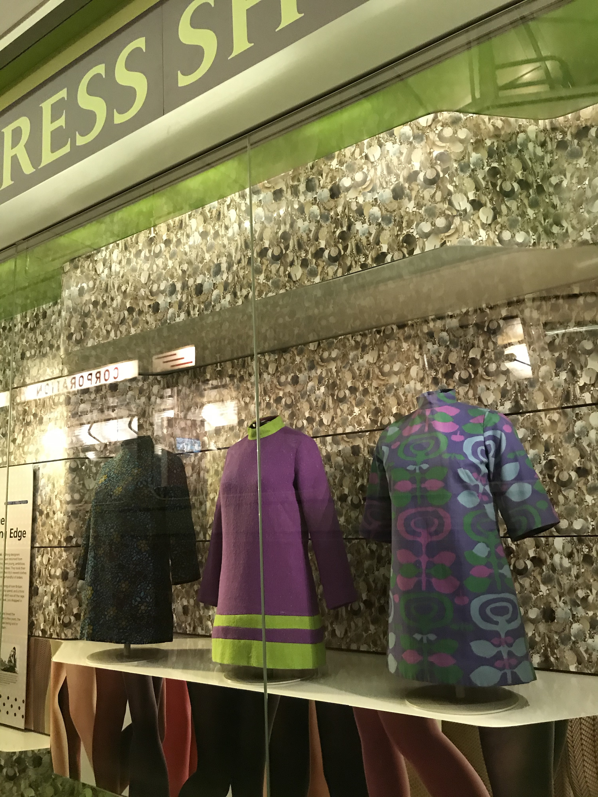
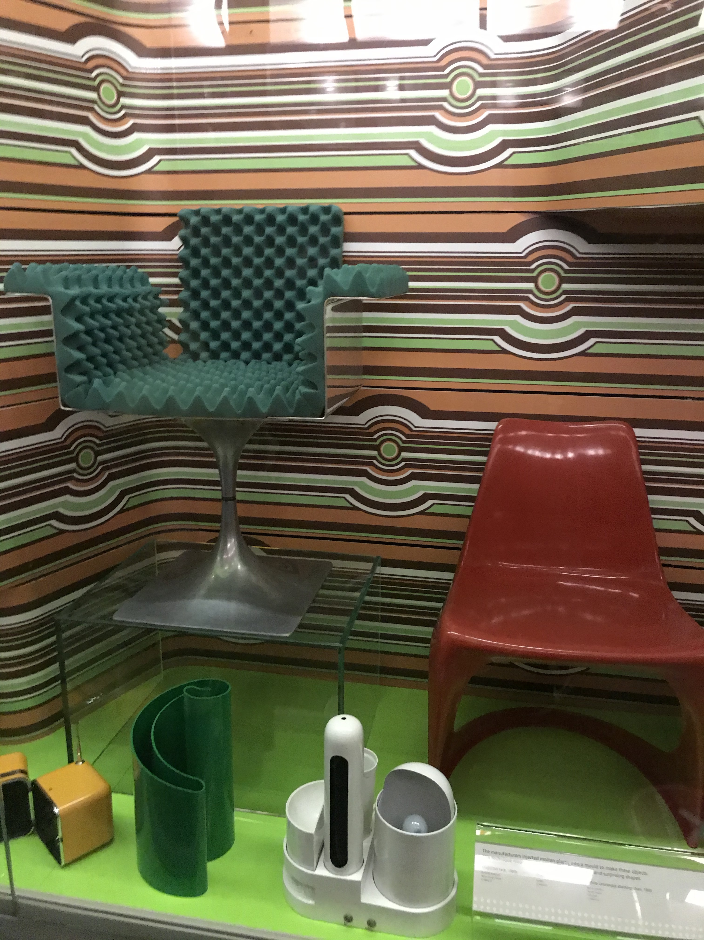
The Swinging Sixties
Here we have a little display
of lovely dresses by
Glasgow designer Marion
Donaldson.
On the right is a display
of futuristic furniture mainly
by Italian designers using
materials that were quite
unusual for the time.
Notes:
This display is one of my favourites featuring dresses by Marion Donaldson and a selection of Italian furniture design.

Slide 12
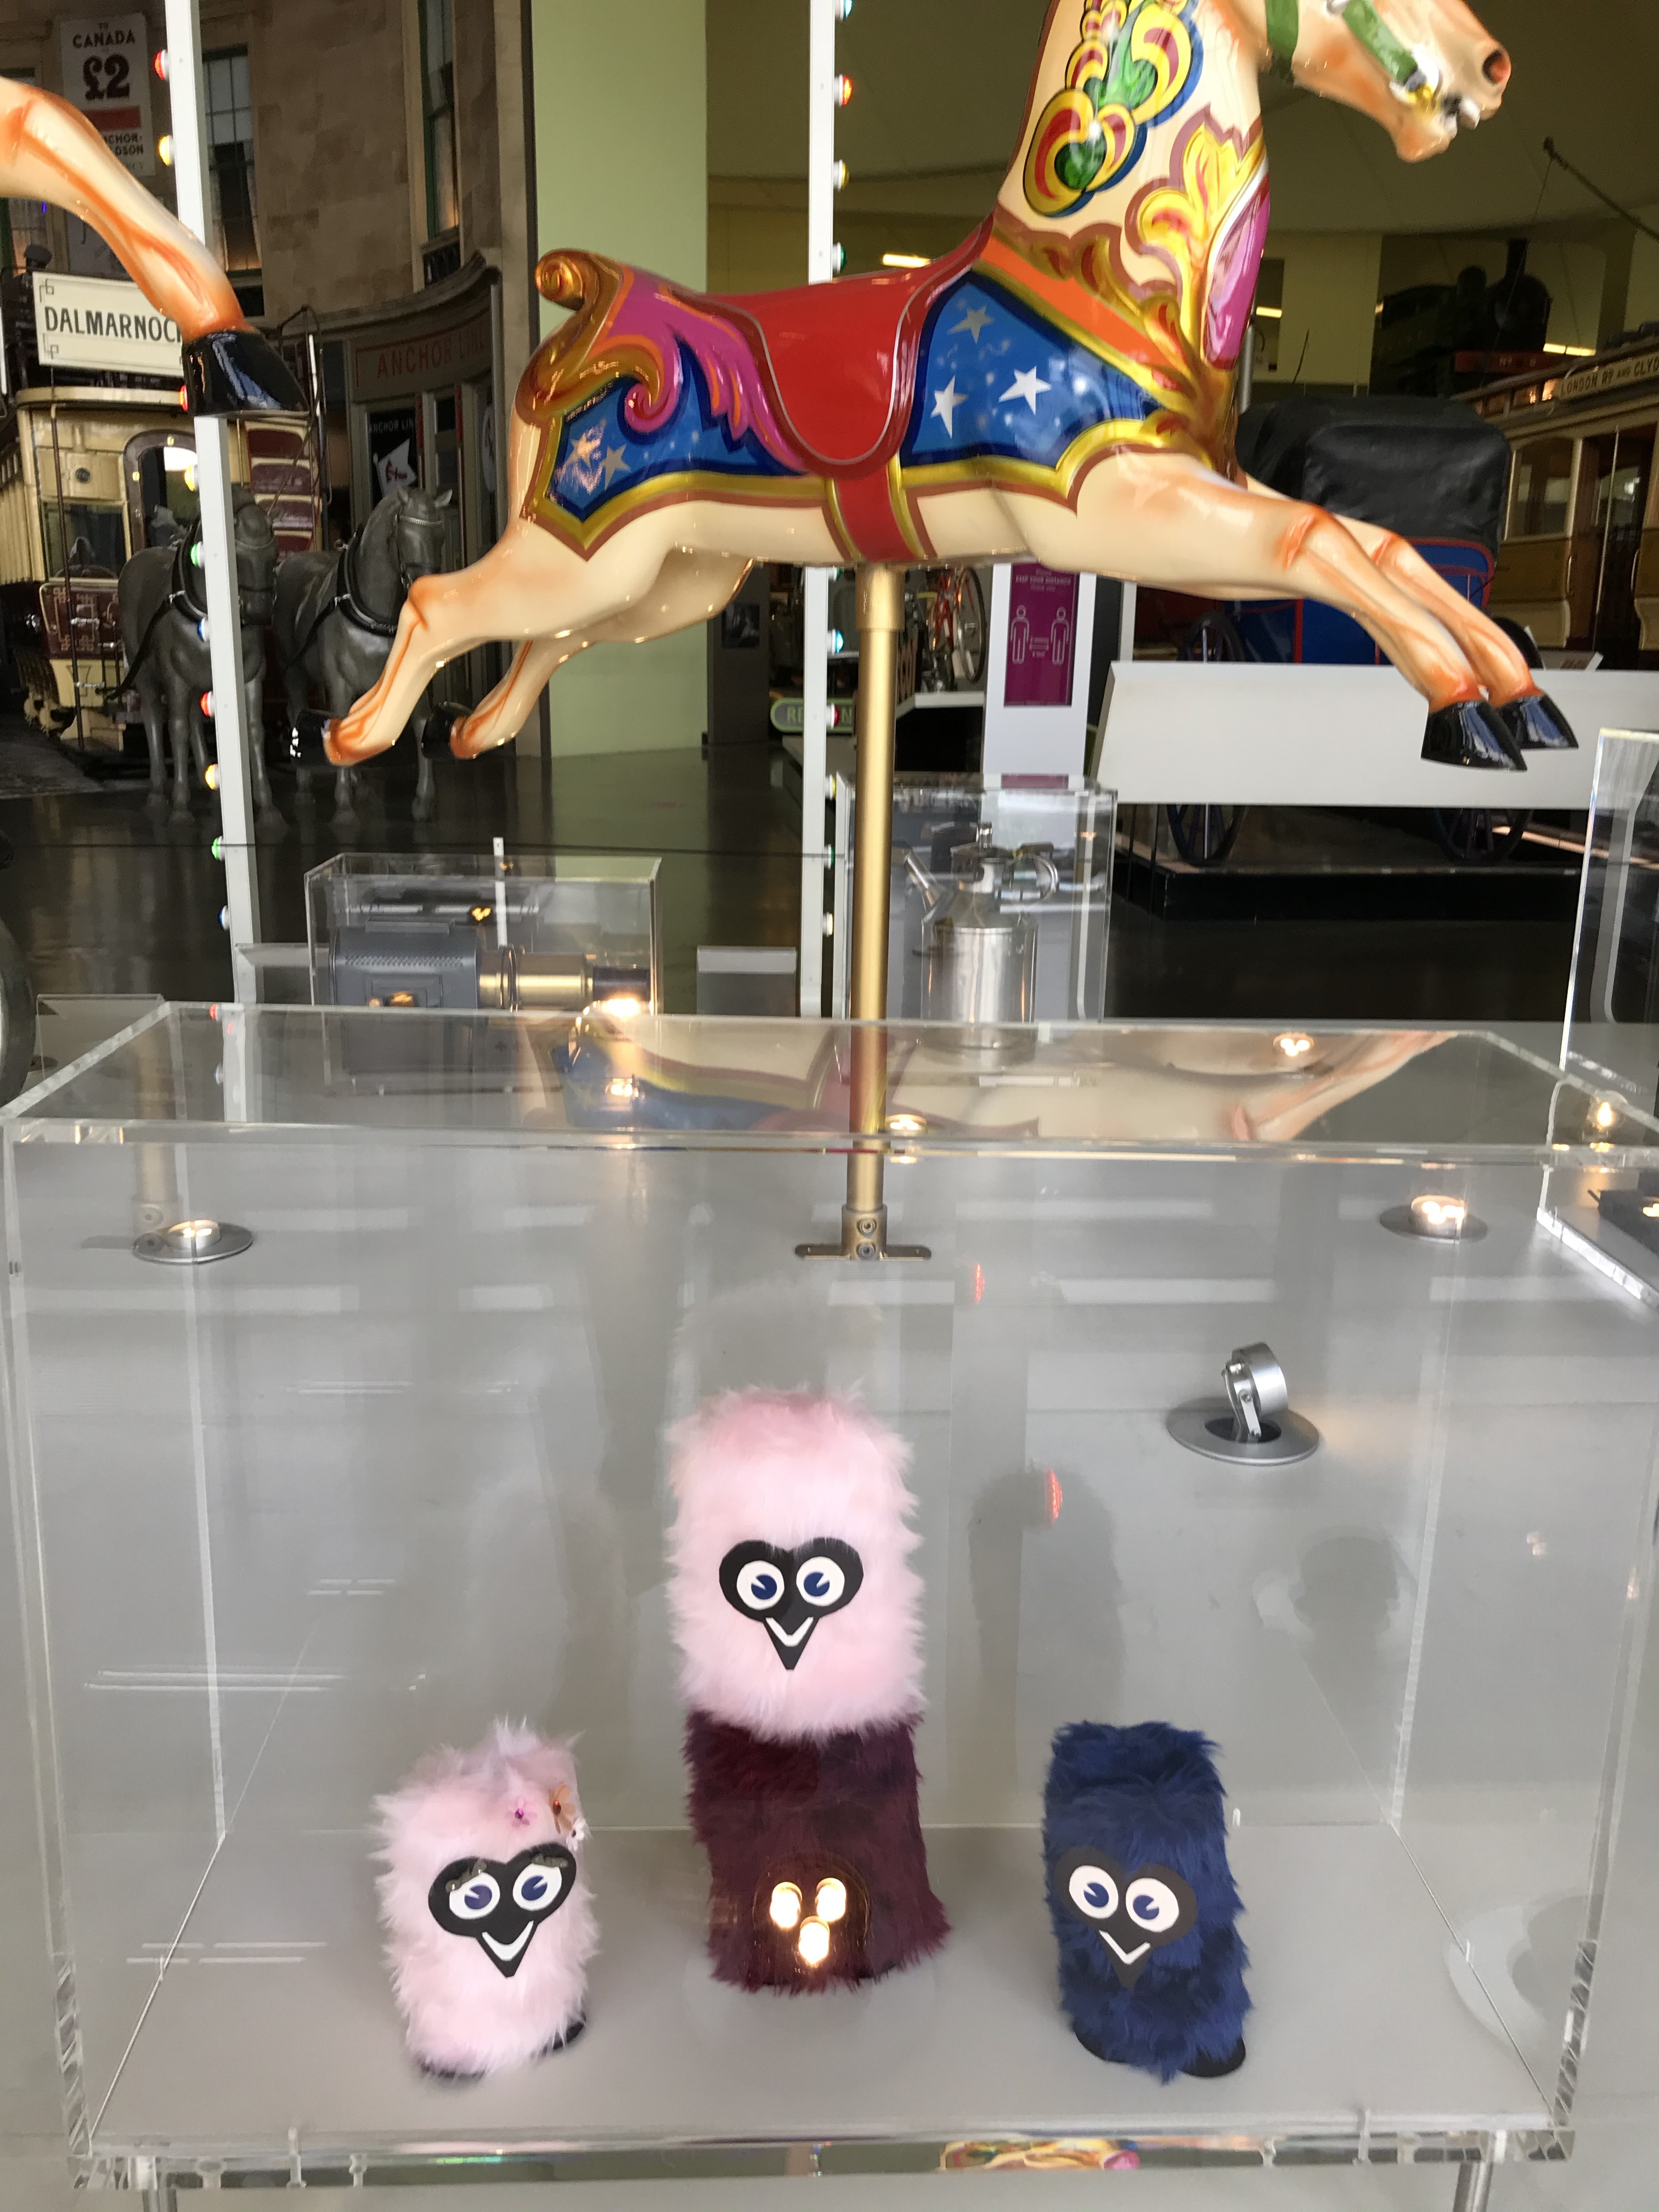
Furry Gonks
Some of the fairground swag
you could have won at the shows
Notes:
•This display is all about Travelling Show people. Do these little furry creatures look familiar? Did you ever go to the shows, carnival, fun fair? Ever win anything good?
These are little gonks and were one of the many things you could have won at the shows!
•Behind is the carousel horses, beautiful aren’t they! Ever been on those?

Slide 13
The Telegram Boys
Display
This red motorcycle was
used for telegram delivery.
Notes:
This display shows the Telegram boys red Motorcycle built by Birmingham’s Small Arms Company.
It also features the Telegram Messenger’s Accident Book (1940s-60s, which lists minor scrapes and slips to actual fatal accidents in Glasgow), messenger belt and pouch and some portraits of real Glasgow Telegram Boys.

Slide 14
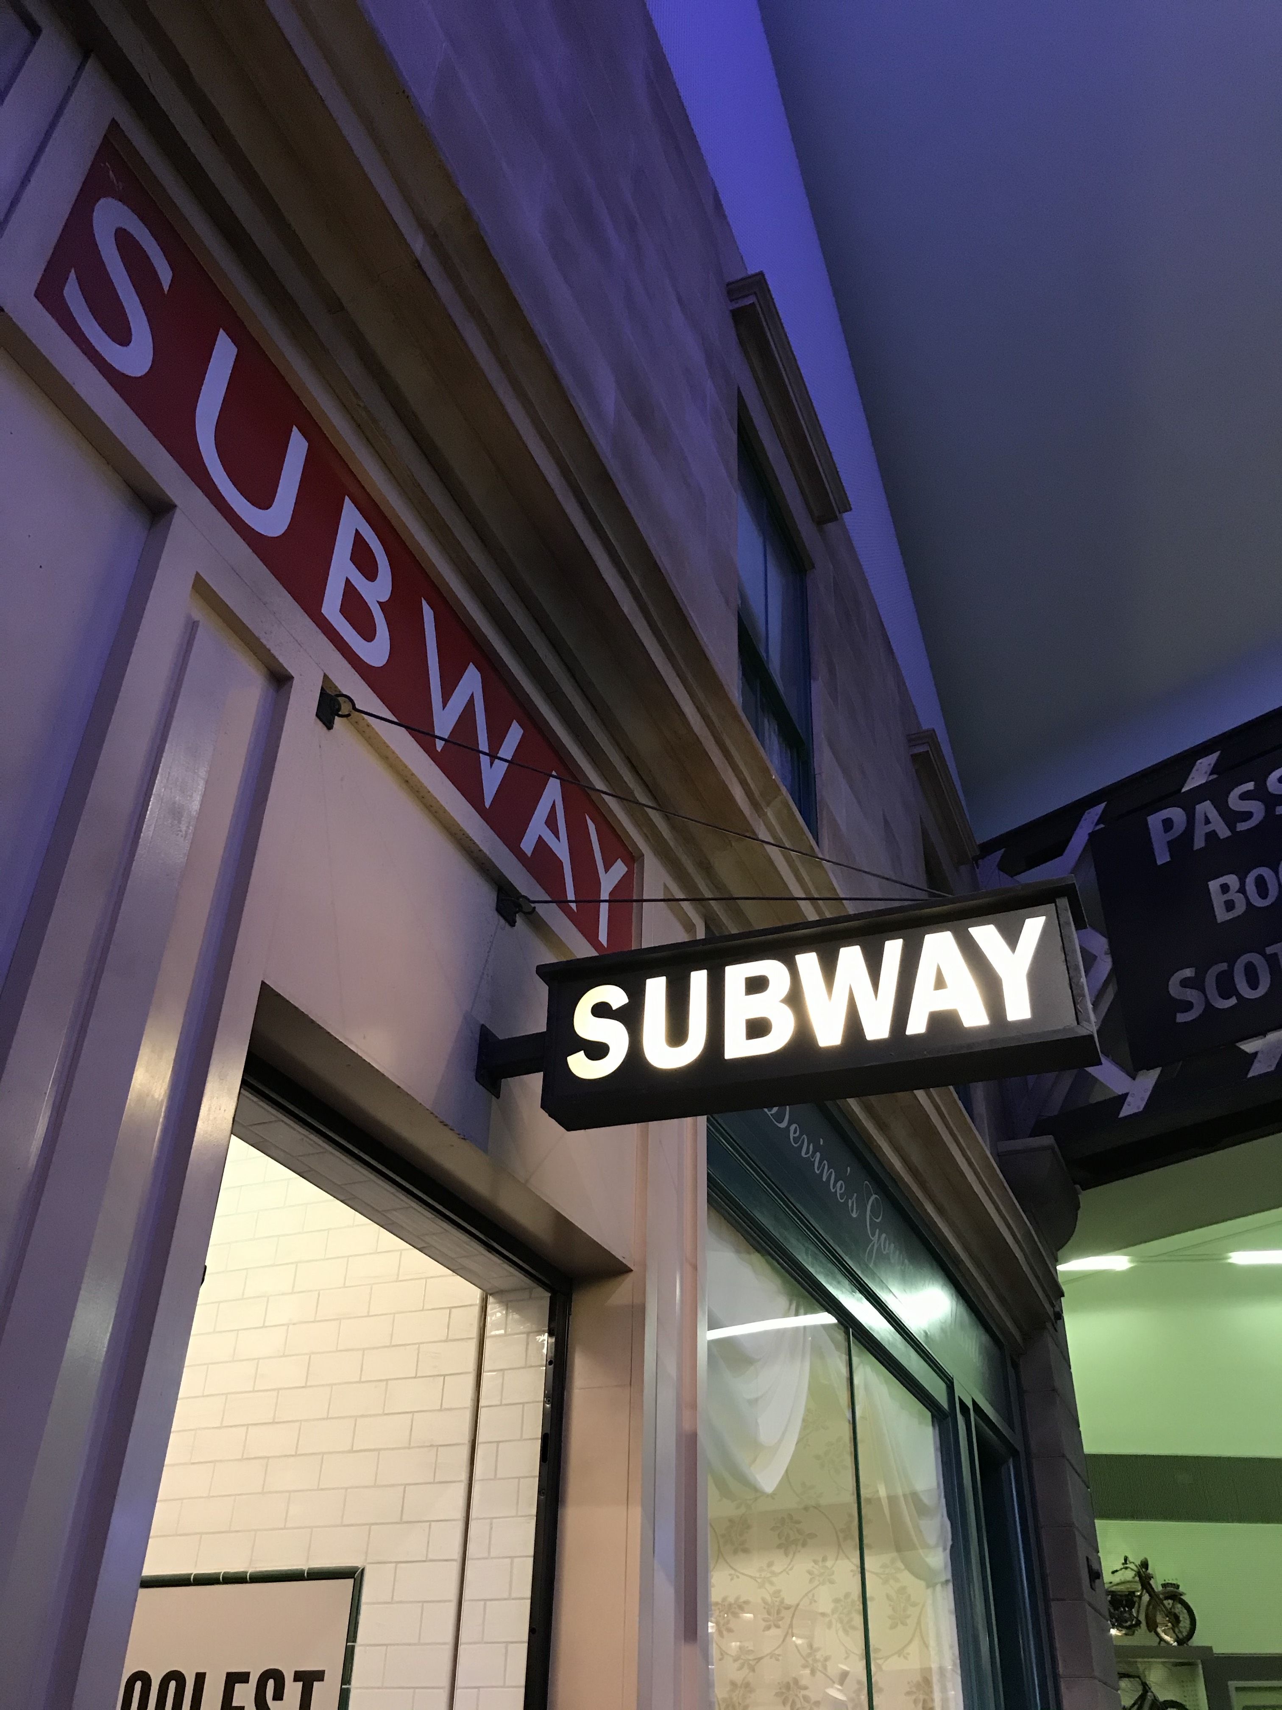
The Subway
The subway featured in our street
Shows visitors how the subway
Train and station would have
Looked in the late 1800s and
Early 1900s.
Did you know Glasgow has the
Third oldest subway system
In the world.
Notes:
The Glasgow Subway was opened in 1896. Budapest and London were the first cities to have a subway system and Glasgow was third in the world.
It was underground, dark and fast and not what Victorian Glaswegians had been used to.
Trains were originally just one carriage but popularity grew and by 1898 more carriages were needed to meet the demand.

Slide 15
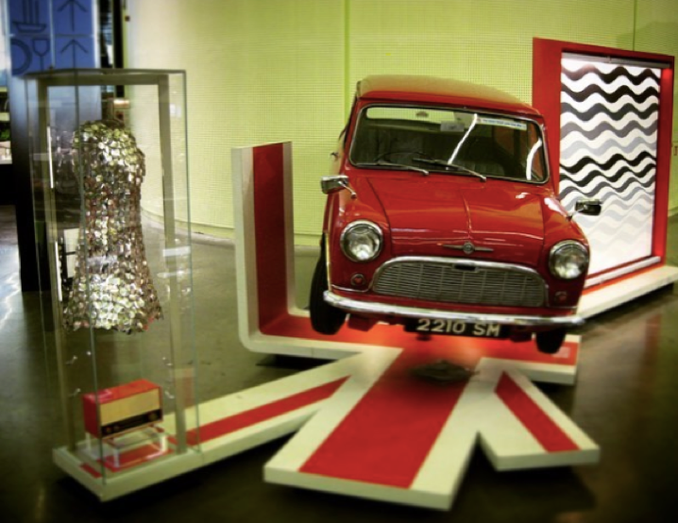
Sixties
This display features the Morris Mini
From 1959. A painting by
Bridget Riley an example of
“Optical Art”.
The dress is by Paco Rabanne
and was worn by
Audrey Hepburn.
Do you know what film it was
that Hepburn wore the dress in?
Notes:
•This is a display at the Riverside Museum it features, the Morris Mini from 1959, a painting by artist Bridget Riley and a Paco Rabanne dress worn by Audrey Hepburn.
This display is about an era of new design, designers were really thinking outside of the box. The painting is an example of “Op Art” Optical art. The dress is made of plastic and metal, it looks a bit like chain mail. The car was the first ever to have a transverse engine which meant a tiny car its size could hold a family of 4.
•Anyone recognise the dress? Can you tell us what film it was that Hepburn worn it in?
•Ever owned a mini or been in one? They still look great now and are still popular it seems!

Slide 16
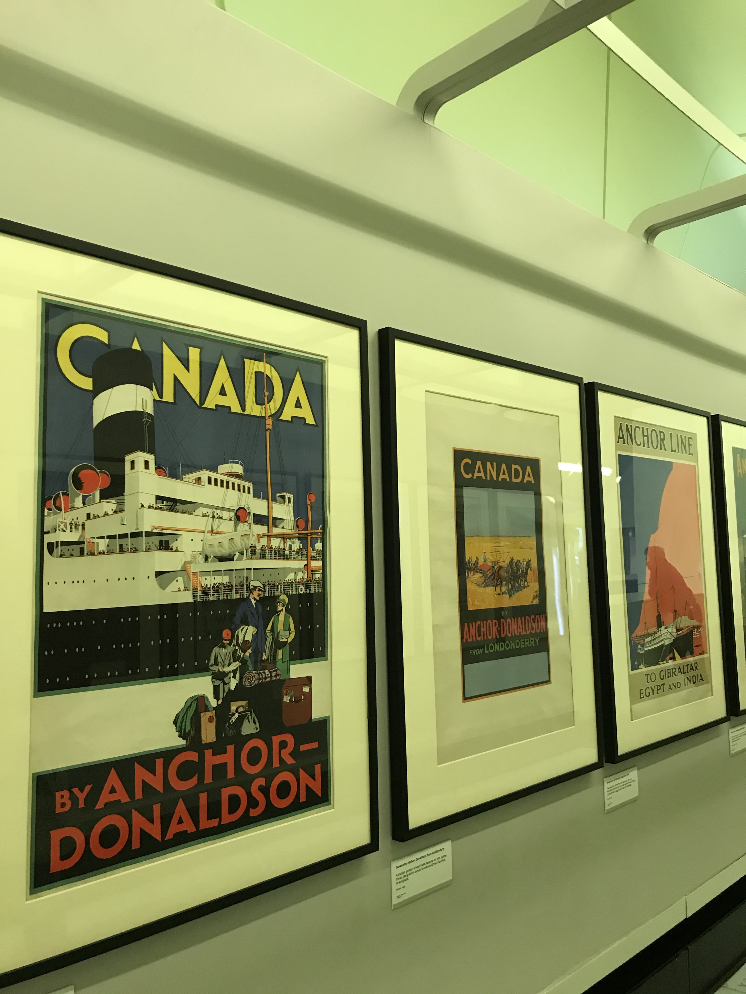
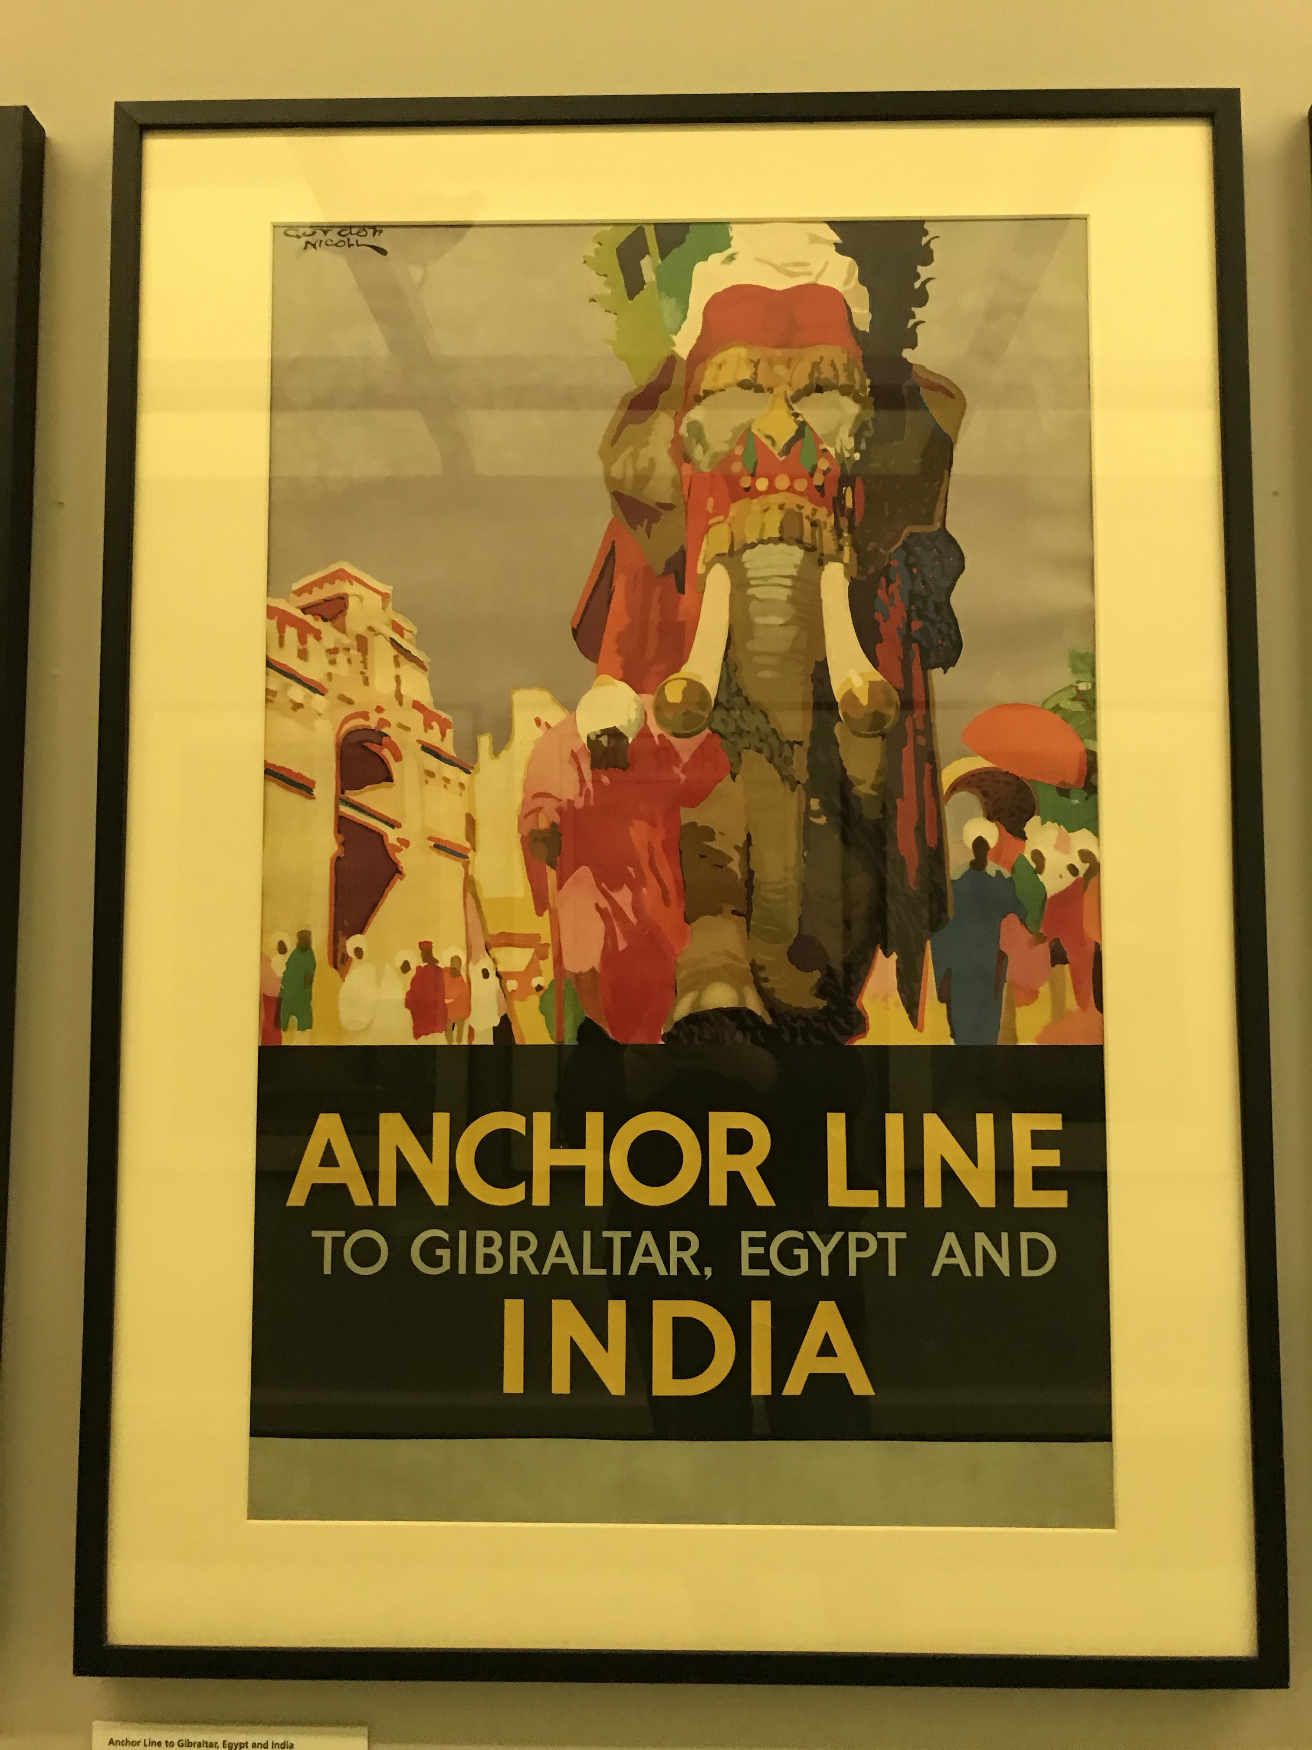
Anchor Line Posters
This is a display of beautiful
posters advertising the
steamship company
Anchor Line.
The graphic designers used
beautiful images of the ships
and destinations along with
bold text to create an impact.
Notes:
There are several posters ranging from the 1920s to 1940s. They advertise some of the exotic destinations you could travel to from Glasgow. New York City, Canada, India were just some of the choices of destinations.
These are Lithography prints.

Slide 17
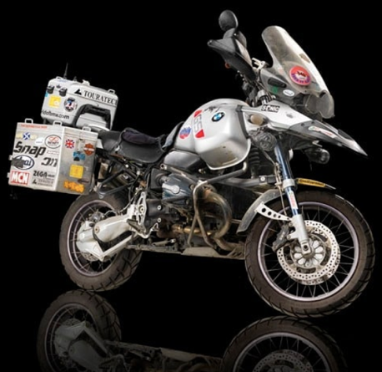
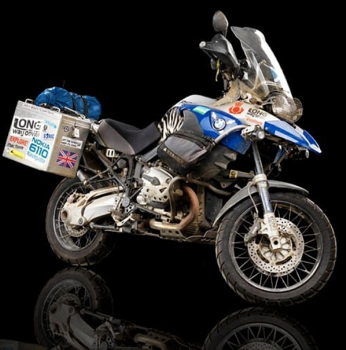
Ewan McGregor’s Motorbikes
McGregor donated both his
motorbikes to the museum
One was featured in the
programme “Long Way Round”
And the other in
“Long Way Down”
Have you seen the
tv programme?
Notes:
•Above are two photographs of Ewan McGregor’s motorbikes which can be found in the Riverside Museum, McGregor donated both bikes to the museum, one featured in the programme “Long Way Round” and the other in “Long Way Down”
•Long Way Down tracked his journey with friend Charley Boorman from John O’Groats, the Northernmost tip of Scotland to Cape Agulhas, the Southernmost tip of South Africa. Long Road Round was from London to New York, journeying through Europe, the Ukraine, Kazakhstan, Mongolia and Russia, across the Pacific to Alaska then down through Canada and America.
•Did you watch the TV documentary? Ever done a long journey or stint of travelling before in the UK or elsewhere?

Slide 18
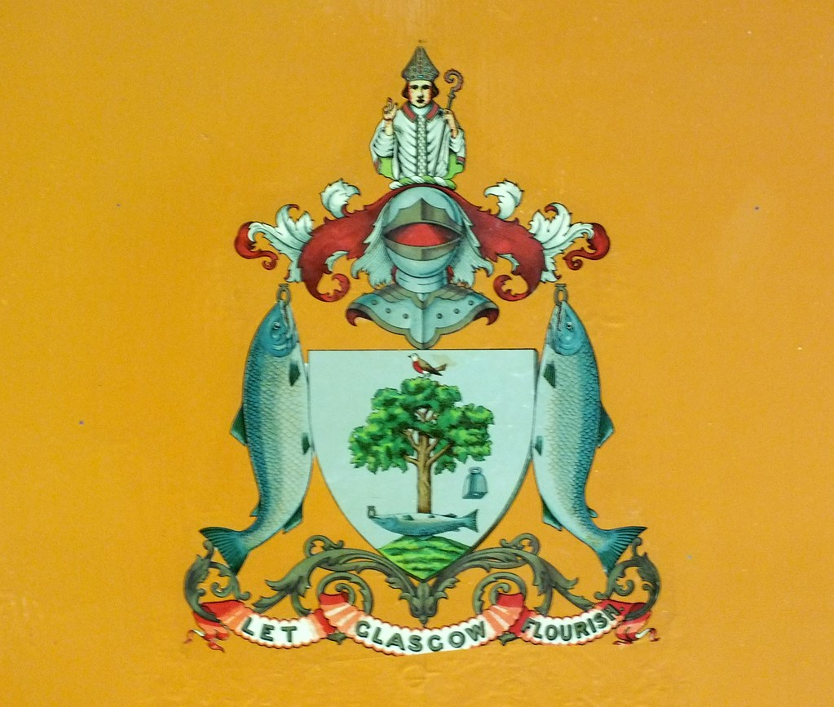
Question 1
Glasgow’s Coat of Arms was introduced when the Lord Lyon granted the city its patent. In which Year did this happen?
A)1866
B)1966
C)1916
Notes:
Answer: A) 1866

Slide 19
Question 1
Glasgow’s Coat of Arms was introduced when the Lord Lyon granted the city its patent. In which Year did this happen?
A)1866
Notes:
Answer: A) 1866

Slide 20
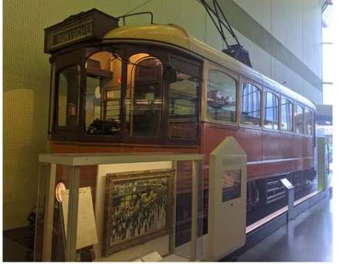
Question 2
How many people turned up to see the last tram parade in Glasgow in 1962?
A)500,000
B)250,000
C)120,000
Notes:
Answer: B) 250,000 - a rainy day in Glasgow but didn’t keep the crowds away it was very busy at the last tram procession.

Slide 21
Question 2
How many people turned up to see the last tram parade in Glasgow in 1962?
B)250,000
Notes:
Answer: B) 250,000 - a rainy day in Glasgow but didn’t keep the crowds away it was very busy at the last tram procession.

Slide 22
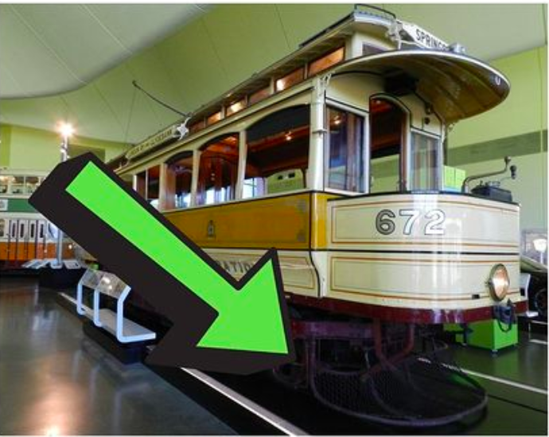
Question 3
What is the name of this net at the front of the tram?
A) A hen catcher
B) Poop scoop
C) Coo catcher
Notes:
Answer: C) Coo Catcher - this device springs up and catches anything that goes in front of the tram, it is a safety device

Slide 23
Question 3
What is the name of this net at the front of the tram?
C) Coo catcher
Notes:
Answer: C) Coo Catcher - this device springs up and catches anything that goes in front of the tram, it is a safety device

Slide 24
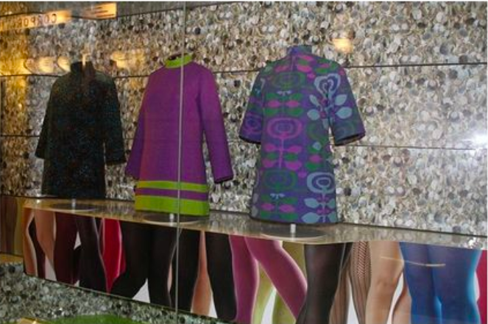
Question 4
These mini dresses from the sixties were designed by a successful and innovative Glaswegian designer. What is her name?
A) Marion Donaldson
B) Mary Quant
C) Shirley Craven
Notes:
Answer: A) Marion Donaldson - 60s designer, she designed clothes with her husband, she has worked with liberty prints and she stocked her wares at the In Gear boutique.

Slide 25
Question 4
These mini dresses from the sixties were designed by a successful and innovative Glaswegian designer. What is her name?
A) Marion Donaldson
Notes:
Answer: A) Marion Donaldson - 60s designer, she designed clothes with her husband, she has worked with liberty prints and she stocked her wares at the In Gear boutique.

Slide 26
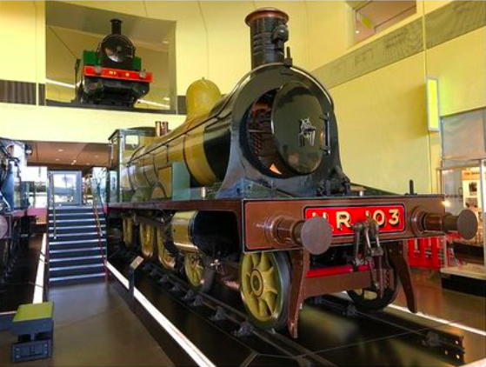
Question 5
The locomotive no.103 is a movie star, can you name the 1965 comedy in which it appeared?
A) Murder on the orient express
B) Around the world in 80 days
C) Those magnificent men in flying machines
Notes:
Answer: C) Those magnificent men in their flying machines - 1965 period comedy drama film starring Benny Hill, Stuart Whitman and Sarah Miles.

Slide 27
Question 5
The locomotive no.103 is a movie star, can you name the 1965 comedy in which it appeared?
A
C) Those magnificent men in flying machines
Notes:
Answer: C) Those magnificent men in their flying machines - 1965 period comedy drama film starring Benny Hill, Stuart Whitman and Sarah Miles.

Slide 28
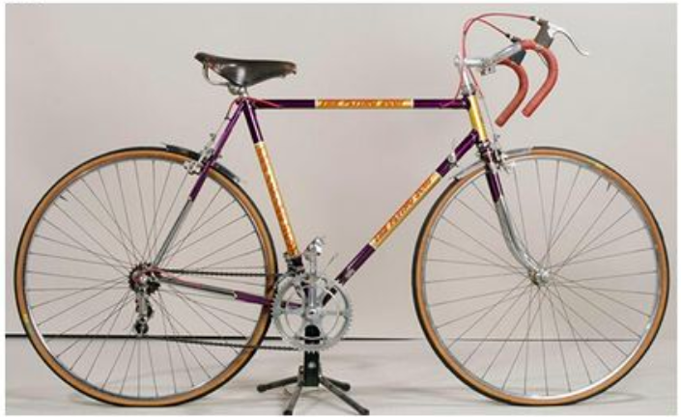
Question 6
What is the name of the company manufacturing Scotland’s premier lightweight bicycles that opened its first shop in Mcaslin street in 1900?
A)Billy Bisland Bikes
B)Tour de Scot
C)The Flying Scot
Notes:
Answer: C) The Flying Scot

Slide 29
Question 6
What is the name of the company manufacturing Scotland’s premier lightweight bicycles that opened its first shop in Mcaslin street in 1900?
C)The Flying Scot
Notes:
Answer: C) The Flying Scot

Slide 30
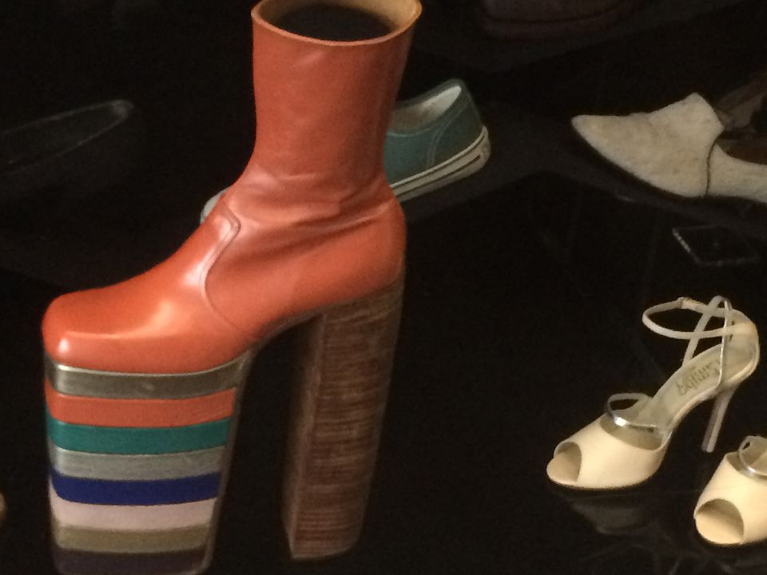
Question 7
These colourful shoes were worn by a famous English singer, who sang hits including “I’m still standing”, who do you think it is?
A)David Bowie
B)Elton John
C)Paul McCartney
Notes:
Answer: B) Elton John - Billy Connelly received these boots during an Elton John tour and he donated them to the museum

Slide 31
Question 7
These colourful shoes were worn by a famous English singer, who sang hits including “I’m still standing”, who do you think it is?
B)Elton John
Notes:
Answer: B) Elton John - Billy Connelly received these boots during an Elton John tour and he donated them to the museum

Slide 32
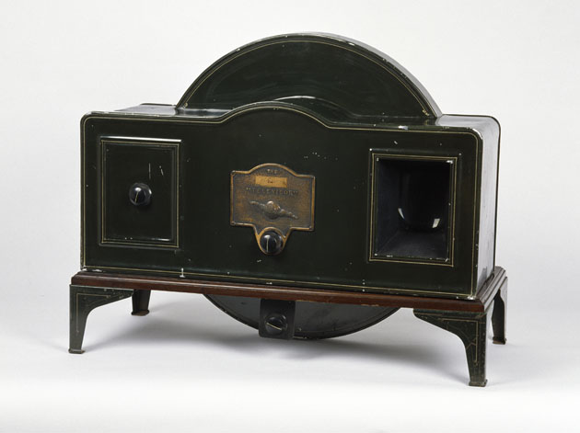
Question 8
In 1928 Scottish inventor John Logie Baird tested his famous invention. What was the invention?
A)Microwave
B)Telephone
C)Television
Notes:
Answer: C) Television - John Logie Baird born in Helensburgh, demonstrated the first live working television system in January 1926.

Slide 33
Question 8
In 1928 Scottish inventor John Logie Baird tested his famous invention. What was the invention?
C)Television
Notes:
Answer: C) Television - John Logie Baird born in Helensburgh, demonstrated the first live working television system in January 1926.

Slide 34
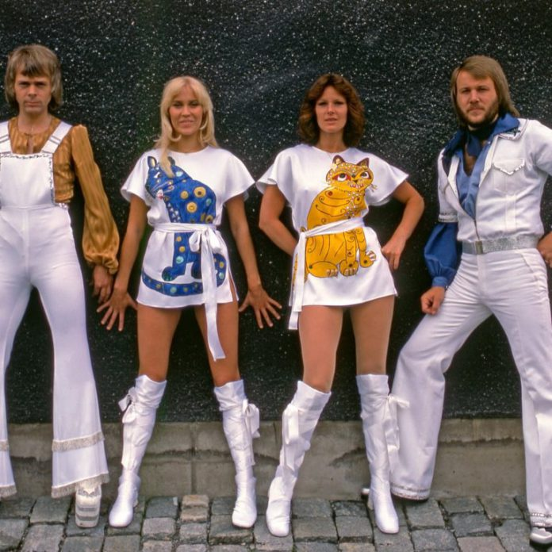
Question 9
Which of the Abba hits below features the lyric, “I was sick and tired of everything when I called you last night from Glasgow”?
A)Mamma mia
B)Dancing Queen
C)Super Trouper
Notes:
Answer: C) Super Trouper

Slide 35
Question 9
Which of the Abba hits below features the lyric, “I was sick and tired of everything when I called you last night from Glasgow”?
C)Super Trouper
Notes:
Answer: C) Super Trouper

Slide 36


you have reached the end of the presentation, we hope you have enjoyed it
Presented to you by the Open Museum team

