Slide 1




Slide 2
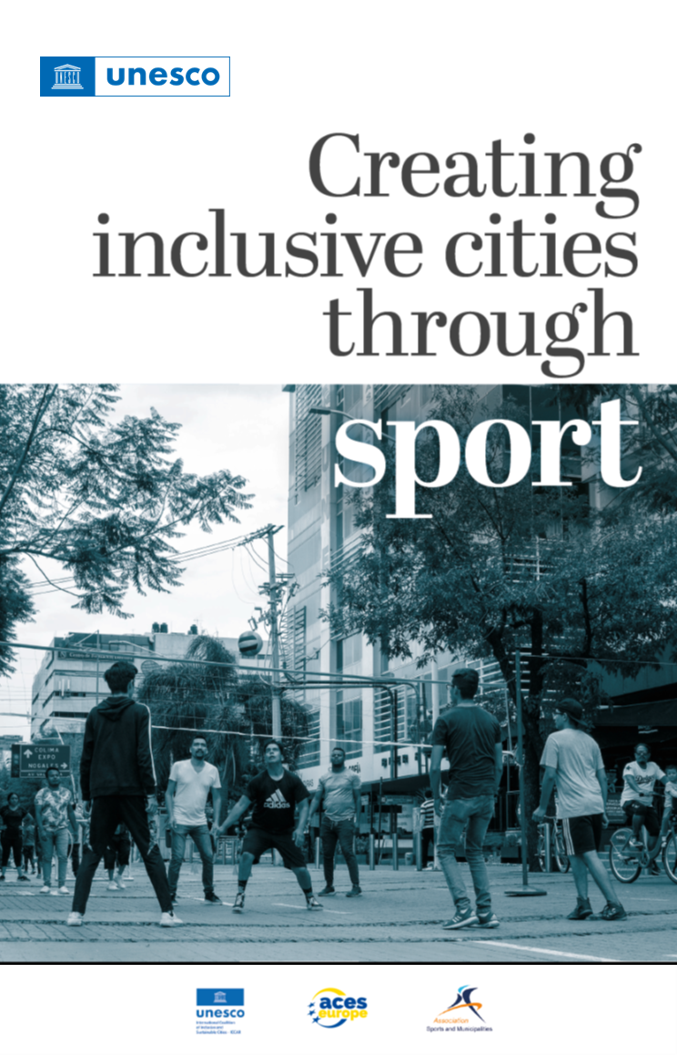

Slide 3
A STRONG WORLDWIDE NETWORK
MORE THAN 3.500 CAPITALS, CITIES AND REGIONS OF SPORT
Awareness at an integrated level: Sport and health in all policies: local, regional, (inter)national;
Capacity building: creating strong organizations;
Knowledge sharing between municipalities, regions and municipal umbrella organizations at (inter)national level
Good examples with evidence-based interventions;
Based on data: for measuring Social Return on Investment and monitoring
Customization: Policy problems are complex and differ per neighborhood, municipality, province, region or country.

Slide 4
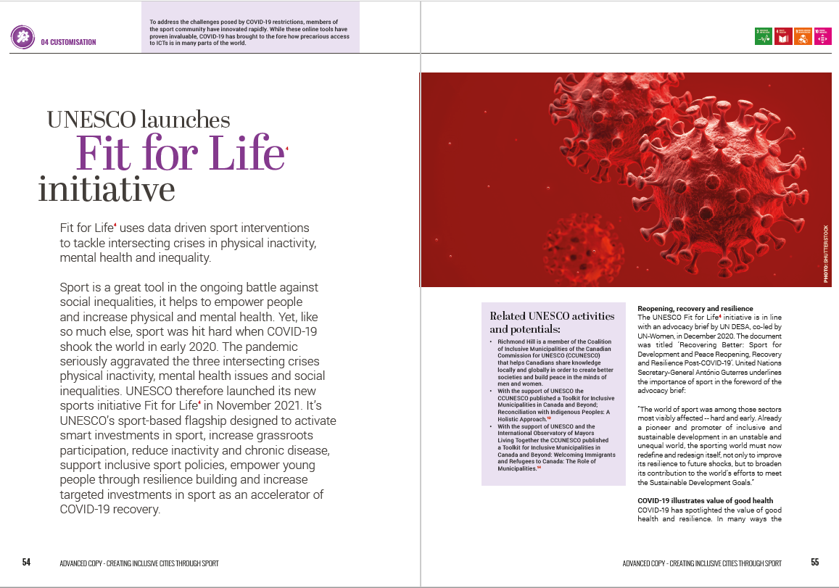
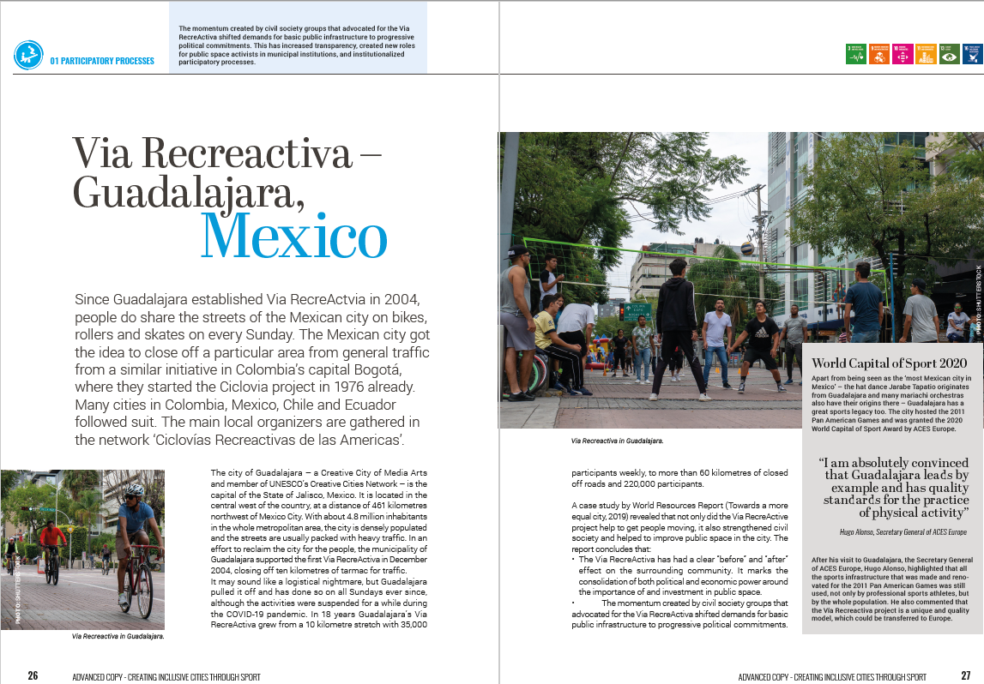
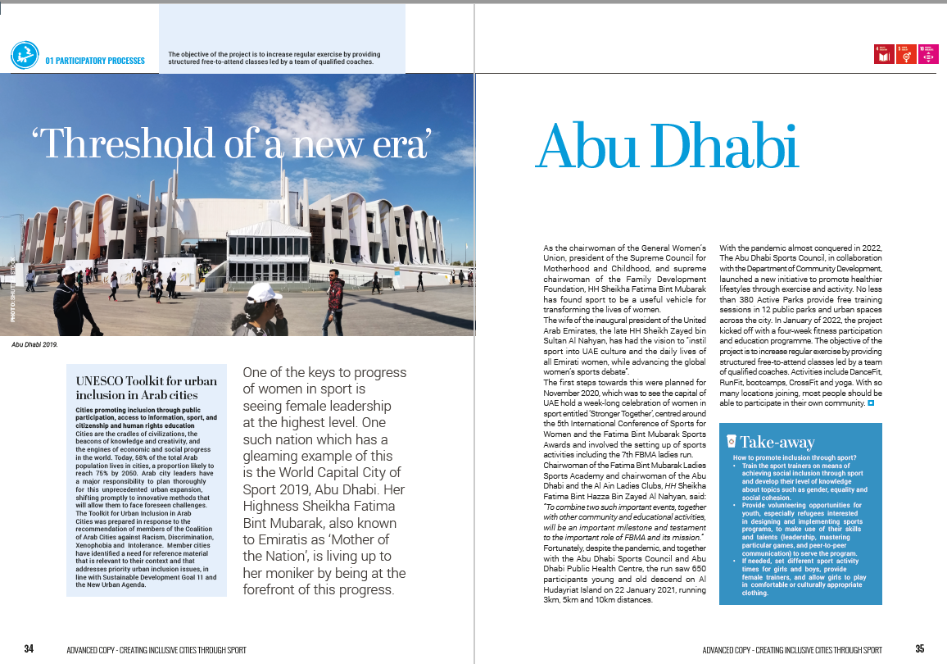
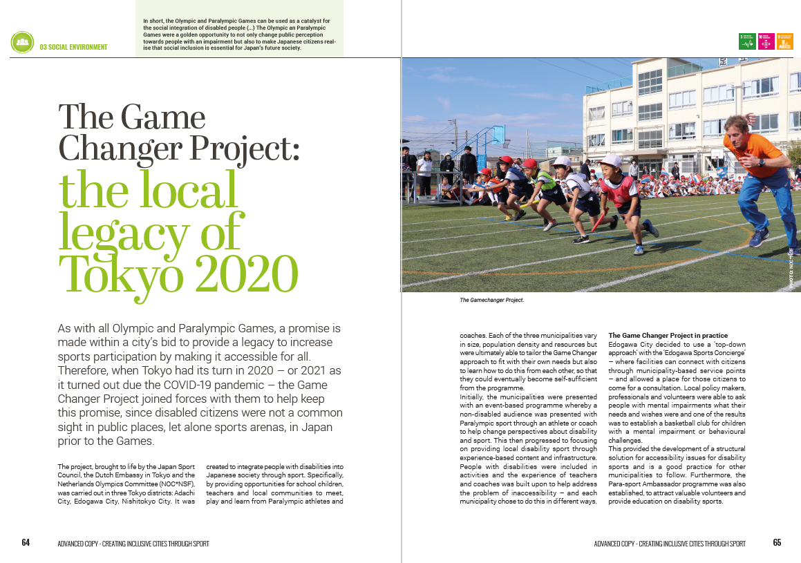
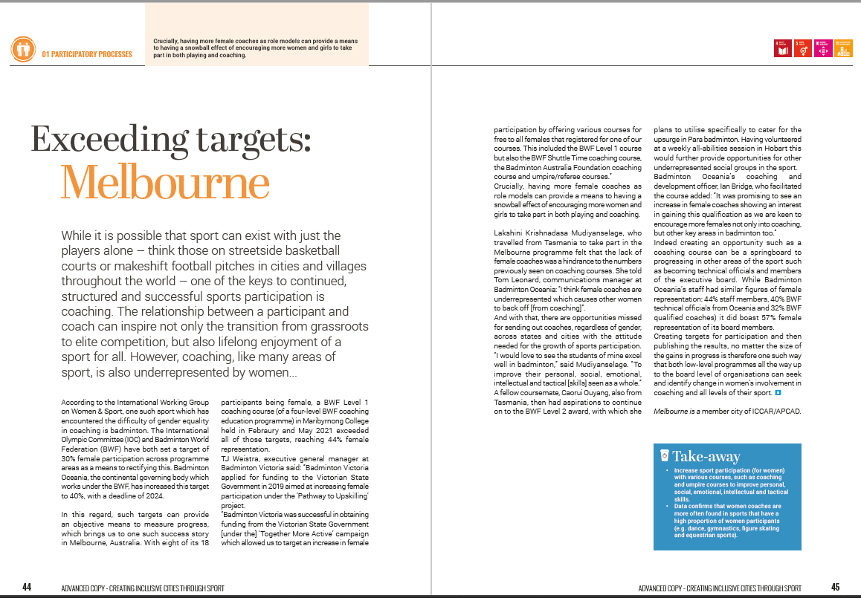
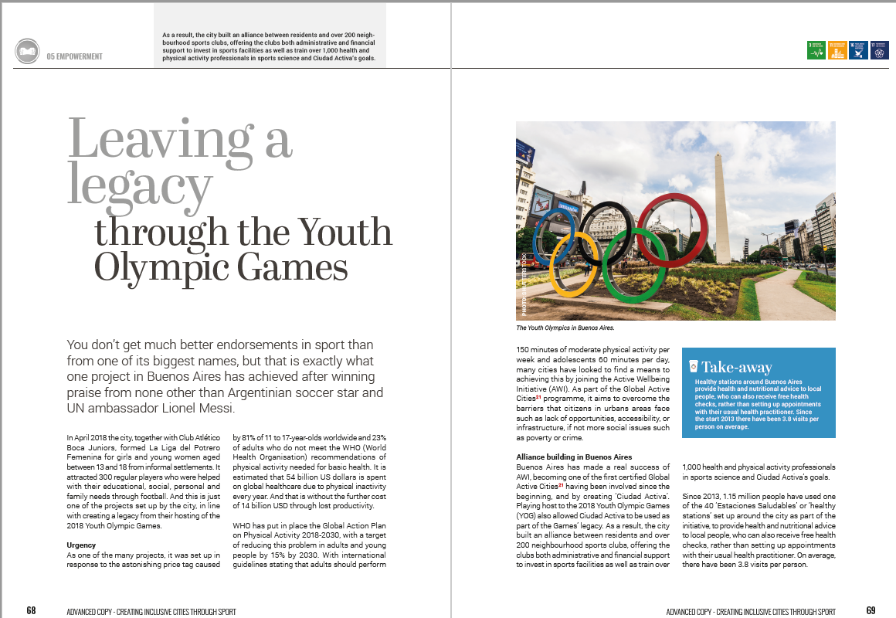
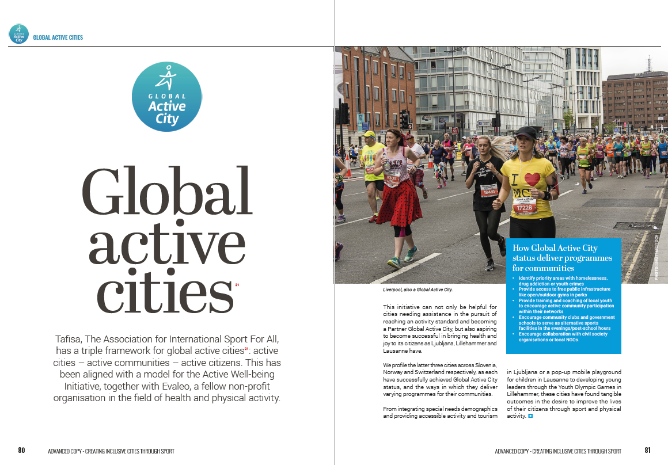

Slide 5
Cities work everyday fo a healthier and more active future for everyone!

Slide 6
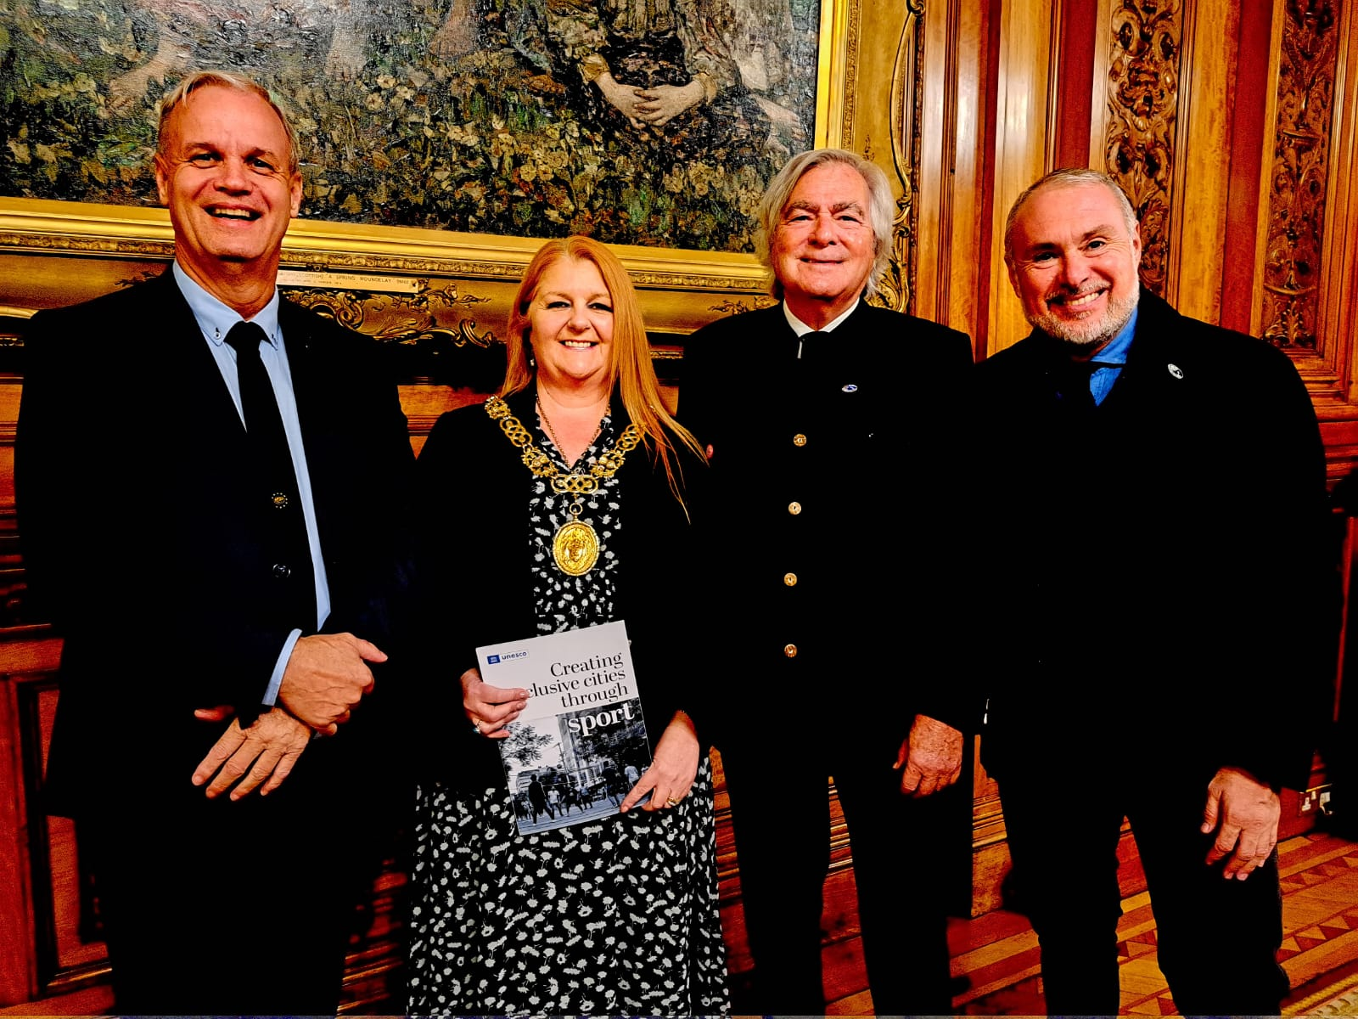
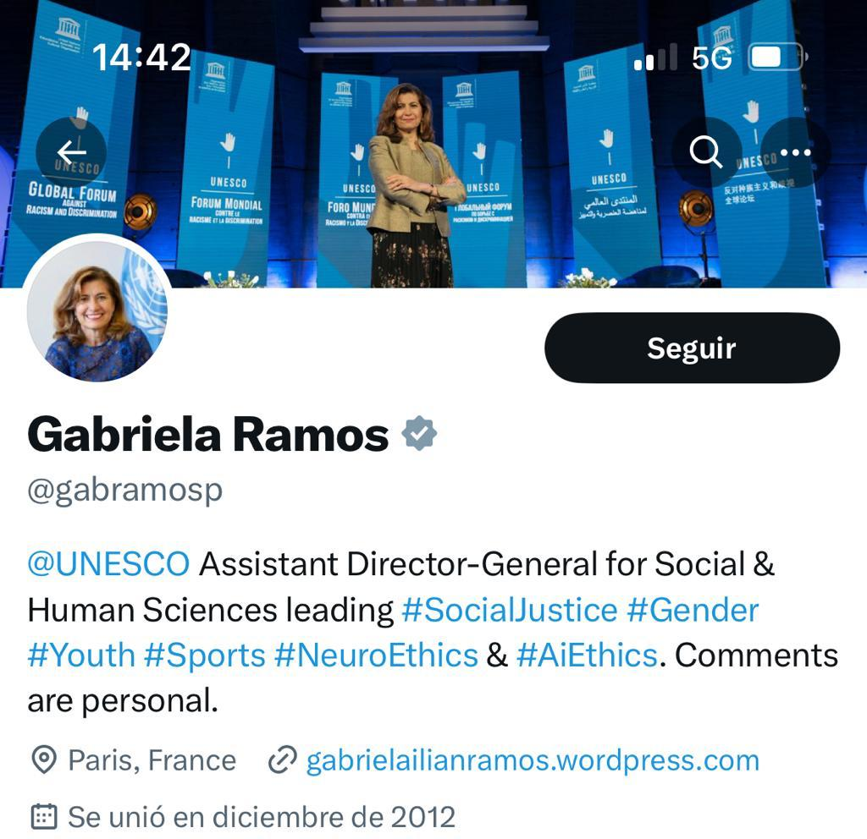
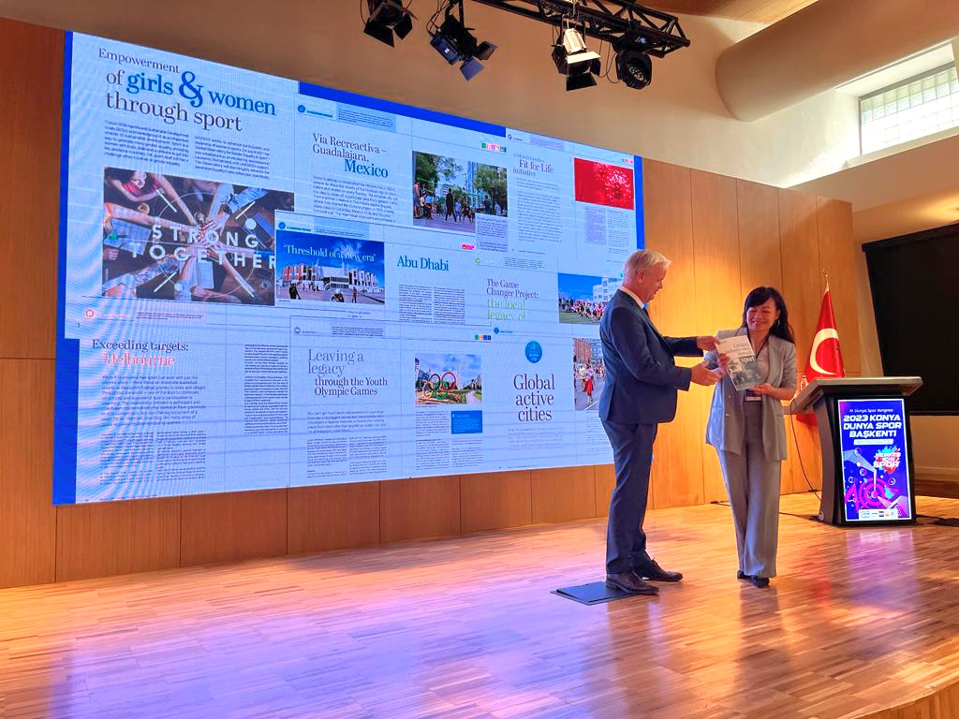
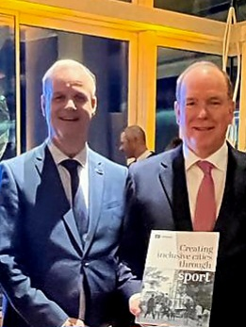
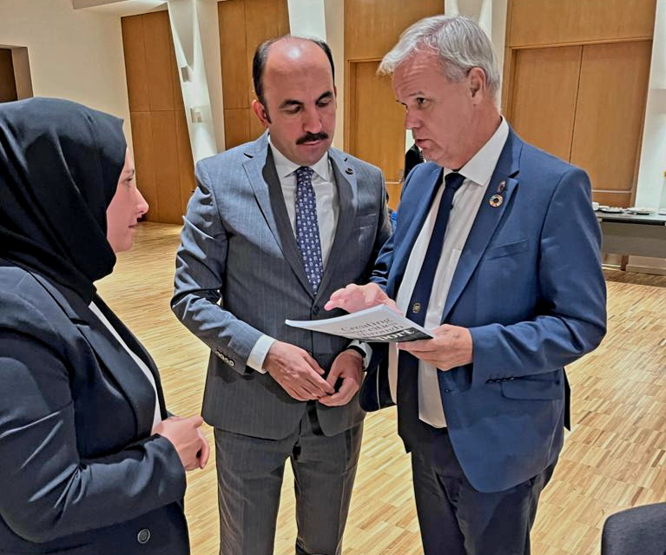
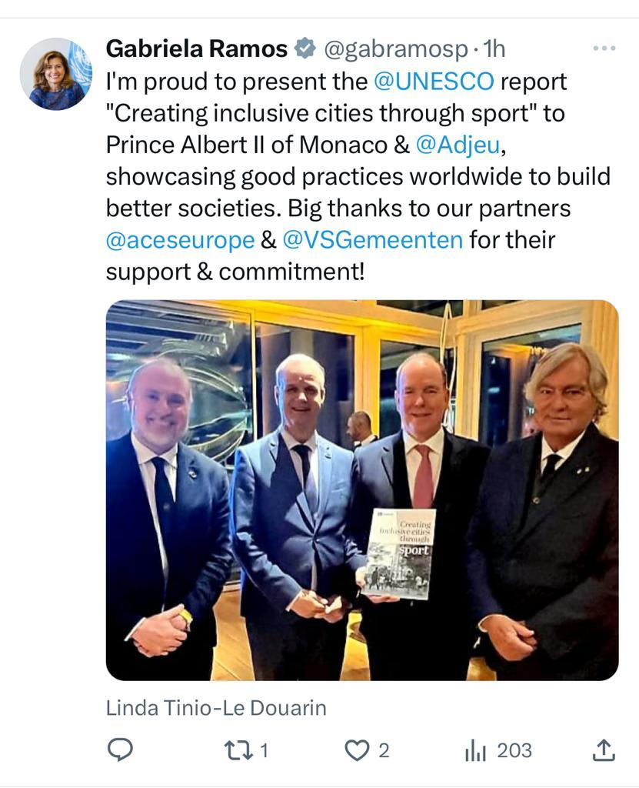

Slide 7

The activity friendly environment model Social Return on Investment: working with data for integrated policymaking
André de Jeu, Glasgow, 26 October 2023

Slide 8
A healthy lifestyle in an unhealthy environment is (almost) impossible…
Where do we start: the individual or the environment? What does the municipality have (more) control over?

Slide 9
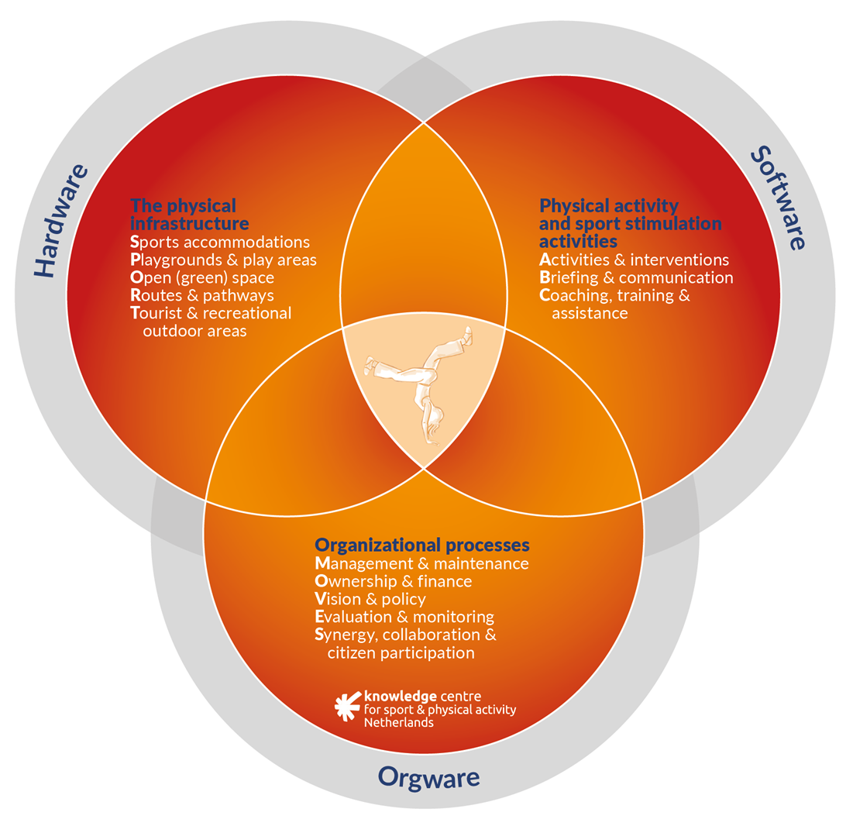
The activity friendly environment-model: Hardware, software, orgware
To create a physical activity friendly environment, you need to combine three particular elements:
Hardware: everything that is physically present in public space;
Software: the activities that are offered in that public space, and;
Orgware: the organizational process behind both hardware and software.
All three elements need to be present and in tune. Only then can your citizens be optimally physically active.

Slide 10
The activity friendly environment-model: Hardware
This needs to be accessible to everyone and facilitate sports, play and physical activity.
Sports accommodations: indoor and outdoor
Playgrounds & play areas: schoolyards, public playgrounds, skate parks, lawns, play areas, etc.
Open (green) space: squares, parks, lakes for recreational purposes, etc.
Routes & pathways: includes sidewalks, walking paths, bicycle paths and highways, recreational routes, inline skating routes, horse trails, etc.
Tourist & recreational outdoor areas: forests, dunes, beaches, etc.

Slide 11
The activity friendly environment-model: Software
Activities & interventions: all sport events, programs, interventions, tournaments, etc. in both private and public space. Also specific interventions that schools, municipal health services, municipalities, health and welfare organizations or others can use to stimulate specific groups to engage in physical activity.
Briefing & communication: campaigns, wayfinding, websites or applications to inform people about different options for physical activity. Also a sign next to an outdoor fitness area that (visually) explains how to use the different fitness equipment can encourage people to try it out.
Coaching, training & assistance: community sports coaches, youth workers, social workers, trainers, instructors, childcare centers, community managers and volunteers to train, coach and assist. These people should be based in the community and know the people, so they can get in touch with (potential) users, can help them become more physically active, or can talk about their wishes and needs.

Slide 12
The activity friendly environment-model: Orgware
The organizational process of accomplishing and maintaining the hardware and software.
From a policy point of view, the municipality is responsible for and in charge of any physical activity friendly environment…
BUT DON’T ACT ON YOUR OWN!
Involve partners: the community, sports clubs, schools, community sports coaches, welfare organizations, housing corporations, project developers, etc.
Management & maintenance: (participatory) designing, building, organizing, managing and maintaining locations, routes and areas.
Communicate: creating support for the development of sports and play areas through communication with local citizens is key. This will create a sense of ownership among residents and users, which will in turn lead to a sense of shared responsibility to maintain and manage the area.
Ownership & finance: an integrated and intersectoral financial approach is necessary. Investments will pay off for multiple sectors, not only in financial terms, but also through greatly improved health outcomes and more sustainability.

Slide 13
The activity friendly environment-model: Orgware
Vision & policy: It is not a temporary investment. Most of the return requires a long-term perspective. Formulate a strategic vision for a HEALTHY AND ACTIVE CITY, include goals for a physical activity friendly environment.
Included in the policy other sectors that can contribute: healthcare, welfare, sport and recreation, urban development, traffic and transport, etc.
Evaluation & monitoring: gain insight into what works, for whom, when and why. Also, remember to evaluate the process: how did the cooperation between different involved sectors and stakeholders go?
Synergy, collaboration & citizen participation: When designing public spaces, it is important to take users’ wishes and needs into account. Local citizens can often pinpoint bottlenecks and opportunities. If you work with partners,include other municipal departments and involve the community, you can achieve synergy and multiple goals.

Slide 14
The activity friendly environment-model: People
People are key: every project that aims to create a physical activity friendly environment should start from a sense of urgency seen and felt by the locals.
Participatory planning, -design and -maintenance are valuable aspects that help make a physical activity friendly environment successful.

Slide 15
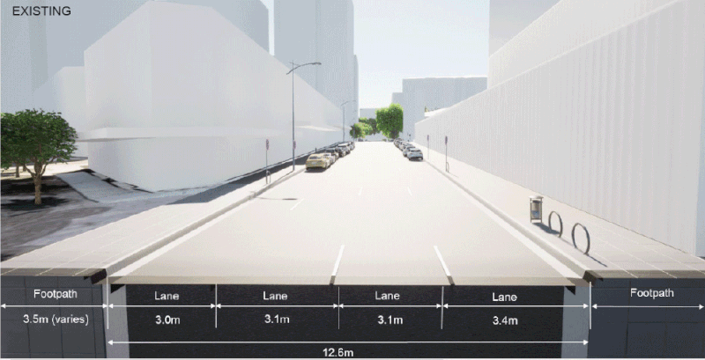

Slide 16
Let’s talk about data based policymaking

Slide 17
Don’t forget… figures are about people

Slide 18
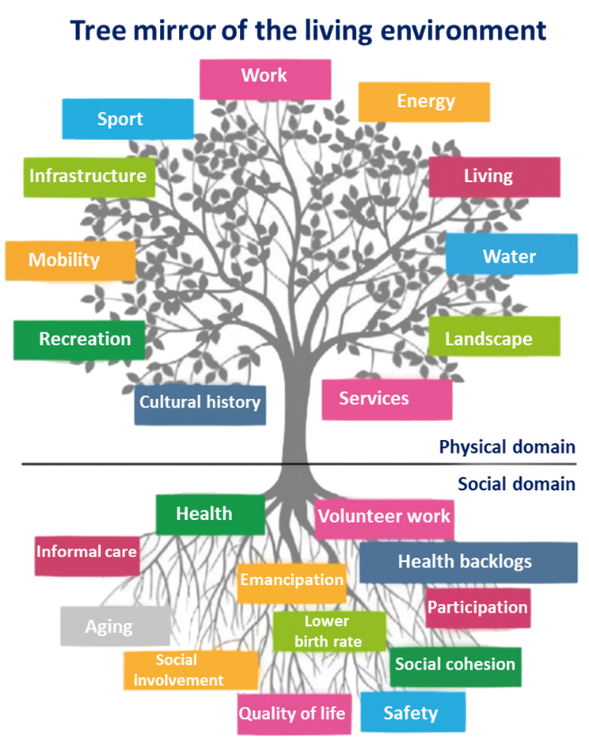
The separate worlds in urban planning, but…

Slide 19
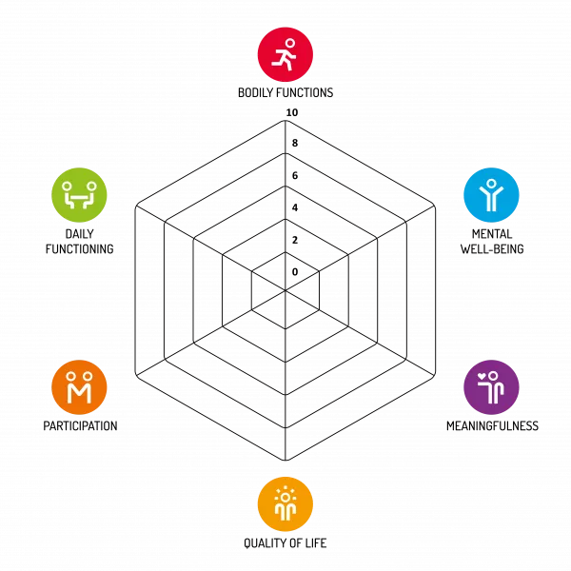

Involve the people

Slide 20
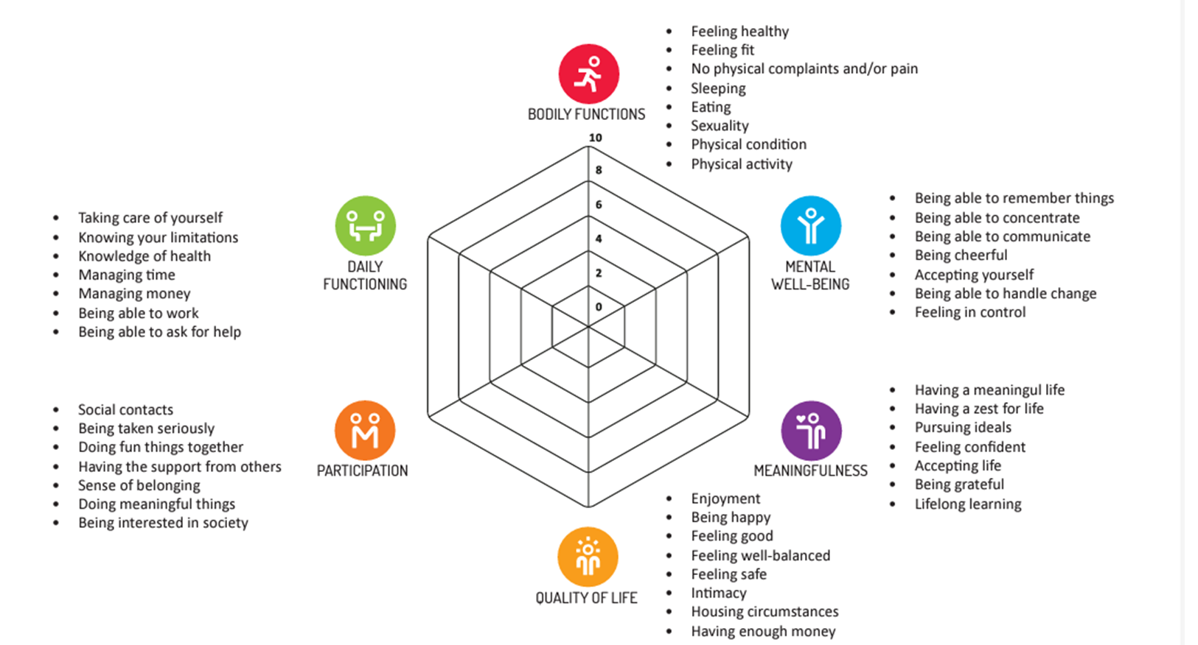
Involve the people

Slide 21
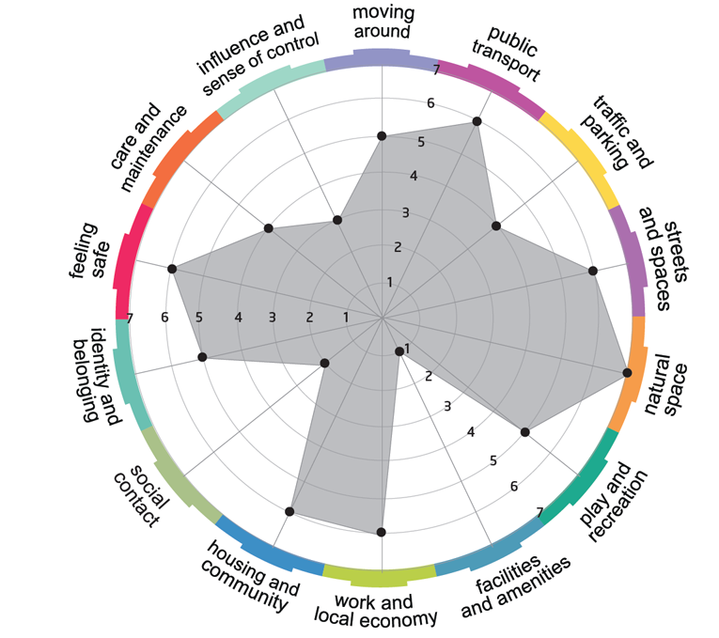
Involve the people
Place Standard (Scotland)
An instrument to determine the quality of a living place;
Can be applied to places that are already there, that are changing, or are still in the planning phase;
Based on knowledge about the positive role that the environment can play in reducing health inequalities;
14 simple questions;
Can be used by residents and/or professionals, individually or in groups;
Provides a visible outcome and offers structured conversations about important themes;
Not normative or standardizing.
It's about WHAT you “FEEL” about it!
https://youtu.be/kbEh9wv60Lc?si=jXLSiMFKYMnaUEjk

Slide 22
How to present data?
Economics
Cycling is a low-cost mode of transport for both individuals and society. Cycling requires a lower individual investment than driving a car, making it more affordable. Each kilometer cycled yields a benefit to society whereas each kilometer done by car and public transport generates a cost on society.

Slide 23
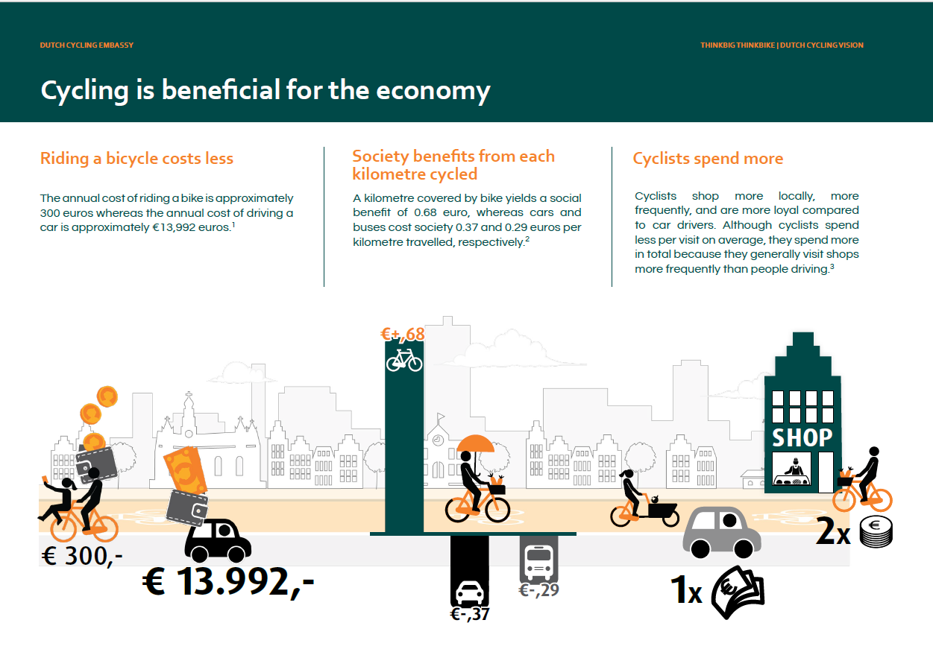

Slide 24
How to present data?
Environment
Cycling and walking are the means of transport that have the least impact on the environment. Switching from driving to cycling reduces carbon emissions and improves air quality. Cycling is good for the planet and for quality of life in cities, increasing the resilience of both.

Slide 25
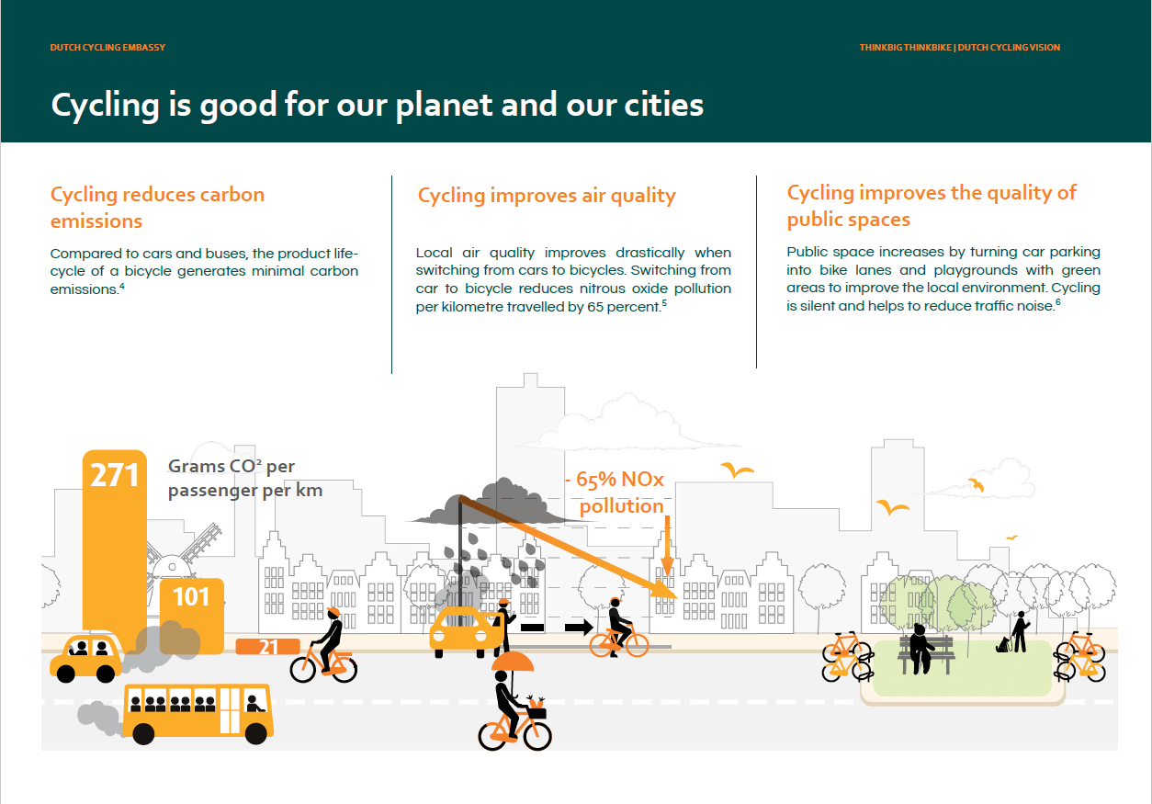

Slide 26
How to present data?
Health
Cycling is good for you! Riding a bicycle is a healthy, enjoyable, and low impact source of physical activity for all ages and abilities. Employees who cycle to work are less likely to call in sick. Cycling keeps you fit longer and your immune system strong. Not only is cycling beneficial for your physical health, but it can do wonders for your mental health as well. No matter the conditions, people will bike with others to various destinations as a method of social mobility. In conclusion, cycling contributes to a healthy lifestyle.

Slide 27
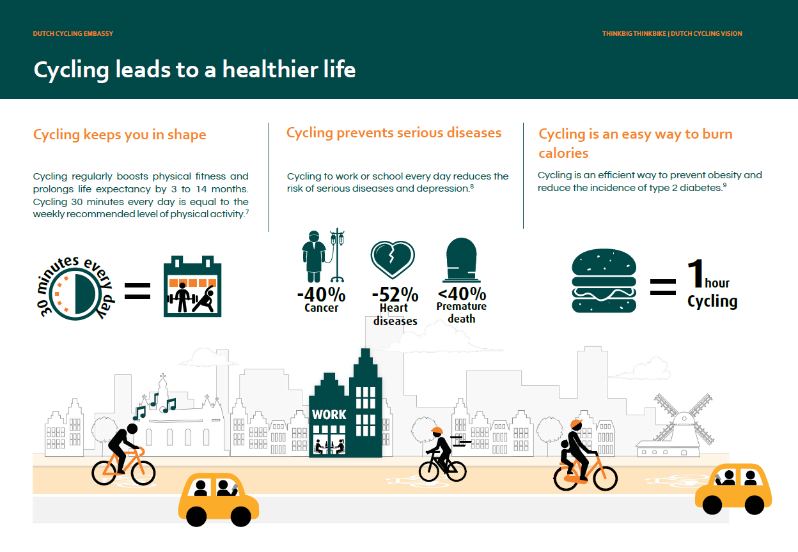

Slide 28
How to present data?
Happiness
People who cycle regularly associate cycling with happiness. Cycling encourages social interactions between different road users. It improves mental health, well-being, and helps reduce stress. Cycling is associated with convenience, independence, and flexibility.

Slide 29
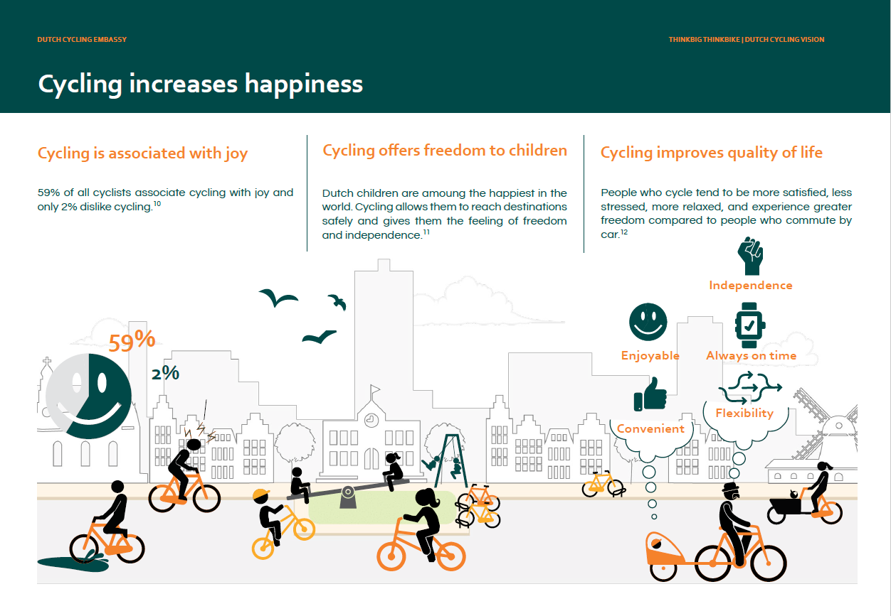

Slide 30
How to present data?
Accessibility
Cities are struggling for space. As the number of residents continually grows, there is increasing competition for a limited amount of public space. Since bicycles take up less space than a car, replacing cars with bicycles frees up space in order to create more room for green space and for people to meet each other.

Slide 31
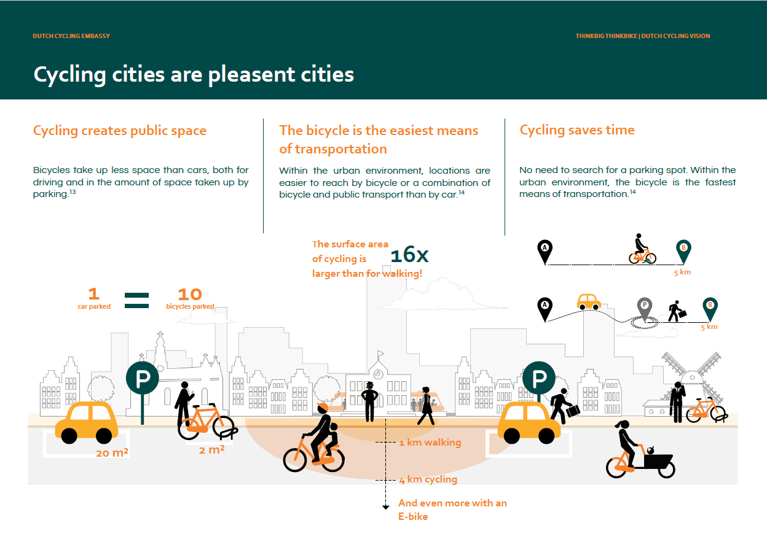

Slide 32
How to present data?
Safety
Policies that improve the safety of walking and cycling create cities safer for pedestrians and cyclists, but more broadly for all road users. Statistically, cyclists are less likely to cause deadly collisions.

Slide 33
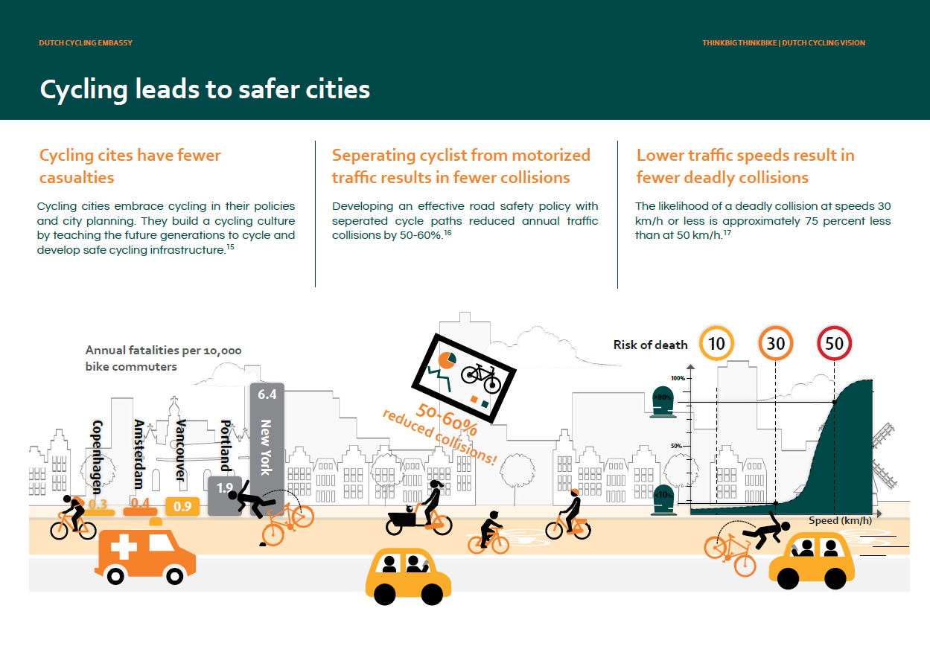

Slide 34
How to present data?
Social Equity
Cycling is a democratic mode of transportation. It offers greater mobility to virtually everyone regardless of origin, age, income, gender, or physical ability, promoting social inclusion. The bicycle increases social participation and is an inexpensive solution to transport poverty.

Slide 35
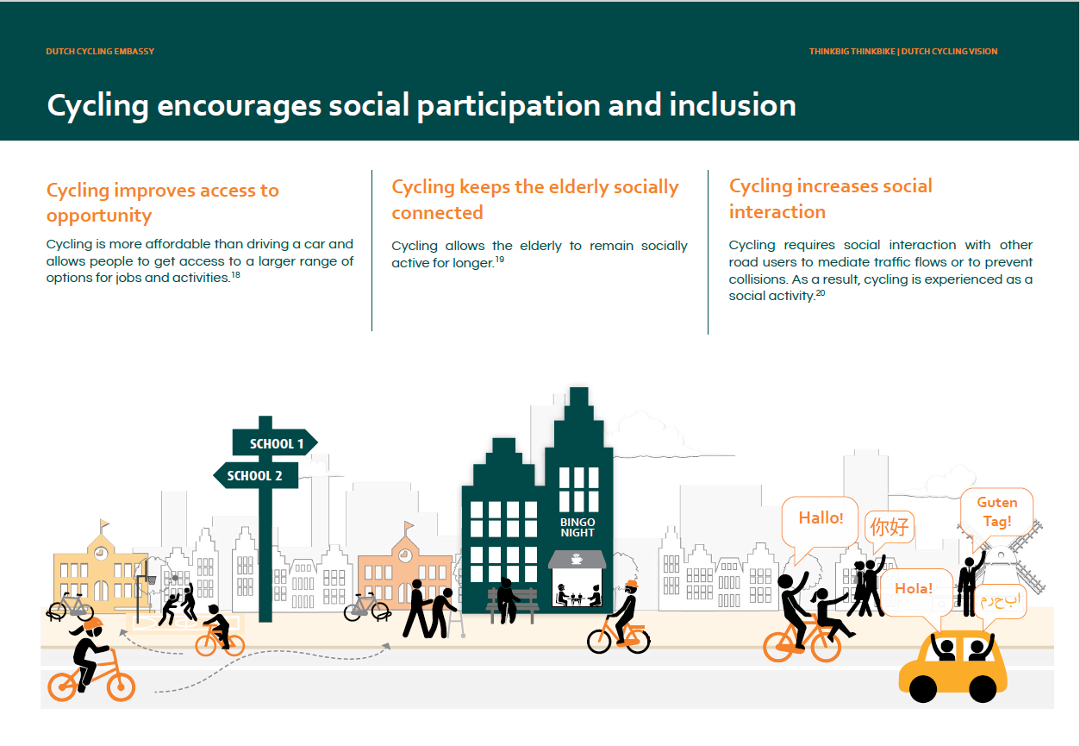

Slide 36
Ok, now we know this, what’s next?

Slide 37
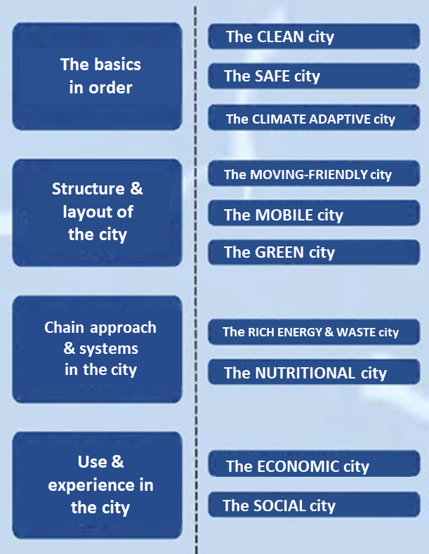
Let’s work on…
Long, healthy, vital, social and independent living together in clean, safe, pleasant, sustainable, caring and economically prosperous cities!

Slide 38
Nice story, but….
Let’s talk about money now

Slide 39
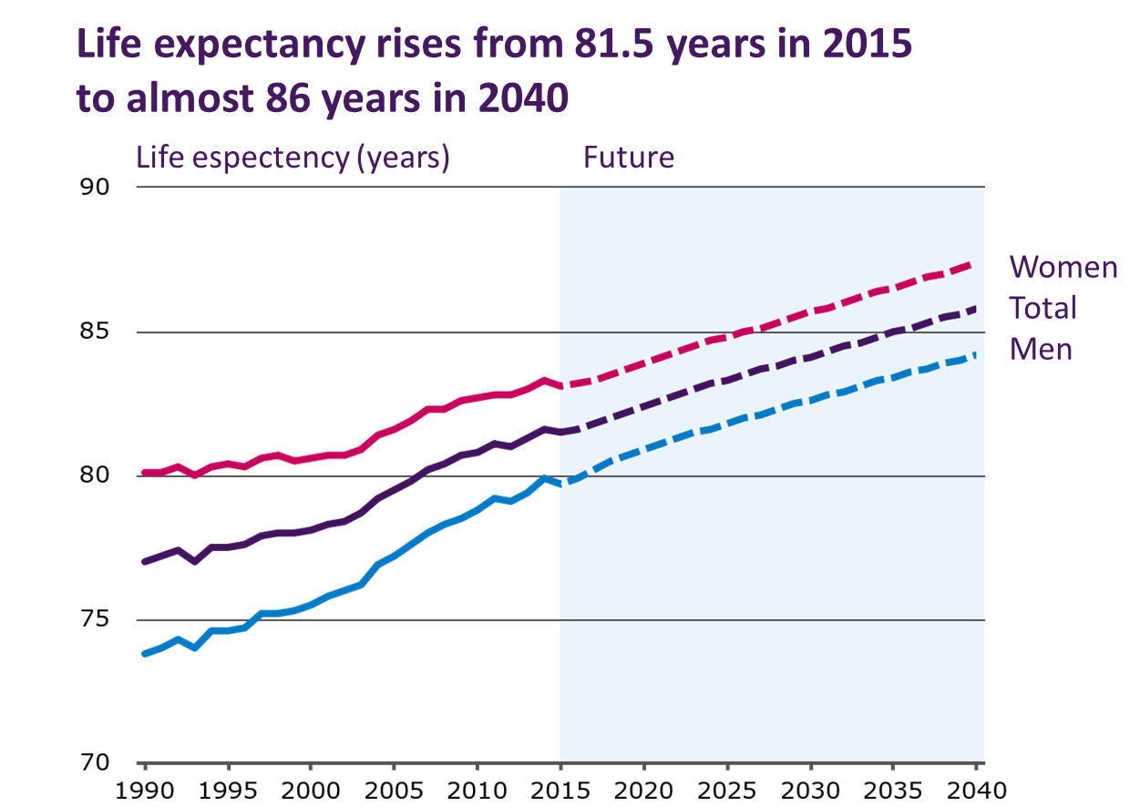

Women

Slide 40
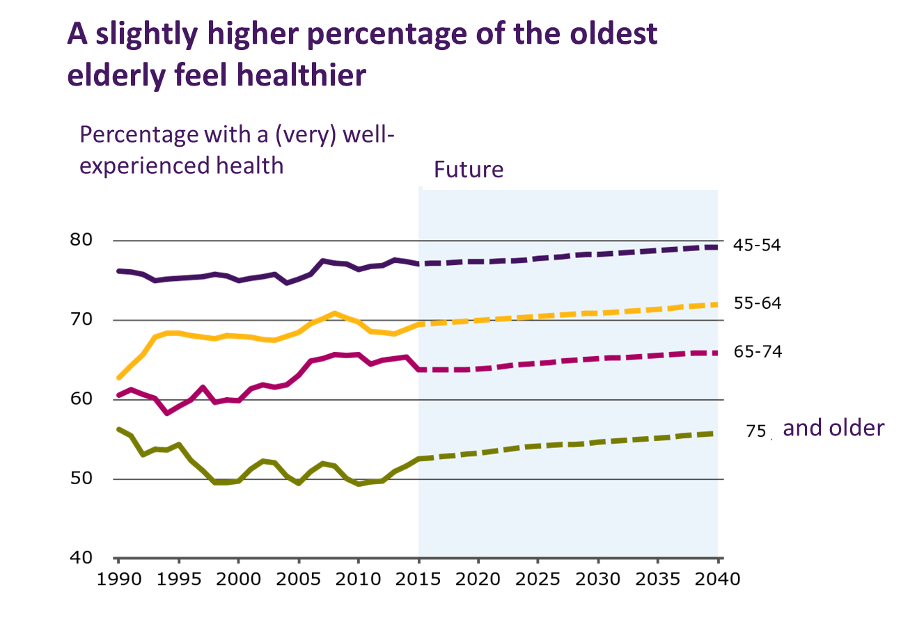

Slide 41
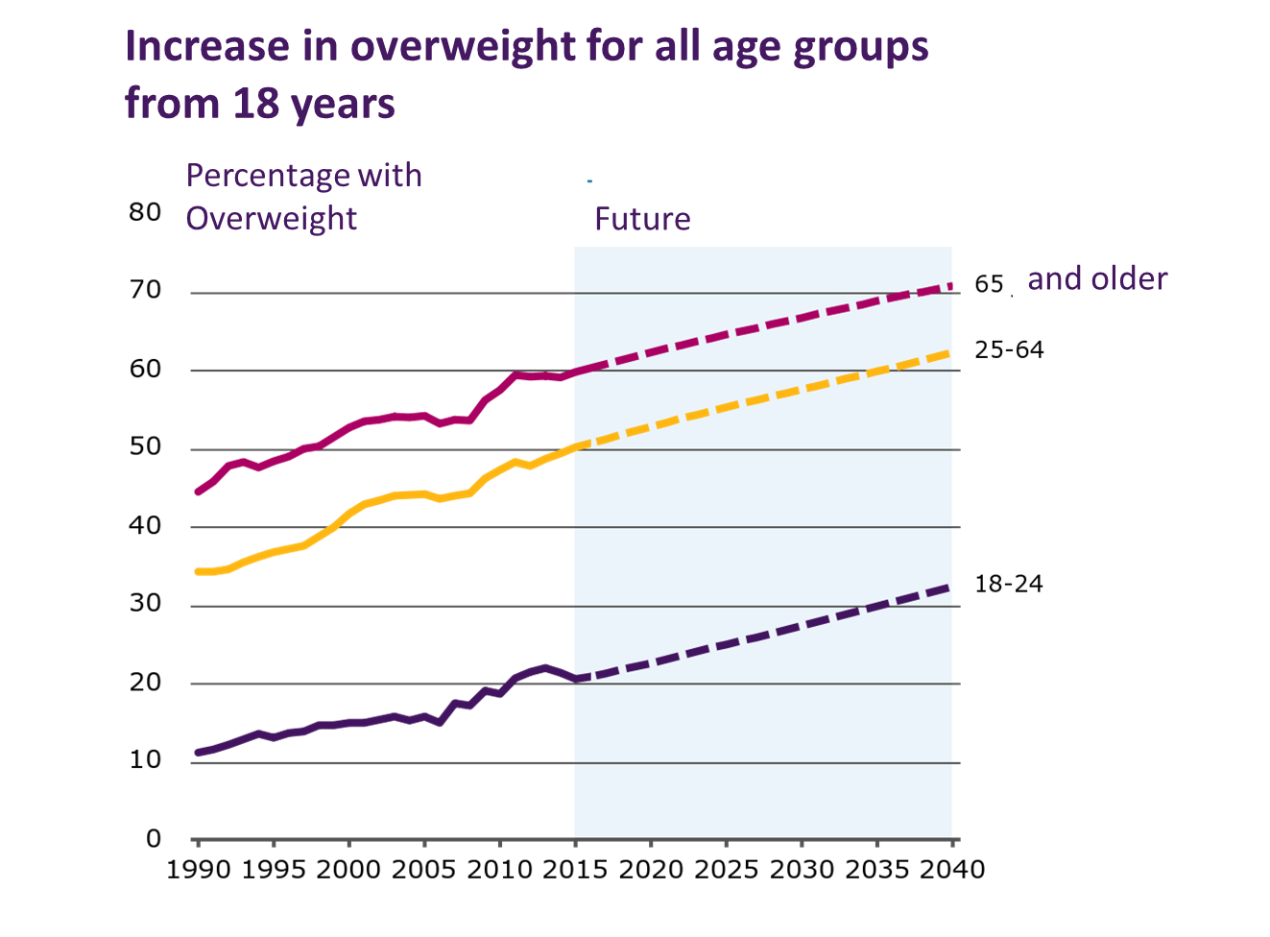

Slide 42
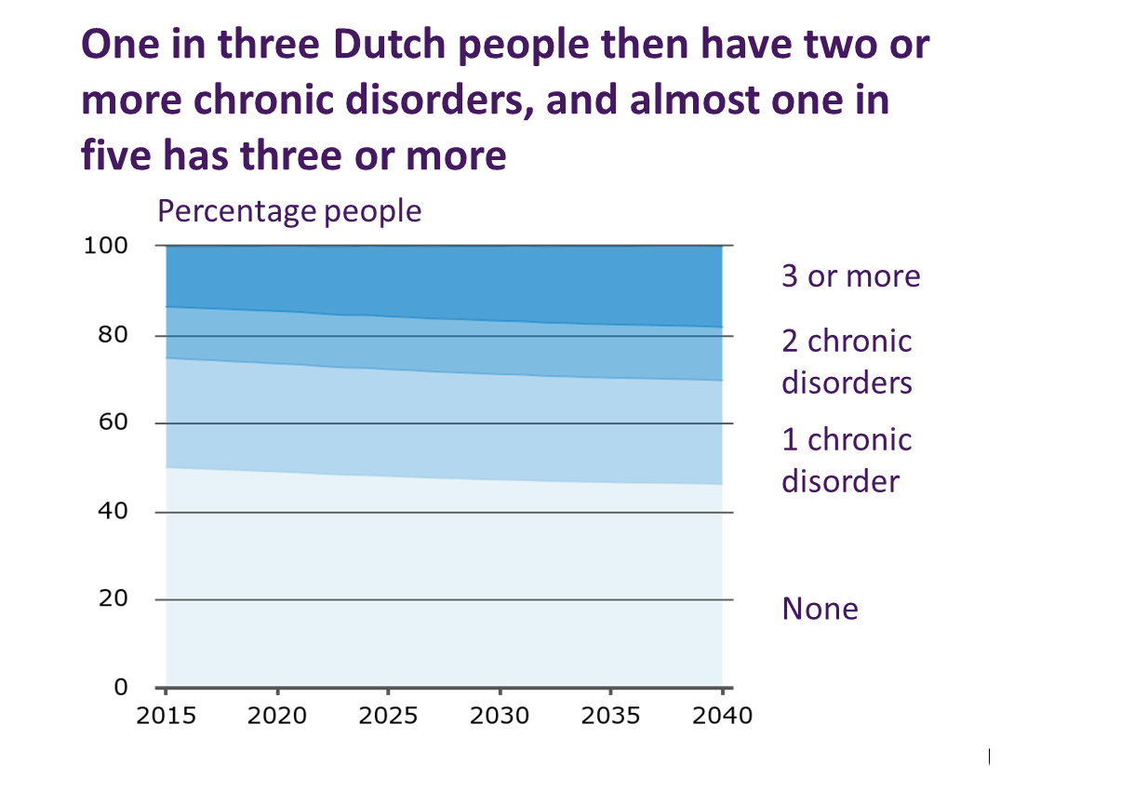

Slide 43
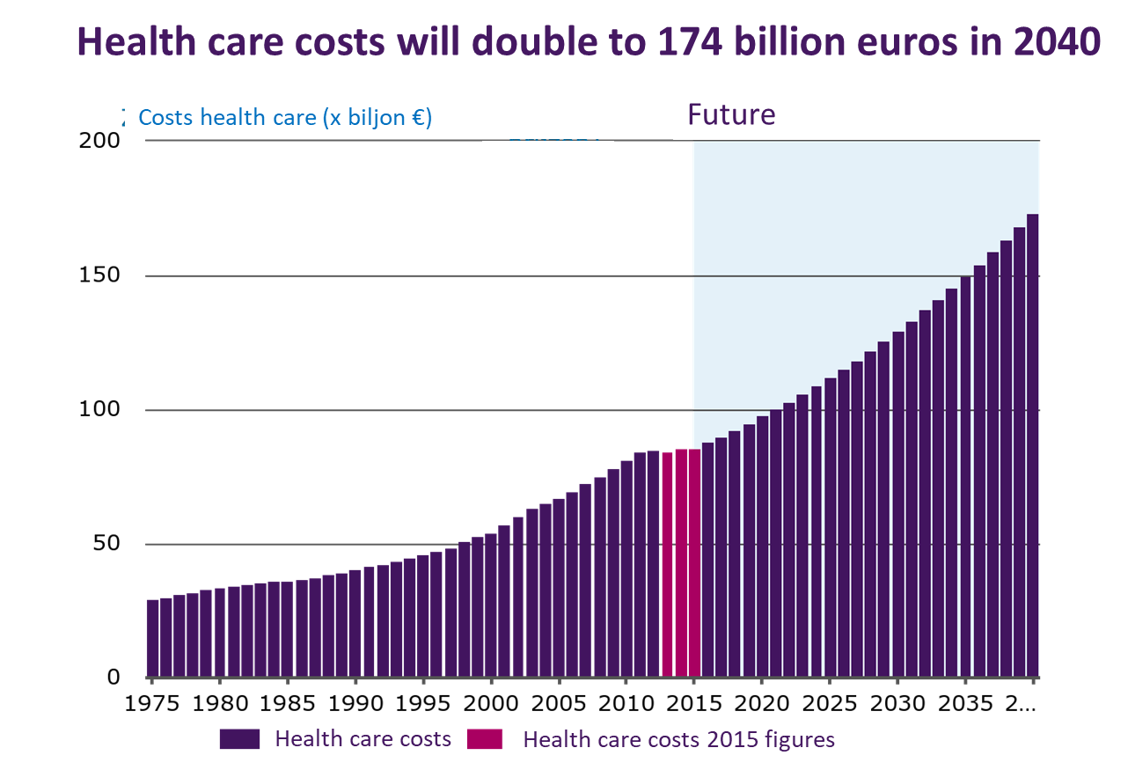

Slide 44
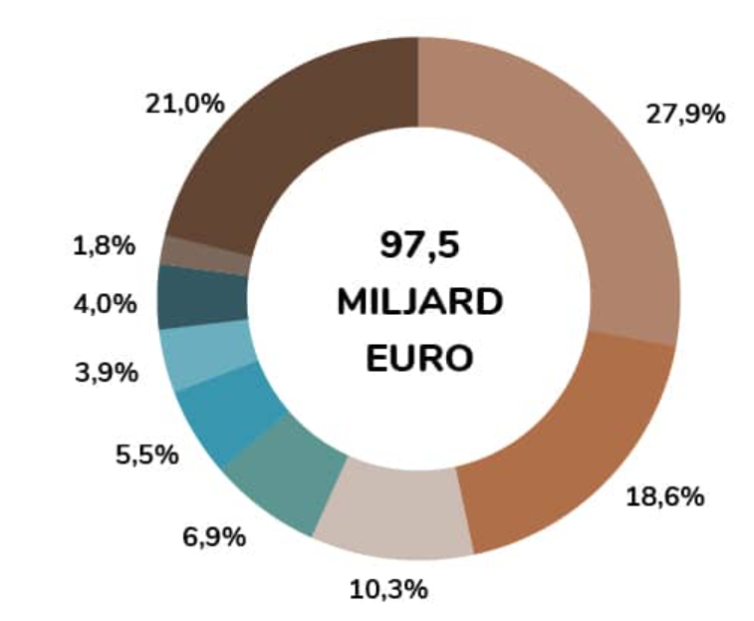
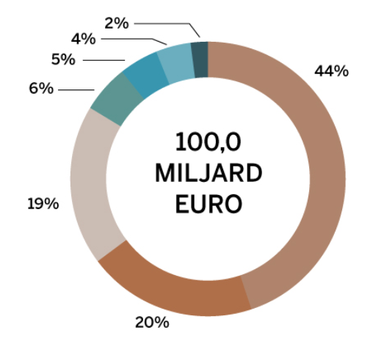
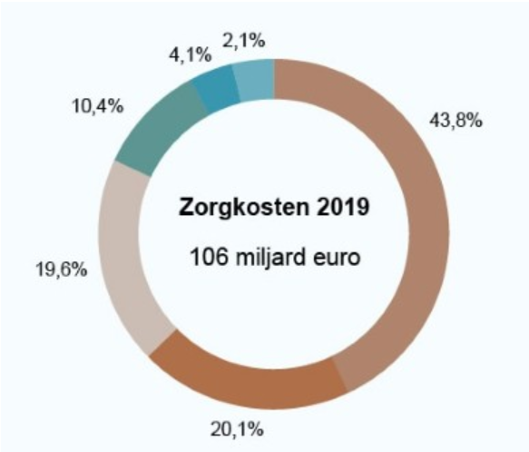
2017 2018 2019
97,5
Billion
euro
100
Billion
euro
106
Billion
euro

Slide 45
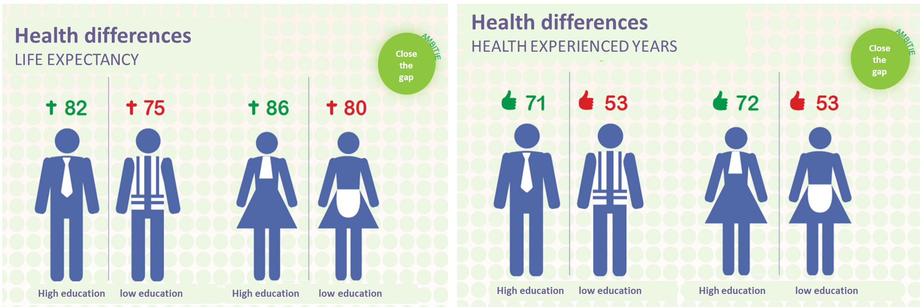

Slide 46
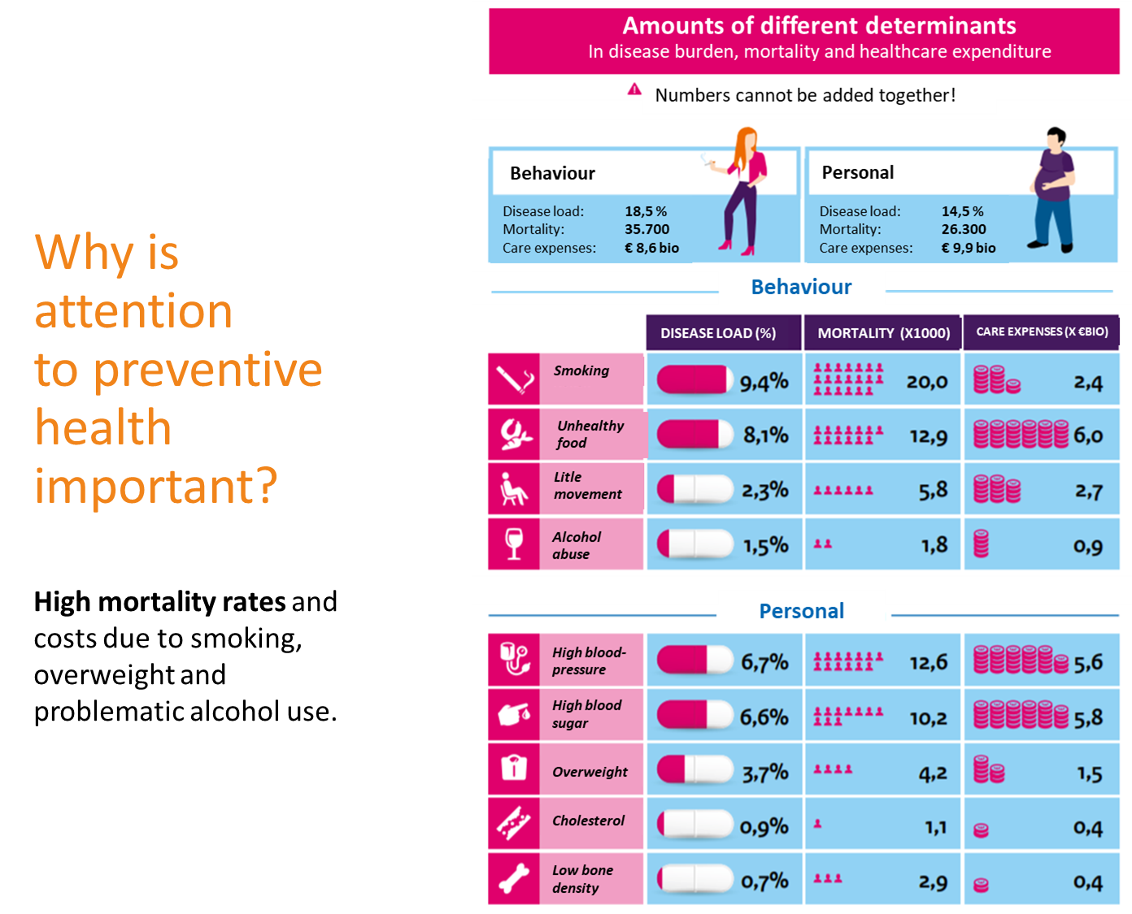

Slide 47
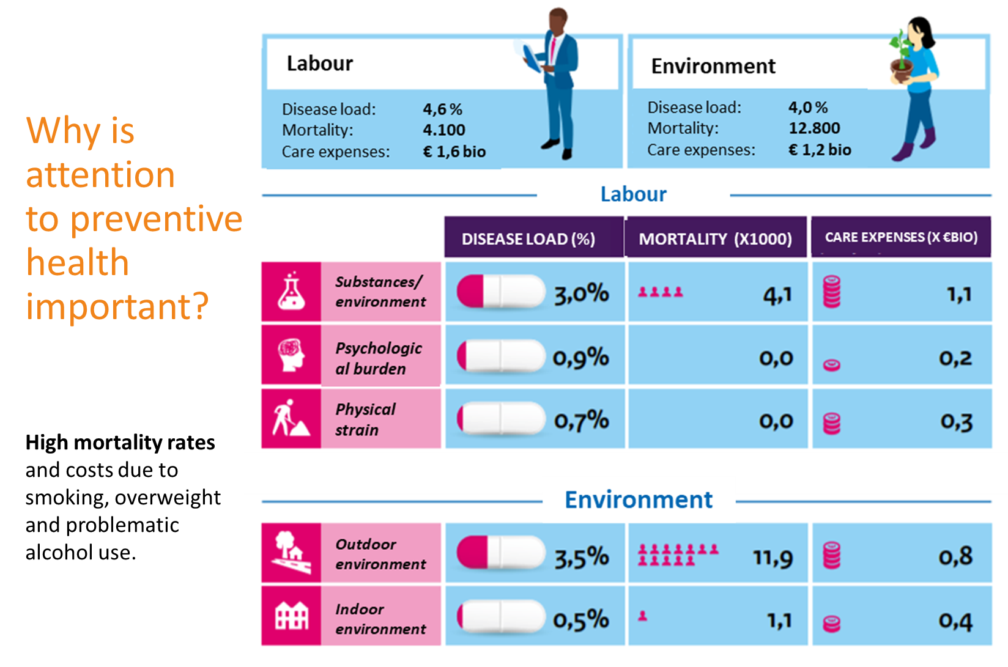

Slide 48
2. Frequency of physical activity outside of sports
And how often do you do other forms of exercise, such as cycling, dancing, gardening, etc.?(%)
Rarely or never
Gender
Men
Women
Gender and age
Man 15-24
Man 25-39
Man 40-54
Man 55+
Woman 15-24
Woman 25-39
Woman 40-54
Woman 55+
Inner chart
outer chart
Profession
Regularly
Independent
Managers
Servants
Manual workers
House persons
Unemployed
Retirees
Students
With some regularity
Rarely
Never
Don’t know

Slide 49
SO WHY INVEST IN SPORT AND PHYSICAL ACTIVITY? The social and economic value of sport SOCIAL RETURN ON INVESTMENT BY SPORT AND PHYSICAL ACTIVITY

Slide 50
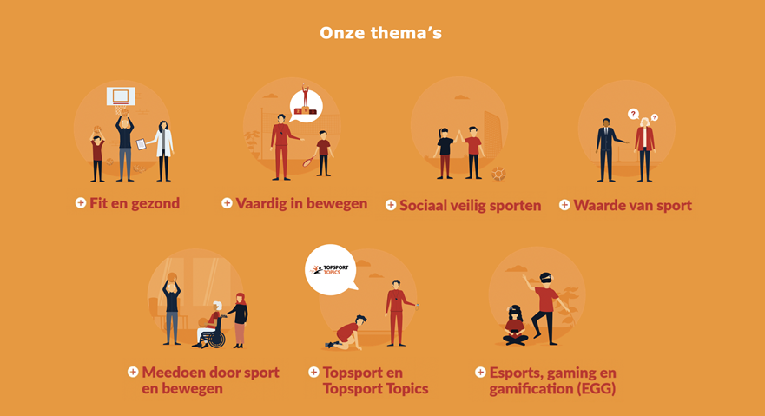
Our topics
Value of sport and exercise: Proven Effects - Can be expressed in euros - SROI of sports and physical activity
Fit and healthy
Skilled in moving
Social safe sport
Value of sport
Participate through sport
Elite sports
E-sports, Gaming
Gamification (EGG)

Slide 51

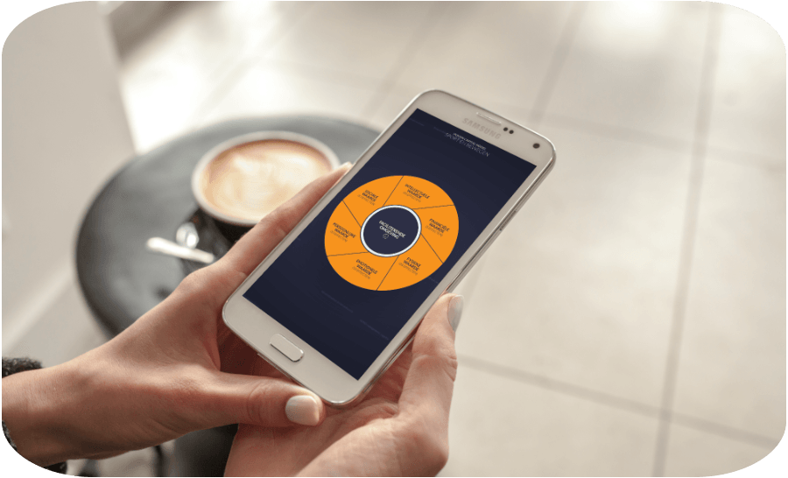
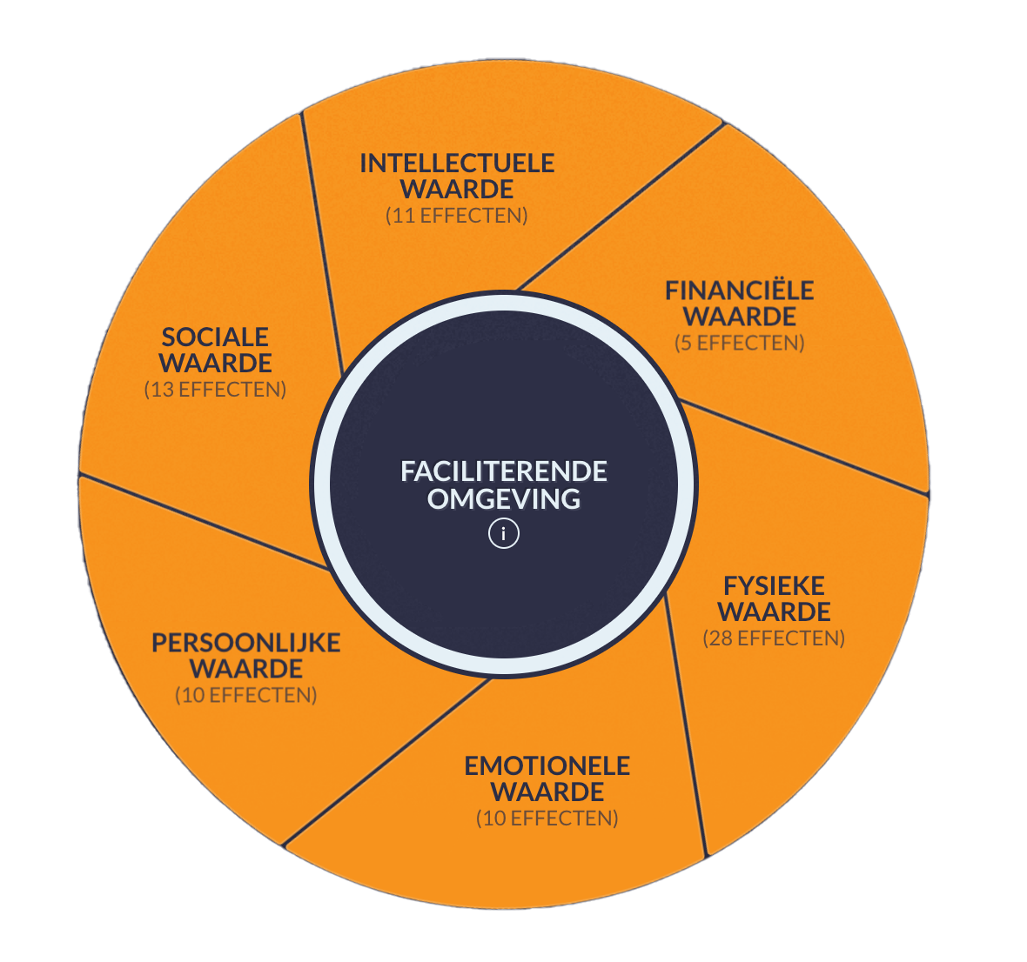
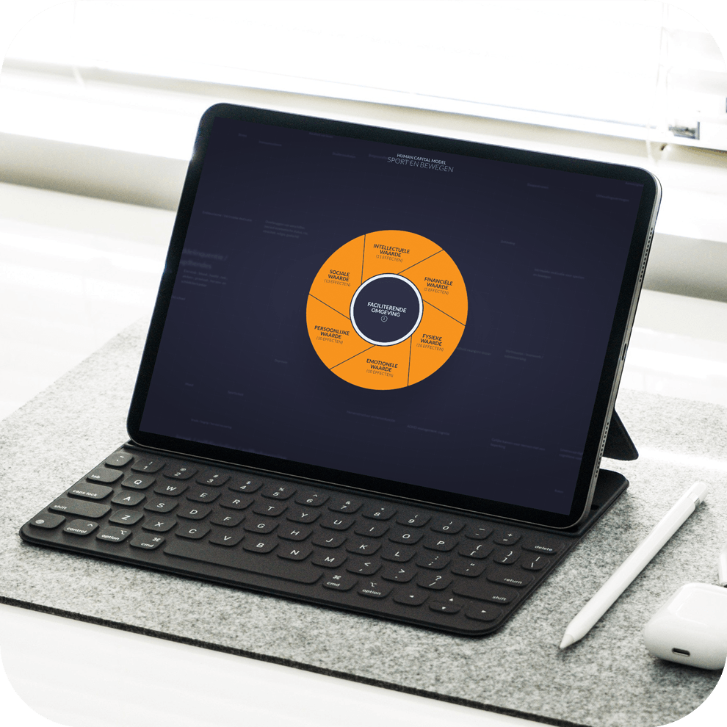
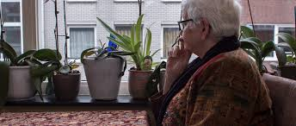

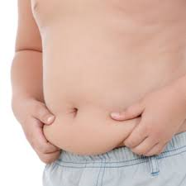
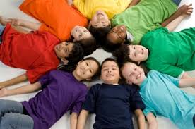
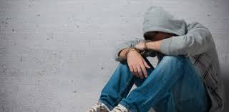
Human Capital Model: 77 proven effects
Move your brain, dont sit
Intelectual value
11 effects
Financial
value
Social
value
5 effects
13 effects
Physical
value
Personal
value
28 effects
10 effects
Emotional
value
10 effects

Slide 52
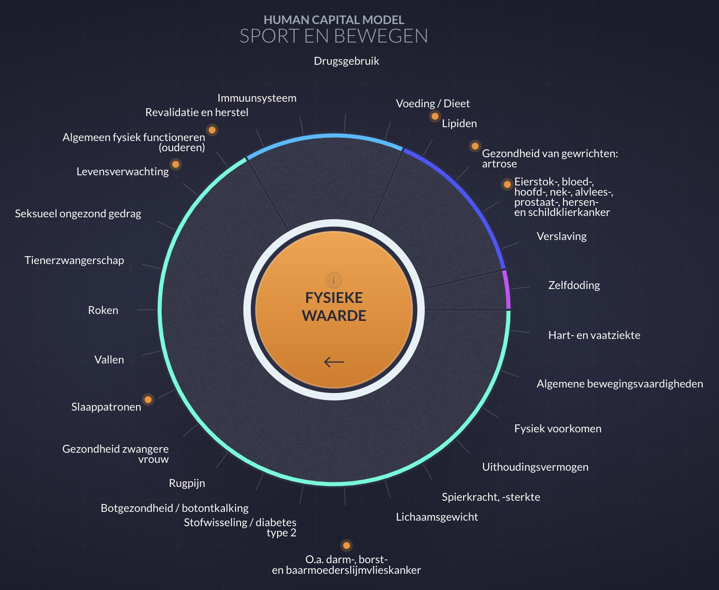
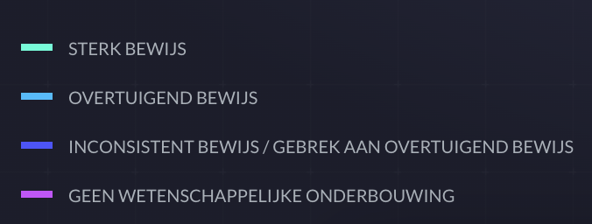
HUMAN CAPITAL MODEL
SPORT AND PHYSICAL ACTIVITY
Drug use
Immune system
Nutrition/diet
Rehabilitation and recovery
Lipids
General physical functioning (elderly)
Joint health:
osteoarthritis
Life expectancy
Ovary: -blood, head, neck, pancreatic, prostate, brain and thyroid cancer
Sexually unhealthy behavior
Addiction
Strong evidence
Convincing evidence
No convincing evidence
No scientific basis
Teenage pregnancy
Physical
value
Suicide
Smoking
Cardiovascular disease
Fall
General movement skills
Sleep pattern
Physical appearance
Health pregnant women
Stamina
Backache
Muscle power, strength
Bone health/bone decalcification
Body weight
Indigestion/diabetes type 2
O.a. colon, breast and endometrial cancer

Slide 53
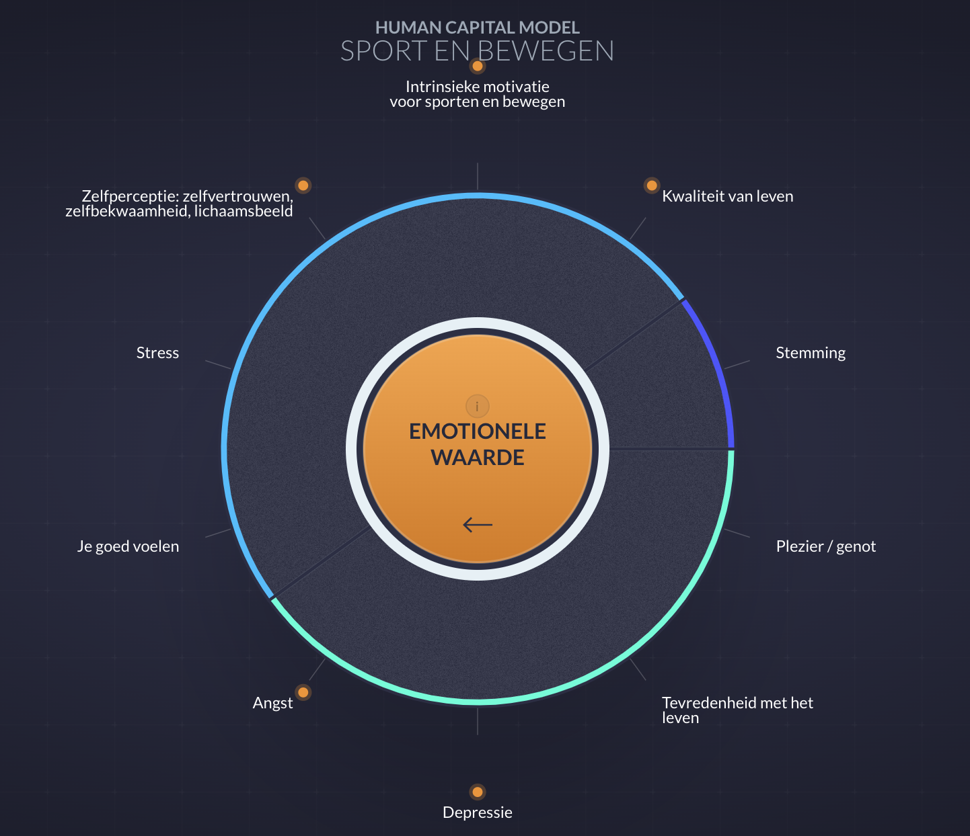
HUMAN CAPITAL MODEL
SPORT AND PHYSICAL ACTIVITY
Intrinsic motivation for sports and exercise
Self-confidence, self-competence, body image
Quality of life
Strong evidence
Convincing evidence
No convincing evidence
No scientific basis
Stress
Mood
Emotional
value
Feeling good
Fun/enjoyment
Fear
Satisfaction with life
Depression

Slide 54

HUMAN CAPITAL MODEL
SPORT AND PHYSICAL ACTIVITY
Taking initiatives/leadership/assertivenes
Goal setting/ determination
Honesty/integrity/respect/
responsibility
Strong evidence
Convincing evidence
No convincing evidence
No scientific basis
Insight into exercise behavior and exercise skills
Personal
value
Sportmanship
Enthusiasm/intrinsic motivation
Life skills (incl. non-cognitive skills)
Commitment/self-discipline/self-control/perseverance
Courage

Slide 55

HUMAN CAPITAL MODEL
SPORT AND PHYSICAL ACTIVITY
Equal opportunities for people with disabilities
Equal opportunities for people with disabilities
Peace/understanding/recovery after war
Sense of community/social connectedness
Bridging differences (social economic status, race, ethnicity, religion, gender)
Crime/juvenile delinquency/ decline in youth gang participation
Strong evidence
Convincing evidence
No convincing evidence
No scientific basis
Safety and support
Social
value
Gender equality
Social networks/positive relationships
Citizen participation
Social status/social involvement
Trust/teamwork/collaboration
Social status/social involvement
Social skills (incl. social norms)
Social integrity/tolerance

Slide 56

HUMAN CAPITAL MODEL
SPORT AND PHYSICAL ACTIVITY
Concentration/attention/
impulse control
Brain structure and brain function
ADHD management: coginition
Education level
Strong evidence
Convincing evidence
No convincing evidence
No scientific basis
To learn
Intelectual
value
Memory
Age-related cognitive decline
Goal-oriented work/mental flexibility
Education level
Processing speed
Involvement in school

Slide 57

SPORT AND PHYSICAL ACTIVITY
Productivity/work performance/career
Model/ responsibility/ awareness of standards/ involvement/ turnover
Strong evidence
Convincing evidence
No convincing evidence
No scientific basis
Financial
value
Presence/absence
Healthcare costs
Income

Slide 58

The distribution of the financial proceeds
Who benefits?
→ Individual
→ Society
→ Government
→ Health insurer
→ Employer
→ Municipality
Healthcare costs
Labor productivity
Quality of live
Sickness absence
Life expectancy
Labour
Health
Injuries
Crime
Learning achievements
Social
Social capital
School drop out
Pleasure
Sociaaleconomische waarde van sporten en bewegen (5 tot 24 jaar)
Socio-economic value of sport and physical activity (5 – 24 years old

Slide 59

When one
5 to 24 year old
will comply with the exercise guidelines the social value amounts to
When one
25 – 54 year old
will comply with the exercise guidelines the social value amounts to
When one
55+ year old
will comply with the exercise guidelines the social value amounts to
For the rest of his/her life
For the rest of his/her life
For the rest of his/her life

Slide 60

Results Netherlands SROI = 2.70
The SROI of sport and Physical Activity
Costs
Savings
Companies
People
Government
Volunteers
Insurance companies

Slide 61


Municipal calculation tool
Value of sport and physical exercise in ..
How does ... score compared to
other municipalities in the Netherlands?
What if 10% becomes more active?

Slide 62

Healthy Lifestyle, Care, Sports, Culture, and Environment connected
A healthy generation by 2040
Sports and Physical Activity:
342 Local Sports Agreement: between municipalities, sports providers (voluntary clubs and professional sports profiders, and societal partners is emphasized.
6000 Neighborhood Sportcoaches: Enabling people to engage in sports and physical activity in their neighborhoods
establishing connections between other sectors (e.g., healthcare and education)
strengthening sports, physical activity, and cultural providers.
Health and Social Foundation:
Reducing Health Disparities
Promising Start: first 1000 days
Mental Health
Addressing Overweight and Obesity
Fall Prevention
Living Environment
Growing up in a Promising Environment & Early Detection of Alcohol Issues
Strengthening the Social Foundation
Informal Care
One Against Loneliness
Welfare on Prescription

Slide 63
Working on healthy cities doesn’t cost money…
It saves money!!!

Slide 64
Thank you
André de Jeu, Glasgow, 26 October 2023

